Slide 1
CY 2550 Foundations of Cybersecurity
Advanced Persistent Threats

Slide 2
Threat Modeling
Threat modeling is the process of systematically identifying the threats faced by a system
Identify things of value that you want to protect
Enumerate the attack surfaces
Hypothesize attackers and map them to
Things of value they want from (1)
Their ability to target vulnerable surfaces from (2)
Survey mitigations
Balance costs versus risks

Slide 3
Advanced
Capabilities far beyond individual hackers or cybercrime gangs
Sometimes backed by nation-state resources
Persistent
Goal-driven, not necessarily opportunistic
Long-term goals, not driven by immediacy
Threats
Offensive operations, not defense

Slide 4
Advanced Persistent Threats (APT)
Origin of the term is unclear
Colloquially used to refer to threat actors backed by nation-states
The most feared hacking groups in the world
E.g, Cozy Bear, Lazarus Group, The Equation Group
Modern usage may refer to any sufficiently advanced and persistent attacker
E.g., High-stakes ransomware gangs, circa 2020

Slide 5
Cybercriminals
Nation-State APTs
Profit-driven
Functions like a business
Opportunistic
Lack sophisticated capabilities like zero-day exploits
Limited to hunting easy victims
Goal is to achieve scale
Part of an underground economy
Operates in the open
Intelligence and espionage-driven
Funding/resources are not issues
Highly targeted
Advanced capabilities like zero-day exploits
Carefully executed, multi-stage attacks
Evading detection is key
Highly secretive
Much of what is known is anecdotal

Slide 6
Case Studies
China, People’s Liberation Army Unit 61398
Russia, Fancy Bear and Cozy Bear
North Korea, Lazarus Group
United States, The Equation Group

Slide 7
Challenging Our Assumptions
General APT Characterization
Counterexample: Lazarus Group
Intelligence and espionage-driven
Funding/resources are not issues
Highly targeted
Advanced capabilities like zero-day exploits
Carefully executed, multi-stage attacks
Evading detection is key
Highly secretive
Much of what is known is anecdotal
Profit-driven
Known to target cryptocurrency exchanges
Sanctions make NK desperate for cash
Statement-driven Mayhem
Trashed Sony Pictures as retribution for mocking Kim Jong Un
Intentionally loud

Slide 8
Challenging Our Assumptions
General APT Characterization
Counterexample: Ransomware Gangs
Intelligence and espionage-driven
Funding/resources are not issues
Highly targeted
Advanced capabilities like zero-day exploits
Carefully executed, multi-stage attacks
Evading detection is key
Highly secretive
Much of what is known is anecdotal
Profit-driven
Extort victims for decryption keys and by threatening to leak sensitive data
Somewhat targeted
Large companies = big ransoms
Carefully executed, multi-stage attacks
Evading detection is key
Operate in the open
Gangs cultivate a reputation
Victims must know threats are real…
And that the gang will act in good faith when paid

Slide 9
Beware Hype
Where do the funny names of APT groups come from?
Cybersecurity companies, e.g., FireEye, Crowdstrike, Microsoft
Are APTs as dangerous and well resourced as professionals claim?
Yes, but only up to a point
Not all targets are appealing to nation-state threat actors
Ransomware gangs are APTs, but they aren’t a nation-state threat
Nuance is essential
“APT” is often a marketing gimmick, meant to sell expensive cybersecurity services

Slide 10
PLA Unit 61398

Slide 11
People’s Liberation Army Unit 63198
Since 2013, China has admitted to possessing cyber warfare units
But details about these units are scarce
Who do they target?
When?
Using what methods?
PLA Unit 63198 is the most infamous APT group in China
Established ~2002
Goals: spying and espionage

Slide 12
Operation Aurora
January 12, 2010: Google revealed that it was the victim of an intrusion
Later analysis suggested 20—34 other companies were also breached
Attacks had been ongoing for months
Leveraged multiple zero-days to infiltrate target organizations
Internet Explorer and Perforce version control
After exploitation, trojans were installed
Intranets were scanned for further vulnerable hosts to spread infection
Goals
Spying on foreign governments and dissidents, e.g., Ai Weiwei and the Dalai Lama
Industrial espionage, e.g., source code and trade secrets

Slide 13
Aftermath
State Department condemned the attacks and demanded a diplomatic response from China
Five suspected members of PLA Unit 61398 were indicted by the US Department of Justice
Caused Google to remove state-mandated censorship on google.cn
Google services have been censored in China ever since
Last attempt to re-enter China was Dragonfly in 2018

Slide 14
Fancy Bear, Cozy Bear

Slide 15
From Russia, With Love
Fancy Bear
Cozy Bear
Established ~2000
Linked to the GRU (Russian military intelligence)
Observed wielding multiple zero-days, as well as spear phishing
Noisy and bold
Established ~2008
Linked to SVR (Russian Foreign Intelligence Service) or FSB (Russian Federal Security Service)
Favors spear phishing attacks
Stealthy

Slide 16
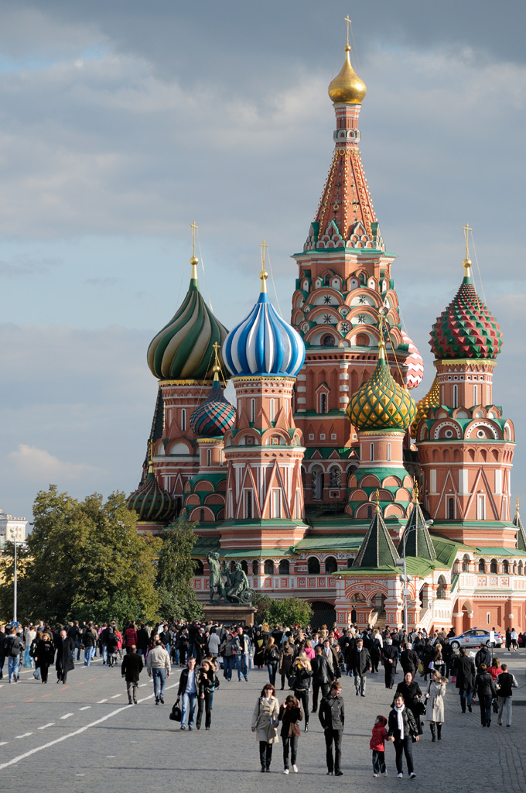
Goals
Foreign intelligence
Linked to hacks against many US, European, and Balkan targets
Think-tanks, NGOs, government agencies
Espionage
Political influence operations
Attacks against journalists and activists
Political campaigns, voting infrastructure, media organizations

Slide 17
Notable Hacks
Fancy Bear
Cozy Bear
Dec. 2014: German parliament
April 2015: French TV channels
August 2016: World Anti-doping Agency
January 2018: International Olympic Committee
August 2015: The Pentagon
Shut down entire Joint Staff unclassified email system
July 2020: COVID vaccine data

Slide 18
DNC and John Podesta
Early 2016: phishing emails directed at Democratic National Convention and Hillary Clinton campaign staff
Among others, Clinton’s campaign manager, John Podesta, falls victim
“Guccifer 2.0” starts leaking emails and documents
Some documents were forgeries containing misinformation
Leveraged Wikileaks to spread the documents
Analysis indicates that Fancy and Cozy broke into the DNC
Cozy was present for ~1 year, Fancy for ~3 weeks
Fancy invented Guccifer 2.0 and initiated the leaks

Slide 19
Lazarus Group

Slide 20
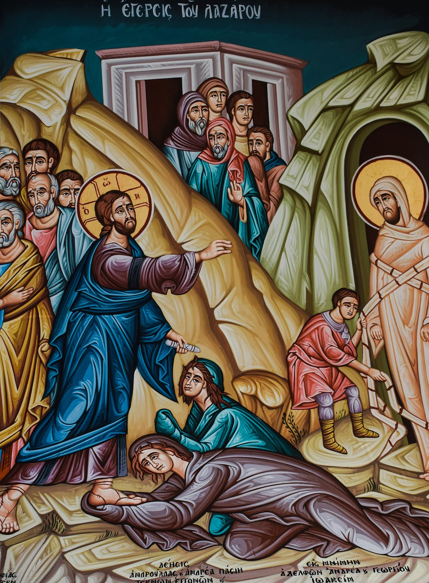
Lazarus Group
Established ~2009
FBI: Lazarus Group is sponsored by the North Korean government
Possible origins as a cybercrime gang
Has gained official state backing over time
Mixed goals
Spying and espionage against South Korea
Theft of money and cryptocurrency
Political hacktivism

Slide 21
Attacks Against South Korea
2009: Operation Troy
DDoS attacks and defacements against South Korean websites
2013: “Ten Days of Rain”
DDoS attacks against media, banks, and infrastructure in South Korea
Malware that infected and destroyed victims’ computers

Slide 22
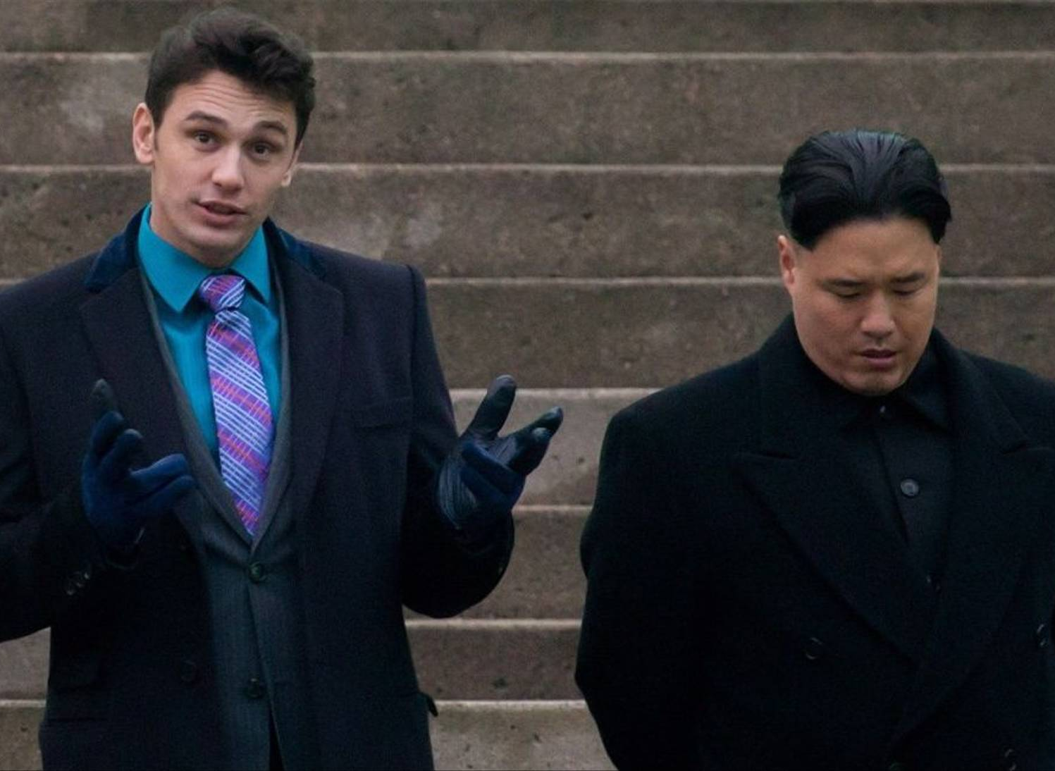

Slide 23
“The Guardians of Peace”
November 2014: GoP leak data from Sony Pictures and destroy their computers
Widespread damage to Sony’s infrastructure
Leaks included emails, contracts, unreleased movies and scripts, etc.
GOP demanded that The Interview be pulled from release
Threatened to bomb theaters otherwise
Outcomes:
Embarrassment of Sony executives, employees, and movie stars
CEO Amy Pascal stepped down
$15M in damage to Sony Pictures, weeks of productivity lost
The Interview was released directly to digital, theater release mostly shelved

Slide 24
Wannacry
April 2017: the “Shadow Brokers” leaked a trove of exploits and attack tools stolen from the NSA
EternalBlue – remote exploit in the SMB protocol used by Windows
Exploit enabled remote infection of unpatched machines without any user interaction
May 2017: Wannacry ransomware begins to spread on the internet
Leveraged EternalBlue and other exploits to automatically spread
Encrypted victims’ hard drives and demanded payment in Bitcoin
Widely suspected to be the work of Lazarus Group
Within 24 hours, ~230K machines were infected
Spread stopped when Marcus Hutchins inadvertently activated a “kill switch” in the malware

Slide 25
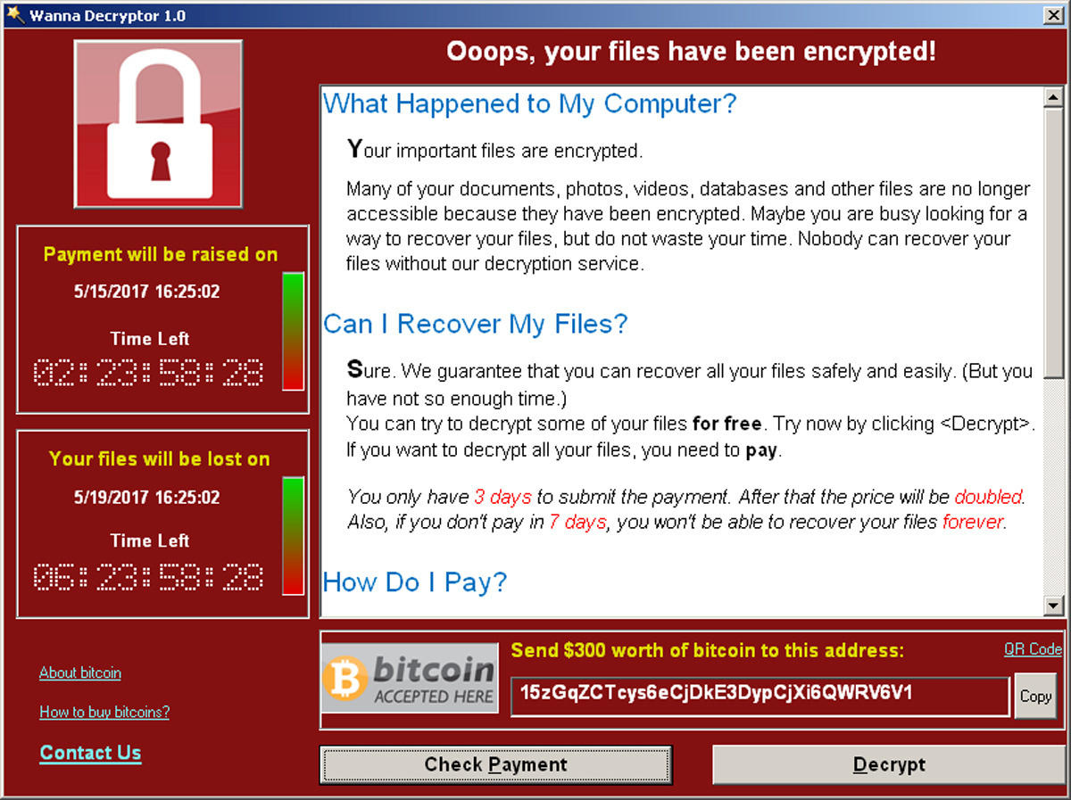

Slide 26
Robbing the Bank, 2017—present day
Infected banks with malware targeting SWIFT money transfers
$12M from Banco del Austro in Ecuador
$1M from Tien Phong Bank in Vietnam
$81M from Bangladesh Bank
$60M from Far Eastern International Bank in Taiwan
Attacks against South Korean cryptocurrency exchanges and users
Spear phishing against cryptocurrency users
Malware attacks against exchanges
$7M from Bitthumb, $7M from Youbit, etc.

Slide 27
The Equation Group

Slide 28
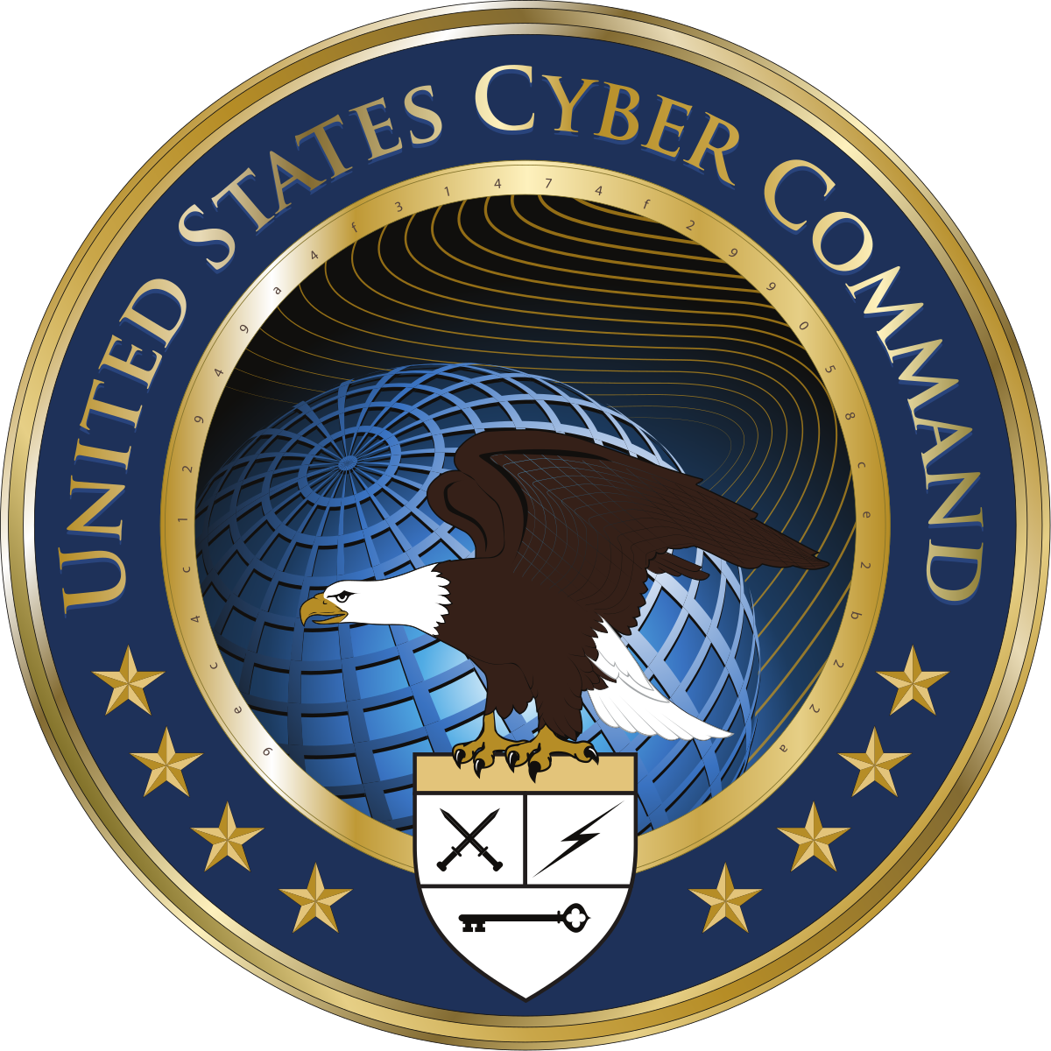
The Tao of the NSA
Equation Group is a blanket term
Refers to a collection of hacking tools and incidents involving them
Known to be associated with US intelligence, law enforcement, and military groups
Equation Group is not a specific team at a specific institution
Tailored Access Operations (TAO) at the NSA
CIA
US Cyber Command
Established ~2001
Suspected of operations in 40+ countries

Slide 29
Goals
Foreign intelligence
Political and military intelligence, not industrial
Enemies and allies alike
Espionage
Stuxnet

Slide 30
What Is Known?
Shadow Brokers
Vault7
Summer 2016
Leaked Linux and Windows attack tools, including several zero-days in Windows
EternalBlue, later weaponized by Lazarus Group
Contractor Harold. T Martin III was the suspected source
Russians stole info from Martin
February 2017
Wikileaks posted an extensive dump of CIA tools and tradecraft documents
Secret base in Frankfurt
Exploits against smart TVs
Trojans and evasion techniques
Zero days
CIA engineer Joshua Adam Shulte is the suspected source

Slide 31
Stuxnet
Arguably, the first “cyber weapon”
Operation Olympic Games
Joint between US and Israel
Designed to infiltrate and destroy nuclear centrifuges in Natanz, Iran
Suspected to be deployed between 2005 and 2010
Three variants have been observed in the wild
Would have remained clandestine if not for a bug that caused uncontrolled spread on the internet

Slide 32
Iran maintains a nuclear fuel enrichment program, in violation of international mandates
Claims the fuel is for civilian reacts
Widely suspected of developing nuclear weapons
Victim of a wide variety of espionage in the past
Natanz facility contains illegally procured centrifuges for nuclear enrichment
Heavily fortified and buried underground
Not directly connected to the internet

Slide 33
Stuxnet Operations
Spread via infected flash drives and network scanning
Moved via USB to jump air gaps, e.g., into the Natanz network
Included limits on propagation to avoid indiscriminate spread
Included six exploits, including four zero-days for automatic infection
Windows .lnk parsing bug
Rootkit for stealth and persistence
Digitally signed using stolen private keys from JMicron and Realtek
Attacked Siemens Programmable Logic Controllers (PLCs)
Carefully engineered to identify PLCs used to control centrifuges
Infected the PLC to randomly speed up centrifuges, causing self-destruction
MitM to hide viral presence and anomalous commands from operators

Slide 34
Aftermath
200K+ machines infected worldwide, mostly in Iran
To this day, portions of Stuxnet remain encrypted
Similar tools found in-the-wild: Duqu and Flame
~1000 centrifuges (10%) at Natanz destroyed
Temporarily slowed enrichment by forcing the facility to shut down
Overall fuel production at Natanz increased, year-over-year
Legitimized destructive cyber weaponry for espionage

Slide 35
Vulnerabilities Equities Process

Slide 36
On Cyberwar
There is no Geneva Convention for conflict on the internet
The closest thing that exists is the Tallinn Manual
Developed and published at the behest of NATO
Academic study that examined how existing international law applies to online conflict
Followed up by an expanded Tallinn Manual 2.0

Slide 37
Focus on Zero Days
Commonality among APTs: they thrive on zero-day exploits
See, for example, the Shadow Brokers and Vault7 leaks
Where do these zero-days come from?
Developed in-house; limited to very sophisticated, well resourced APTs
Bought on the grey market ($10K – $1M per exploit)
Treated as a scarce resource
Used sparingly – once used their advantage quickly fades
E.g., Stuxnet included an unprecedented four zero-days

Slide 38
Problem: should intelligence services hoard or disclose zero-days?
Hoarding
Disclosure
Zero-days are expensive, rare weapons
Disclosure is akin to disarmament
Strong defense requires a strong offense
Deterrence, i.e., “mutually assured destruction”
Adversaries may also discover and leverage zero-days
Plus, exploits leak from APTs
Asymmetric costs
How much value do we gain from a given exploit?
How much value do we lose if that exploit was used against us?
Damage disproportionally falls on ordinary people and companies

Slide 39
Vulnerabilities Equities Process
US policy for how to handle zero-day vulnerabilities
Developed in 2008, publicly disclosed in 2016 (redacted) and 2017
Decisions made by an Equities Review Board
NSA serves as the executive secretariat
Also includes Director of National Intelligence and representatives from DHS, DOD, CIA, DOE, State, Treasury, etc.
Process:
Vulnerabilities are submitted, along with a recommendation to hoard or disclose
Stakeholders may weigh in; if disagreement, escalate to the full Board
Full Board decides based on “rational, objective methods” considering prevalence and severity

Slide 40
Criticism of the VEP
NSA has the controlling interest
Primarily an offensive, rather than defensive, organization
Fmr. NSA Director Michael Hayden – “Nobody but us”
Hoard zero-days that only the US is sophisticated enough to identify
But unclear how to quantify or ensure that this is true
Non-transparent and weighted towards hoarding
Doesn’t use standard methods for quantifying risk like DREAD
Unclear if all agencies (e.g., the CIA) are obeying the rules

Slide 41
Prioritizing Defense Over Offense
Prominent experts like Bruce Schneier and Cory Doctorow argue for greater and faster disclosure
The risks to millions of Americans by unpatched zero-days outweighs the potential offensive value
Hoarding reduces trust in US technology
Tantamount to the government favoring vulnerable products to secure products
Disclosure ≠ unilateral disarmament
Disclosure + patching also disarms our adversaries

