Slide 1
CY 2550 Foundations of Cybersecurity
Access Control

Slide 2
Authentication
Verification of identity claim made by a subject on behalf of a principal
Three classes of secrets:
  Something you know
    Example: a password
  Something you have
    Examples: a smart card or smart phone
  Something you are
    Examples: fingerprint, voice scan, iris scan
Desirable properties include being unforgeable, unguessable, and revocable

Slide 3
Authorization
Authorization follows authentication
  If asking what someone can do, you must know who they are
Usually represented as a policy specification
  What resources can be accessed by a given subject?
  Can also include the nature of the access

Slide 4
Access Control
Policy specifying how entities can interact with resources
  i.e., Who can access what?
  Requires authentication and authorization
Access control primitives
Principal | User of a system
Subject | Entity that acts on behalf of principals | Software program
Object | Resource acted upon by subjects | Files Sockets Devices OS APIs

Slide 5






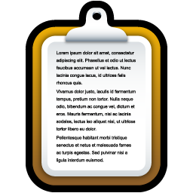
Access Control Check
Given an access request from a subject, on behalf of a principal, for an object, return an access control decision based on the policy
Object
Allow
Deny
Principal
Subject
Policy

Slide 6
Access Control Models
Discretionary Access Control (DAC)
Mandatory Access Control (MAC)
The kind of access control you are familiar with
Access rights propagate and may be changed at subject’s discretion
Access of subjects to objects is based on a system-wide policy
Denies users full control over resources they create

Slide 7

Discretionary Access Control
Access Control Matrices
Access Control Lists
Unix Access Control

Slide 8
Discretionary Access Control
According to Trusted Computer System Evaluation Criteria (TCSEC)
"A means of restricting access to objects based on the identity and need-to-know of users and/or groups to which they belong. Controls are discretionary in the sense that a subject with a certain access permission is capable of passing that permission (directly or indirectly) to any other subject."

Slide 9
Access Control Matrices
Given subjects s_{i} ∈ S, objects o_{j} ∈ O, rights {Read, Write, eXecute},
 | o1 | o2 | o3
s1 | RW | RX
s2 | R | RWX | RW
s3 |  | RWX
Introduced by Butler Lampson in 1971
Static description of system protection state
Abstract model of concrete systems

Slide 10
Access Control List (ACL)
Each object has an associated list of subject→operation pairs
Authorization verified for each request by checking list of tuples
Used pervasively in filesystems and networks
  "Users a, b, and c and read file x."
  "Hosts a and b can listen on port x."
ACL for o₂
 | o1 | o2 | o3
s1 | RW | RX
s2 | R | RWX | RW
s3 |  | RWX

Slide 11
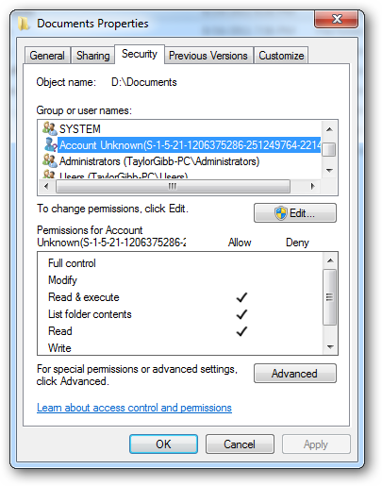






Windows ACLs
 | D:\Music | D:\Images | D:\Documents
System | RWX | RWX | RWX
Administrators | RW | RW | RW
Users:cbw | RWX | RW
Users:amislove |  | RW | R

Slide 12
ACL Review
The Good
The Bad
Very flexible
  Can express any possible access control matrix
  Any principal can be configured to have any rights on any object
Complicated to manage
  Every object can have wildly different policies
  Infinite permutations of subjects, objects, and rights

Slide 13

DAC in *nix

Slide 14
Unix-style Permissions
Based around the concept of owners and groups
  All objects have an owner and a group
  Permissions assigned to owner, group, and everyone else
Authorization verified for each request by mapping the subject to owner, group, or other and checking the associated permissions

Slide 15
Unix Permissions
Directory
Permission to list the contents of a directory
cbw@DESKTOP:~$ ls -l
drwxrwxrwx 0 cbw cbw 512 Jan 29 22:46 my_dir
-rw-rw-rw- 1 cbw cbw 17 Jan 29 22:46 my_file
-rwxrwxrwx 1 cbw faculty 313 Jan 29 22:47 my_program.py
-rw------- 1 root root 896 Jan 29 22:47 sensitive_data.csv
Owner
Group
Group
Other
Owner
d → Directory r → Read w → Write x → eXecute

Slide 16
Setting Permissions
+ → add permissions
- → remove permissions
chmod [who]<+/-><permissions> <file1> [file2] …
(omitted) → user, group, and other
a → user, group, and other
u → user
g → group
o → other
r → Read
w → Write
x → eXecute

Slide 17
cbw@DESKTOP:~$ ls -l
drwxrwxrwx 0 cbw cbw 512 Jan 29 22:46 my_dir
-rw-rw-rw- 1 cbw cbw 17 Jan 29 22:46 my_file
-rwxrwxrwx 1 cbw faculty 313 Jan 29 22:47 my_program.py
cbw@DESKTOP:~$ chmod ugo-rwx my_dir
cbw@DESKTOP:~$ chmod go-rwx my_program.py
cbw@DESKTOP:~$ chmod u-rw my_program.py
cbw@DESKTOP:~$ chmod +x my_file
cbw@DESKTOP:~$ ls -l
d--------- 0 cbw cbw 512 Jan 29 22:46 my_dir
-rwxrwxrwx 1 cbw cbw 17 Jan 29 22:46 my_file
---x------ 1 cbw faculty 313 Jan 29 22:47 my_program.py

Slide 18
Alternate Form of Setting Permissions
chmod ### <file1> [file2] …
#s correspond to owner, group, and other
Each value encodes read, write, and execute permissions
  1 → execute
  2 → write
  4 → read
What if you want to set something as read, write, and execute?
  1 + 2 + 4 = 7

Slide 19
cbw@DESKTOP:~$ ls -l
drwxrwxrwx 0 cbw cbw 512 Jan 29 22:46 my_dir
-rw-rw-rw- 1 cbw cbw 17 Jan 29 22:46 my_file
-rwxrwxrwx 1 cbw faculty 313 Jan 29 22:47 my_program.py
cbw@DESKTOP:~$ chmod 000 my_dir
cbw@DESKTOP:~$ chmod 100 my_program.py
cbw@DESKTOP:~$ chmod 777 my_file
cbw@DESKTOP:~$ ls -l
d--------- 0 cbw cbw 512 Jan 29 22:46 my_dir
-rwxrwxrwx 1 cbw cbw 17 Jan 29 22:46 my_file
---x------ 1 cbw faculty 313 Jan 29 22:47 my_program.py

Slide 20
Who May Change Permissions?
cbw@DESKTOP:~$ groups
cbw faculty
cbw@DESKTOP:~$ ls -l
-rw-rw-rw- 1 cbw cbw 17 Jan 29 22:46 my_file
-rw-rw-rw- 1 cbw faculty 17 Jan 29 22:46 my_other_file
-rw------- 1 root root 896 Jan 29 22:47 sensitive_data.csv
-rwxrwx--- 1 root faculty 313 Jan 29 22:47 program.py
Which files is user cbw permitted to chmod?
  Only owners can chmod files
  cbw can chmod my_file and my_other_file
  Group membership doesn’t grant chmod ability (cannot chmod program.py)

Slide 21
Setting Ownership
Unix uses discretionary access control
  New objects are owned by the subject that created them
How can you modify the owner or group of an object?
chown <owner>:<group> <file1> [file2] …

Slide 22
Who May Change Ownership?
cbw@DESKTOP:~$ groups
cbw faculty
cbw@DESKTOP:~$ ls -l
-rw-rw-rw- 1 cbw cbw 17 Jan 29 22:46 my_file
-rw-rw-rw- 1 cbw faculty 17 Jan 29 22:46 my_other_file
-rw------- 1 root root 896 Jan 29 22:47 sensitive_data.csv
-rwxrwx--- 1 root faculty 313 Jan 29 22:47 program.py
Which operations are permitted?
chown cbw:faculty my_file | Yes, cbw belongs to the faculty group
chown root:root my_other_file | No, only root many change file owners!
chown cbw:cbw sensitive_date.csv | No, only root many change file owners!
chown cbw:faculty program.py | No, only root many change file owners!

Slide 23
Unix Access Control Exercise (1)
What Unix group and permission assignments satisfy this access control matrix?
User | Groups
user1 | user1
user2 | user2
user3 | user3
user4 | user4
Desired Permissions
 | file1 | file2
user1 | r-- | rwx
user2 | r-- | rw-
user3 | r-- | rw-
user4 | rwx | rw-
~$ ls -l
-rwxr--r-- 1 user4 user4 0 file1
-rwxrw-rw- 1 user1 user1 0 file2

Slide 24
Unix Access Control Exercise (2)
What Unix group and permission assignments satisfy this access control matrix?
User | Groups
user1 | user1
user2 | user2, group1
user3 | user3, group1, group2
user4 | user4, group2
Desired Permissions
 | file1 | file2
user1 | r-- | --x
user2 | r-x | rwx
user3 | r-x | r--
user4 | rwx | r--
~$ ls -l
-rwxr-xr-- 1 user4 group1 0 file1
-rwxr----x 1 user2 group2 0 file2

Slide 25
Unix Access Control Exercise (3)
What Unix group and permission assignments satisfy this access control matrix?
Trick question! This matrix cannot be represented
file2: four distinct privilege levels
  Maximum of three levels (user, group, other)
file1: two users have high privileges
  If user3 and user4 are in a group, how to give user2 read and user1 nothing?
  If user1 or user2 are owner, they can grant themselves write and execute permissions :(
Desired Permissions
 | file 1 | file 2
user 1 | --- | rw-
user 2 | r-- | r--
user 3 | rwx | rwx
user 4 | rwx | ---

Slide 26
Unix Access Control Review
The Good
The Bad
Very simple model
  Owners, groups, and other
  Read, write, execute
Relatively simple to manage and understand
Not all policies can be encoded!
  Contrast to ACL
Not quite as simple as it seems
  setuid

Slide 27

Problems with Principals
setuid
The Confused Deputy Problem
Capability-based Access Control

Slide 28
From Principals to Subjects
Thus far, we have focused on principals
  What user created/owns an object?
  What groups does a user belong to?
What about subjects?
  When you run a program, what permissions does it have?
  Who is the “owner” of a running program?

Slide 29
Process Owners
cbw@DESKTOP:~$ ls -l
-rwxr-xr-x 1 cbw cbw 313 Jan 29 22:47 my_program.py
cbw@DESKTOP:~$ ./my_program.py
…
cbw is the owner. Why?
Who is the owner of this process?
cbw@DESKTOP:~$ ps aux | grep my_program.py
cbw tty1 S 01:06 0:00 python ./my_program.py

Slide 30
Process Owners
cbw@DESKTOP:~$ ls -l /bin/ls
-rwxr-xr-x 1 root root 110080 Mar 10 2016 /bin/ls
cbw@DESKTOP:~$ ls
…
Who is the owner of this process?
cbw is the owner. Why?
cbw@DESKTOP:~$ ps aux | grep ls
cbw tty1 S 01:06 0:00 /bin/ls

Slide 31
Subject Ownership
Under normal circumstances, subjects are owned by the principal that executes them
  File ownership is irrelevant
Why is this important for security?
  A principal that is able to execute a file owned by root should not be granted root privileges
cbw@DESKTOP:~$ ls -l /bin/bash
-rwxr-xr-x 1 root root 110080 Mar 10 2016 /bin/bash

Slide 32
Corner Cases
cbw@DESKTOP:~$ passwd
Changing password for cbw.
(current) UNIX password:
Consider the passwd program
  All users must be able to execute it (to set and change their passwords)
  Must have write access to /etc/shadow (file where password hashes are stored)
Problem: /etc/shadow is only writable by root user
cbw@DESKTOP:~$ ls -l /etc/shadow
-rw-r----- 1 root shadow 922 Jan 8 14:56 /etc/shadow

Slide 33
setuid
Objects may have the setuid permission
  Program may execute as the file owner, rather than executing principal
cbw@DESKTOP:~$ ls -l /usr/bin/passwd
-rwsr-xr-x 1 root root 47032 May 16 2017 /usr/bin/passwd
cbw@DESKTOP:~$ passwd
Changing password for cbw.
(current) UNIX password:
cbw@DESKTOP:~$ ps aux | grep passwd
root tty1 S 01:06 0:00 python ./my_program.py

Slide 34
chmod Revisited
How to add setuid to an object?
chmod u+s <file1> [file2] …
chmod 2### <file1> [file2] …
WARNING: NEVER SET A SCRIPT AS SETUID
  Only set setuid on compiled binary programs
  Scripts with setuid lead to Time of Check Time of Use (TOCTOU) vulnerabilities

Slide 35

Ambient Authority and the Confused Deputy Problem

Slide 36
Another setuid Example
Consider an example turnin program
/cy2550/turnin <project #> <in_file> <out_file>
  Copies <in_file> to <out_file>
  Grades the assignment
  Writes the grade to /cy2550/<project#>/grades
Challenge: students cannot have write access to project directories or grade files
  turnin program must be setuid

Slide 37
alice@login:~$ /cy2550/turnin project1 pwcrack.py /cy2550/project1/pwcrack.py
Thank you for turning in project 1.
alice@login:~$ ls –l /cy2550/
drwx--x--x 0 cbw faculty 512 Jan 29 22:46 project1
-rwsr-xr-x 1 cbw faculty 17 Jan 29 22:46 turnin
alice@login:~$ ls –l /cy2550/project1/
-r-x------ 0 cbw faculty 512 Jan 29 22:46 pwcrack.py
-rw------- 1 cbw faculty 17 Jan 29 22:46 grades

Slide 38
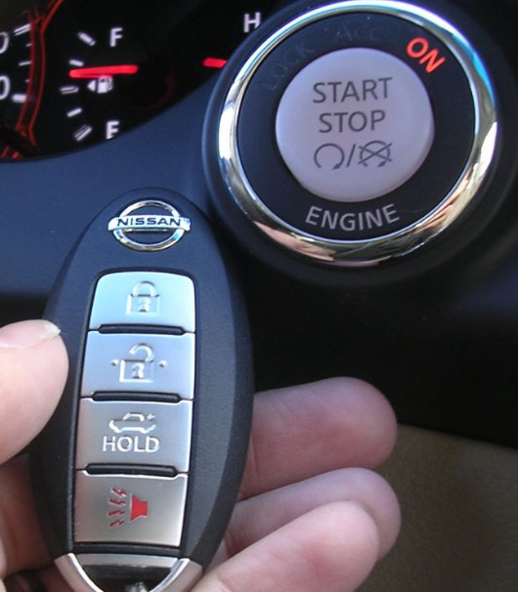
Ambient Authority
Ambient authority
  A subject’s permissions are automatically exercised
  No need to select specific permissions
Systems that use ACLs or Unix-style permissions grant ambient authority
  A subject automatically gains all permissions of the principal
  A setuid subject also gains permissions of the file owner
Ambient authority is a security vulnerability

Slide 39
The Confused Deputy Problem
mallory@login:~$ /cy2550/turnin project1 best_grade.txt /cy2550/project1/grades
Thank you for turning in project 1.
alice@login:~$ ls –l /cy2550/project1/
-rw------- 1 cbw faculty 17 Jan 29 22:46 grades
The turnin program is a confused deputy
  It is the deputy of two principals: mallory and cbw
  mallory cannot directly access /cy2550/project1/grades
  However, cbw can access /cy2550/project1/grades
Key problem: the subject cannot tell which principal it is serving when it performs a write

Slide 40

Preventing Confused Deputies
ACL and Unix-style systems are fundamentally vulnerable to confused deputies
  Cannot prevent misuse of ambient authority
Solution: move to capability-based access control system

Slide 41
Capabilities
ACLs
Capabilities
Encode columns of an access control matrix
Encode rows of an access control matrix
ACL for o₂
 | o1 | o2 | o3
s1 | RW | RX
s2 | R | RWX | RW
s3 |  | RWX
 | o1 | o2 | o3
s1 | RW | RX
s2 | R | RWX | RW
s3 |  | RWX
Capabilities for s₁

Slide 42
Capability-based Access Control
Principals and subjects have capabilities which:
  Give them access to objects
    Files, keys, devices, etc.
  Are transferable and unforgeable tokens of authority
    Can be passed from principal to subject, and subject to subject
    Similar to file descriptors
Why do capabilities solve the confused deputy problem?
  When attempting to access an object, a capability must be selected
  Selecting a capability inherently also selects a master

Slide 43
Confused Deputy Revisited
Principal | … | /home/mallory/* | /cs2550/project1/grades | …
mallory | … | RWX | --- | …
Allow
mallory@login:~$ /csy550/turnin project1 open(best_grade.txt) open(/cy2550/project1/grades)
ERROR: Permission denied to /cs2550/project1/grades
Deny
Principal must pass capabilities to objects at invocation time
  mallory has permission to access best_grade.txt
  mallory does not have permission to access /cy2550/project1/grades
No ambient authority in a capability-based access control system
  Principal cannot pass a capability it doesn’t have

Slide 44
Capabilities vs. ACLs
Consider two security mechanisms for bank accounts
  Identity-based
    Each account has multiple authorized owners
    To authenticate, show a valid ID at the bank
    Once authenticated, you may access all authorized accounts
  Token-based
    When opening an account, you are given a unique hardware key
    To access an account, you must possess the corresponding key
    Keys may be passed from person to person
ACL system
Ambient authority to access all authorized accounts
Capability system
No ambient authority

Slide 45
Capabilities IRL
From a security perspective, capability systems are more secure than ACL and Unix-style systems
… and yet, most major operating systems use the latter
Why?
  Easier for users
    ACLs are good for user-level sharing, intuitive
    Capabilities are good for process-level sharing, not untuitive
  Easier for developers
    Processes are tightly coupled in capability systems
    Must carefully manage passing capabilities around
    In contrast, ambient authority makes programming easy, but insecure

Slide 46
Small Steps Towards Capabilities
Some limited examples of capability systems exist
  Android/iOS app permissions
  POSIX capabilities
  SELinux

Slide 47
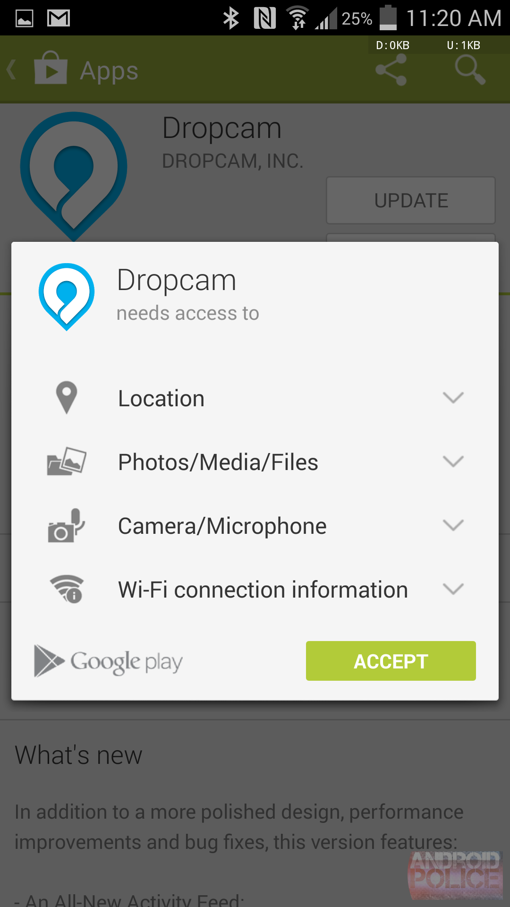
Android/iOS Capabilities
Android and iOS support (relatively) fine grained capabilities for apps
  User must grant permissions to apps at install time
  May only access sensitive APIs with user consent
Apps can “borrow” capabilities from each other by exporting intents
  Example: an app without camera access can ask the camera app to return a photo

Slide 48
POSIX Capabilities
Traditional Unix systems had two types of processes
  Privileged, i.e. root processes
    Bypass all security and access control checks
  Unprivileged, i.e. everything else
    Subject to access controls
Modern Unix/Linux systems offer some finer grained capabilities
  Specified processes may be granted a subset of root privileges
  CAP_CHOWN: make arbitrary changes to file owners and groups
  CAP_KILL: kill arbitrary processes
  CAP_SYS_TIME: change the system clock

Slide 49
Mandatory Access Control
Multi-level Security
Bell-LaPadula Model
Biba Model

Slide 50
Keeping Secrets?
Suppose we have secret data that only certain users should access
Is DAC enough to prevent leaks?
charlie@DESKTOP:~$ groups
charlie topsecret
charlie@DESKTOP:~$ ls –la /top-secret-intel/
drwxr-xr-x 0 root root 512 Jan 8 14:55 .
drwxr-xr-x 0 root root 512 Oct 11 19:58 ..
-rw-r----- 1 root topsecret 896 Jan 29 22:47 northkorea.pdf
charlie@DESKTOP:~$ groups mallory
mallory secret
charlie@DESKTOP:~$ ls –la /home/mallory
drwxrwxrwx 0 mallory mallory 512 Jan 8 14:55 .
drwxr-xr-x 0 root root 512 Oct 11 19:58 ..
charlie@DESKTOP:~$ cp /top-secret-intel/northkorea.pdf /home/mallory
charlie@DESKTOP:~$ ls –l /home/mallory
-rw-r----- 1 charlie charlie 896 Jan 29 22:47 northkorea.pdf
charlie@DESKTOP:~$ chmod ugo+rw /home/mallory/northkorea.pdf

Slide 51



Failure of DAC
DAC cannot prevent the leaking of secrets
Malicious
Trojan
Secret.pdf
rwx User A
--- User B
Execute
Read
User A
Write
NotSecret.pdf
rwx User A
rwx User B
User B

Slide 52

Why is DAC Vulnerable?
Implicit assumptions
  Software is benign
  Software is bug free
  Users are well behaved
Reality
  Software is full of bugs (i.e. confused deputies)
  Malware is widely available
  Users may be malicious (inside threats)

Slide 53
Towards Mandatory Access Control (MAC)
Mandatory access controls (MAC) restrict the access of subjects to objects based on a system-wide policy
  Denying users full control over to resources that they create
  System security policy (as set by the administrator) entirely determines access rights
Often used in systems that must support Multi-level Security (MLS)

Slide 54
Multi-level Security (MLS)
The capability of a computer system to carry information with different sensitivities
  Permit simultaneous access by users with different security clearances and need-to-know
  Prevent users from obtaining access to information for which they lack authorization
Examples of security levels
  Top Secret > Secret > Confidential > Unclassified
Overall goal is confidentiality
  Ensure that information does not flow to those not cleared for that level

Slide 55

Bell-Lapadula Model of MAC

Slide 56
Bell-LaPadula: A MAC Model for MLS
Introduced in 1973
  Extremely influential document
  Introduced fundamental ideas for formally modeling security
Air Force was concerned about data confidentiality in time-sharing systems
  Old OS with many bugs
  Accidental misuse by operators
  Insider threats
Goal: formally show that a computer system can securely process classified information

Slide 57

Security Models
Bell-LaPadula is a security model
  A mathematical formalization of what a computer system should do
  Formally defines security requirements (policy)
  System model + security policy = security model
Bell-LaPadula is not software
  It’s not an implementation
  Security model that can be (and has been) adopted and implemented by others

Slide 58
Bell-LaPadula Approach
Model the computer system using state transitions
System is secure iff every reachable state obeys four properties
  Simple-security property
  ★-property
  Discretionary-security property
  Tranquility principle
Prove a Basic Security Theorem (BST)
  Given a state-transition model of a system…
  That begins in a secure state…
  Each transition leads to another secure state

Slide 59

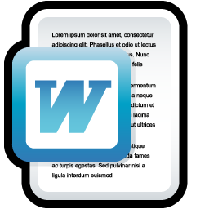



Elements of the Bell-LaPadula Model
Subjects
L_{m}(s) : maximum level
L_{c}(s) : current level
Objects
L(o) : level
Discretionary Access
Control Matrix
Defined by the administrator
Top Secret
Top Secret
 | o1 | o2 | o3
s1 | RW | RX
s2 | R | RWX | RW
s3 |  | RWX
Secret
Secret
Confidential
Confidential
Unclassified

Slide 60
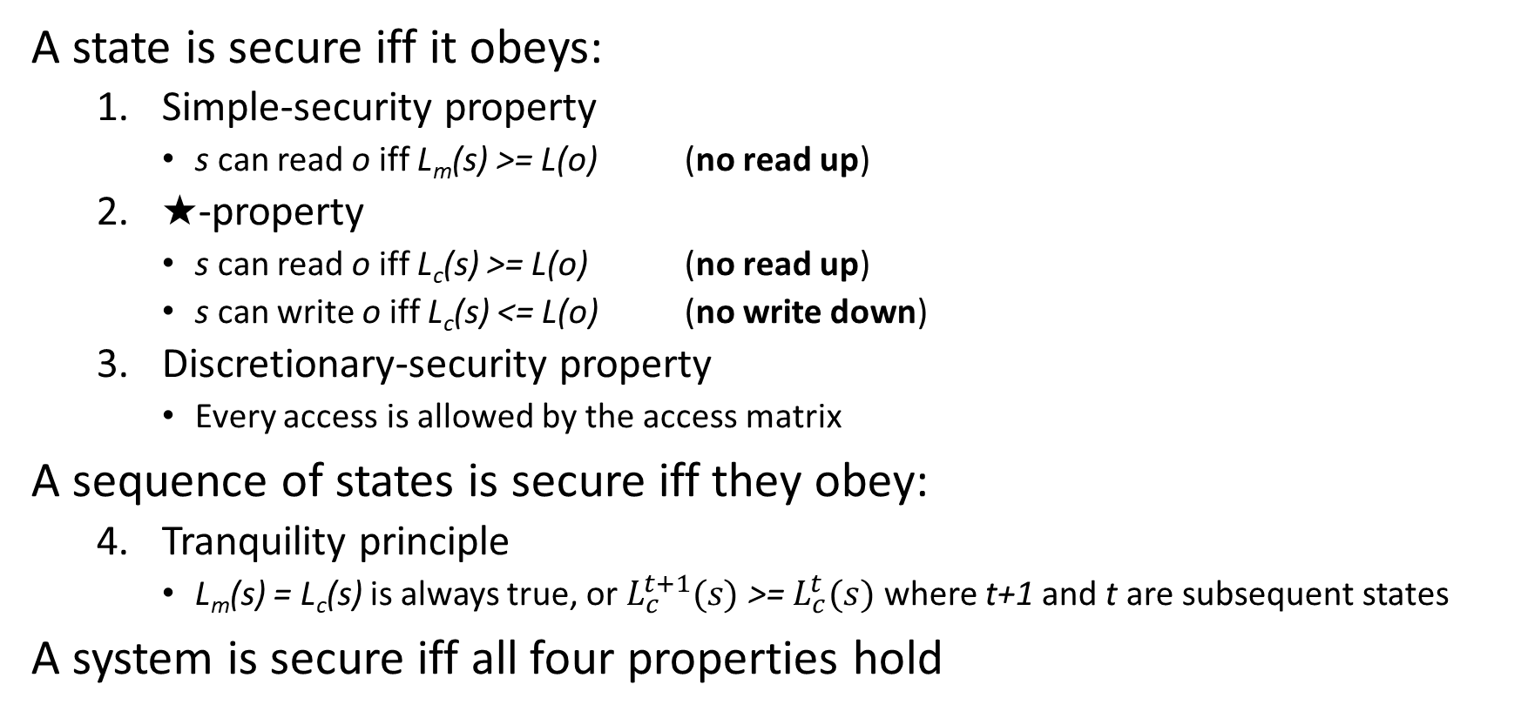
Bell-LaPadula Security Policy
A state is secure iff it obeys:
  Simple-security property
    s can read o iff L_{m}(s) >= L(o) (no read up)
  ★-property
    s can read o iff L_{c}(s) >= L(o) (no read up)
    s can write o iff L_{c}(s) <= L(o) (no write down)
  Discretionary-security property
    Every access is allowed by the access matrix
A sequence of states is secure iff they obey:
  Tranquility principle
    L_{m}(s) = L_{c}(s) is always true, or $L_{c}^{t+1}(s)$ >= $L_{c}^{t}(s)$ where t+1 and t are subsequent states
A system is secure iff all four properties hold

Slide 61
Simplified Bell-LaPadula Example
Assume L_{m}(s) = L_{c}(s) is always true
★-property
  s can read o iff L(s) >= L(o) (no read up)
  s can write o iff L(s) <= L(o) (no write down)
Top Secret
Writeable
Secret
Confidential
Confidential
Read and Write
Unclassified
Readable

Slide 62
Caveats
★-property applies to subjects (programs), not principles (users)
  We must assume that users are trusted
  Assume users won’t disclose secrets outside of the computer system
★-property prevents overt leakage of information
  Does not address covert channels
Bell-LaPadula only addresses confidentiality
  No integrity guarantees
OMG! There’s a nuclear missile headed towards Hawaii!
Confidential
Top Secret

Slide 63
Biba Model of MAC

Slide 64
Biba Integrity Model
Proposed in 1975
Like Bell-LaPadula, security model with provable properties based on a state transition model
  Each subject has an integrity level
  Each object has an integrity level
  Integrity levels are totally ordered (high → low)
Integrity levels in Biba are not the same as security levels in Bell-LaPadula
  Some high integrity data does not need confidentiality
  Examples: stock prices, official statements from the president

Slide 65
Possible Mandatory Policies in Biba
Strict integrity
  s can read o iif i(s) <= i(o) (no read down)
  s can write o iff i(s) >= i(o) (no write up)
Subject low-water mark
  s can always read o; afterward i(s) = min(i(s), i(o)) (subject tainting)
  s can write o iff i(s) >= i(o) (no write up)
Object low-water mark
  s can read o iif i(s) <= i(o) (no read down)
  s can always write o; afterward o(s) = min(i(s), i(o)) (object tainting)
Low-water mark integrity audit
  s can always read o; afterward i(s) = min(i(s), i(o)) (subject tainting)
  s can always write o; afterward o(s) = min(i(s), i(o)) (object tainting)
Ring
  s can read any object o
  s can write o iff i(s) >= i(o) (no write up)

Slide 66
Biba Strict Integrity Example
Strict integrity
  s can read o iif i(s) <= i(o) (no read down)
  s can write o iff i(s) >= i(o) (no write up)
High Integrity
Readable
Medium Integrity
Medium Integrity
Read and Write
Low Integrity
Writeable
Unverified

Slide 67

Practical Example of Biba Integrity
Military chain of command
  Generals may issue orders to majors and privates
  Majors may issue orders to privates, but not generals
  Privates may only take orders

Slide 68
Comparison
Bell-LaPadula
Biba
Offers confidentiality
“Read down, write up”
Focuses on controlling reads
Theoretically, no requirement that subjects be trusted
  Even malicious programs can’t leak secrets they don’t know
Offers integrity
“Read up, write down”
Focuses on controlling writes
Subjects must be trusted
  A malicious program can write bad information

Slide 69
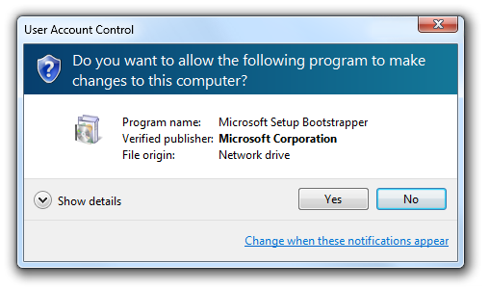
Integrity Protection in Practice
Mandatory Integrity Control in Windows
  Since Vista
  Four integrity levels: Low, Medium, High, System
  Each process assigned a level
    Processes started by normal users are Medium
    Elevated processes have High
  Some processes intentionally run as Low
    Internet Explorer in protected mode
  Ring policy
    Reading and writing do not change integrity level

Slide 70

Covert Channel Attacks

Slide 71
Caveats of Bell-LaPadula
★-property prevents overt leakage of information
  Does not address covert channels
What does this mean?

Slide 72

Covert Channels
Access control is defined over “legitimate” channels
  Read/write an object
  Send/receive a packet from the network
  Read/write shared memory
However, isolation in real systems is imperfect
  Actions have observable side-effects
External observations can create covert channels
  Communication via unintentional channels
  Examples:
    Existence of file(s) or locks on file(s)
    Measure the timing of events
    CPU cache (e.g. Meltdown and Spectre)

Slide 73

Simple Example
Bell-LaPadula MAC
Top Secret
Hmm, a classified file named russia_intel.docx must already exist…
Secret
Writeable
Error
Confidential
russia_intel.docx
Create File
Unclassified
Unclassified
Read and Write
russia_intel.docx

Slide 74

Exploiting a Covert Channel
Bell-LaPadula MAC
Binary Encoded Message
010010…
Top Secret
Received Message
Secret
Create File
0
1
0
1
0
Confidential
Secret
Create File
Unclassified
0
1
Unclassified

Slide 75
Leveraging Covert Channels
Covert channels are typically noisy
  Based on precise timing of events
  May result in encoding errors, i.e. errors in data transmission
  Communication is probabilistic
Information theory and coding theory can be applied to make covert channels more robust
  Naïve approach: duplicate the data n times
  Better approach: uses Forward Error Correction (FEC) coding
  Zany approach: use Erasure Coding

Slide 76
Bell-LaPadula and Covert Channels
Covert channels are not blocked by the ★-property
It is very hard, perhaps impossible, to block all covert channels
  May appear in program code
  Or operating system code
  Or in the hardware itself (e.g. CPU covert channels)
Potential mitigations:
  Limit the bandwidth of covert channels by enforcing rate limits
    Warning: may negatively impact system performance
  Intentionally make channels noisier by using randomness to introduce “chaff”
    Warning: slows down attacks, but may not stop them
  Use anomaly detection to identify subjects using a covert channel
    Warning: may result in false positives
    Warning: no guarantee this will detect all covert channels

Slide 77
Side Channel Attacks

Slide 78
Side Channel Attacks
Side channels result from inadvertent information leakage
  Timing – e.g., password recovery by timing keystrokes
  Power – e.g., crypto key recovery by power fluctuations
  RF emissions – e.g., video signal recovery from video cable EM leakage
Virtually any shared resource can be used

Slide 79
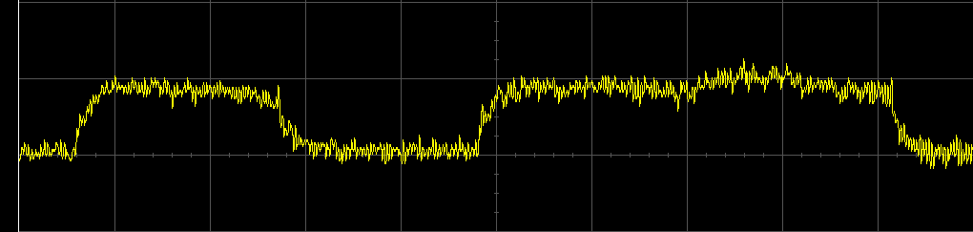
Side Channel Attack Example
Victim is decrypting RSA data
  Key is not known to the attacker
  Encryption process is not directly accessible to the attacker
Attacker is logged on to the same machine as the victim
  Secret key can be deciphered by observing the CPU voltage
  Short peaks = no multiplication (0 bit), long peaks = multiplication (1 bit)

Slide 80
Real Side Channel Attacks
CPU voltage attacks against RSA
Keystroke timing attacks against SSH
Timing and CPU cache attacks against AES
RF radiation attacks against computer monitors!
  Attacker can observe what is on your screen
CPU cache attacks against process isolation
  Meltdown and Spectre
  Also leverage a covert channel ;)

