Slide 1
CS2550 Foundations of Cybersecurity
Social Engineering

Slide 2
Focus on the Human
Cybersecurity is not just about computers
People play equally critical roles
Authentication principals
Holders of important information
Operators and maintainers of security critical infrastructure
Users of security sensitive apps
In many cases, humans are the easiest avenue to compromise

Slide 3
Psychological Heuristics

Slide 4
Raw sensory input
Social context
Physical context
Symbolic interpretation and reasoning
Internal monolog

Slide 5
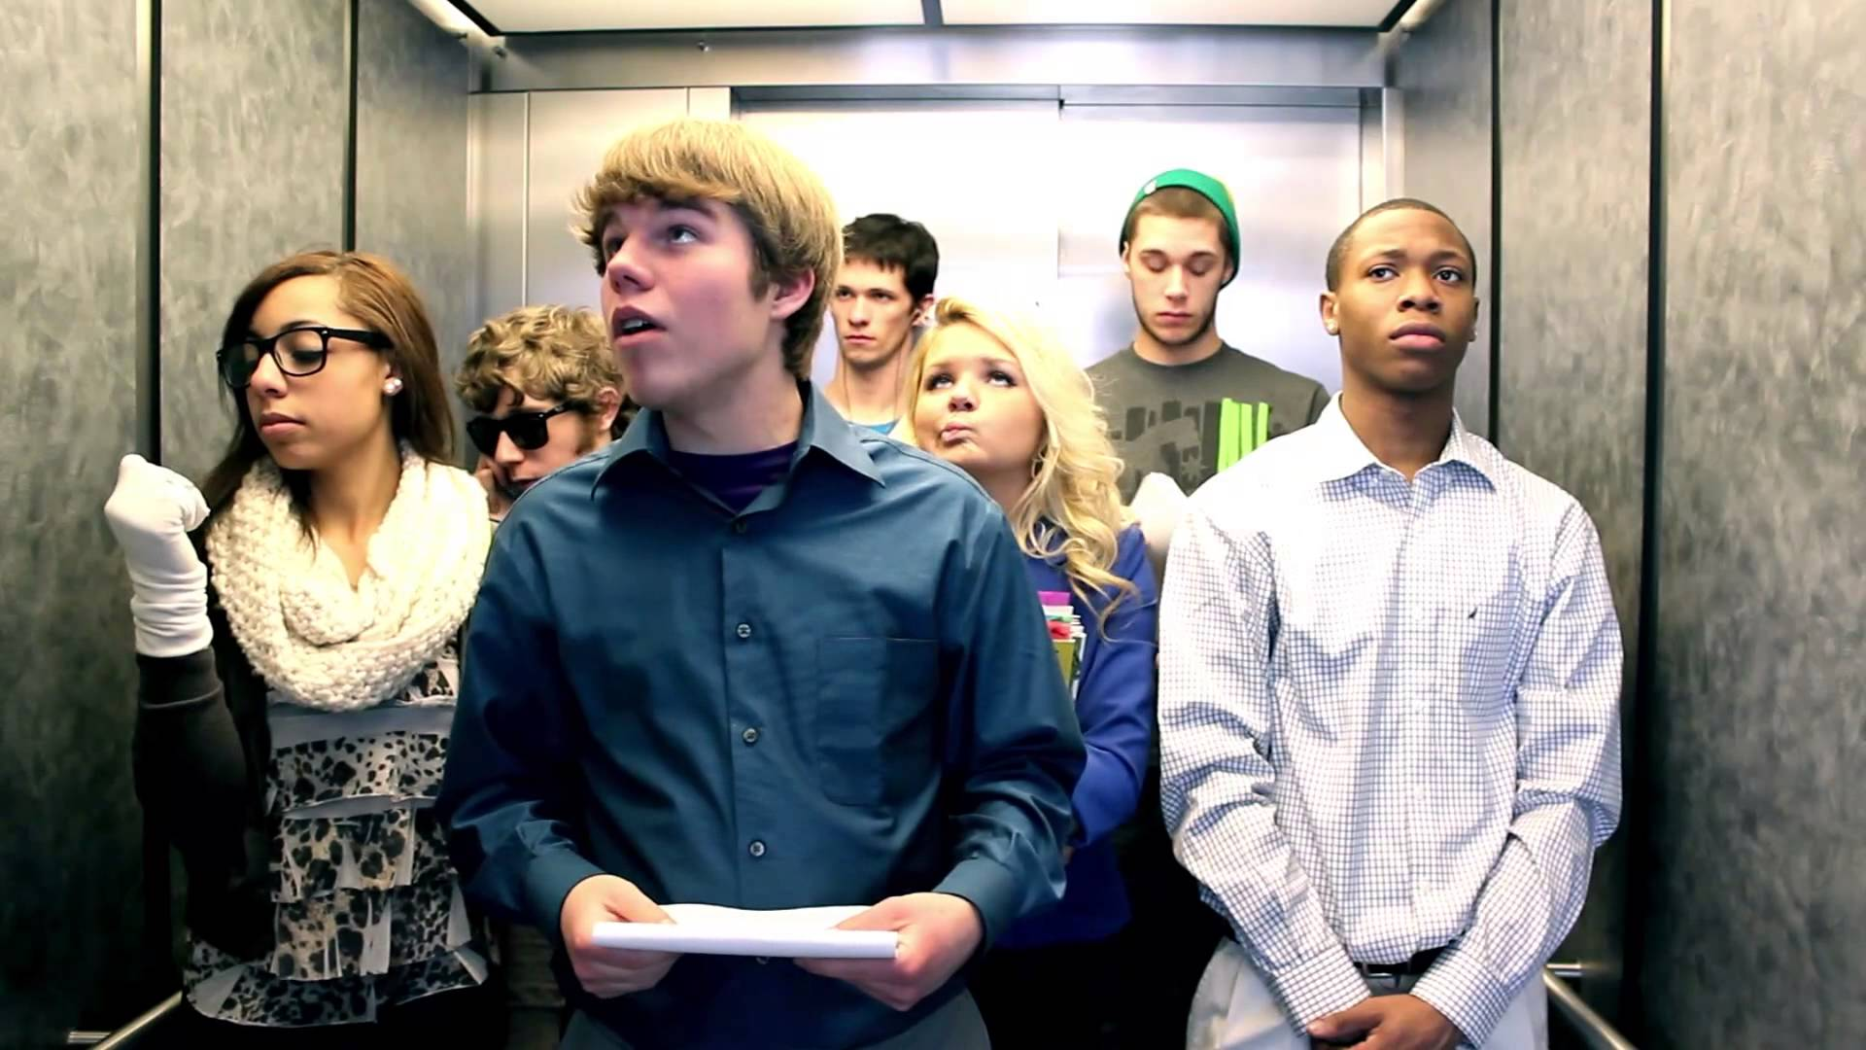

Slide 6
Psychological Heuristics
Social proof
Over time, we internalize unspoken social rules
Assume the actions of others reflect correct behavior
Familiarity heuristic
Assume past behaviors can be applied to current situations
Often necessary when under high cognitive load
Fluency heuristic
Information that is easier to grasp is “better”
Does not consider logic or veracity

Slide 8
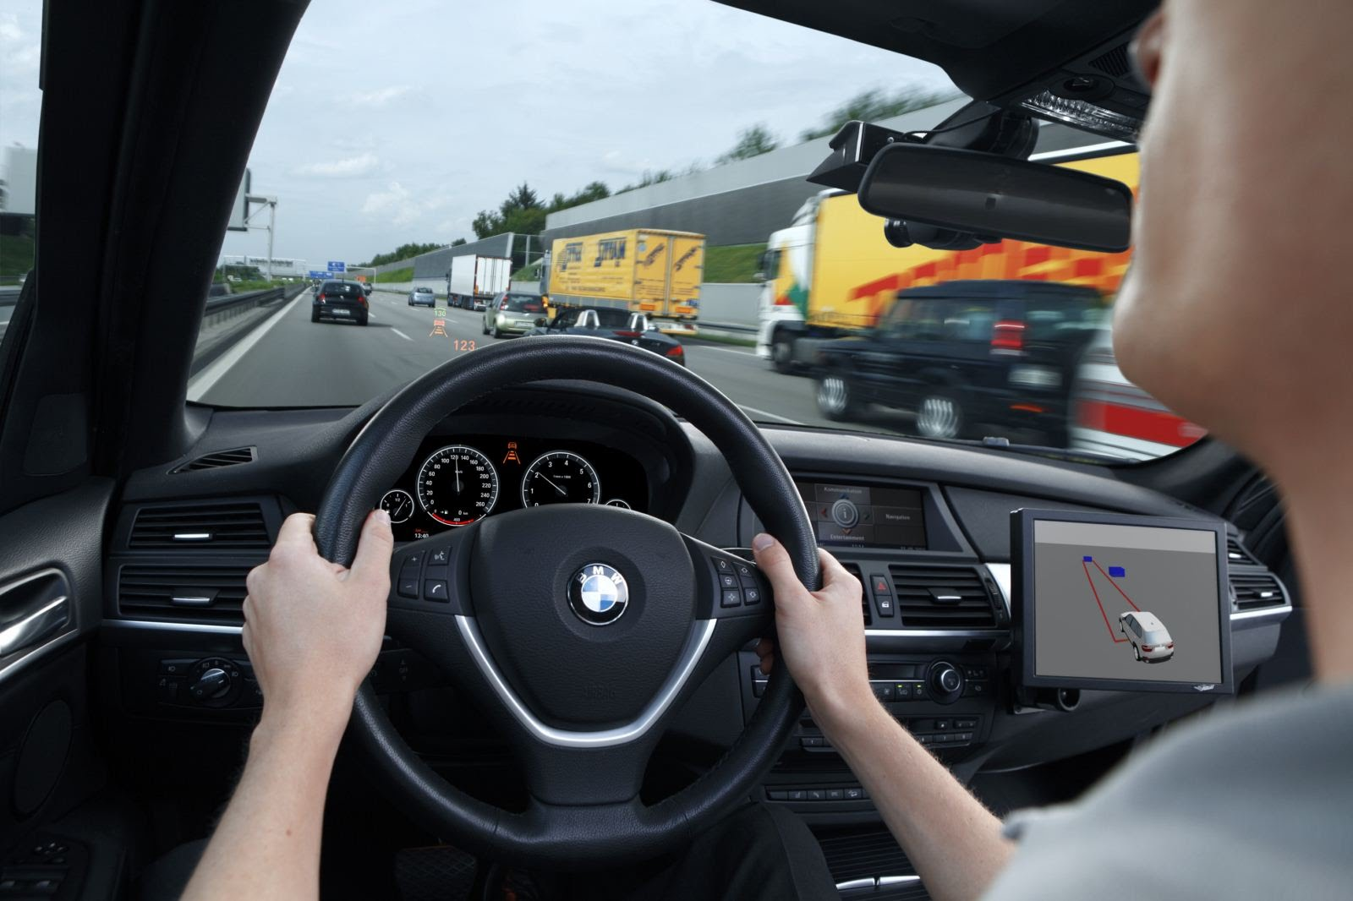

Slide 9
Subconscious Thought
You are not the master of your own mind
Subconscious decisions may be made before you are consciously aware
Many routine actions are completely automated
Subconscious decision making reduces cognitive burden
Contextually driven behaviors
Combined with heuristics
Psychological heuristics (shortcuts) can and do go wrong
Cognitive biases
We are typically unaware of subconscious biases
Knowledgeable attackers can exploit cognitive biases

Slide 10
Cognitive Biases

Slide 11
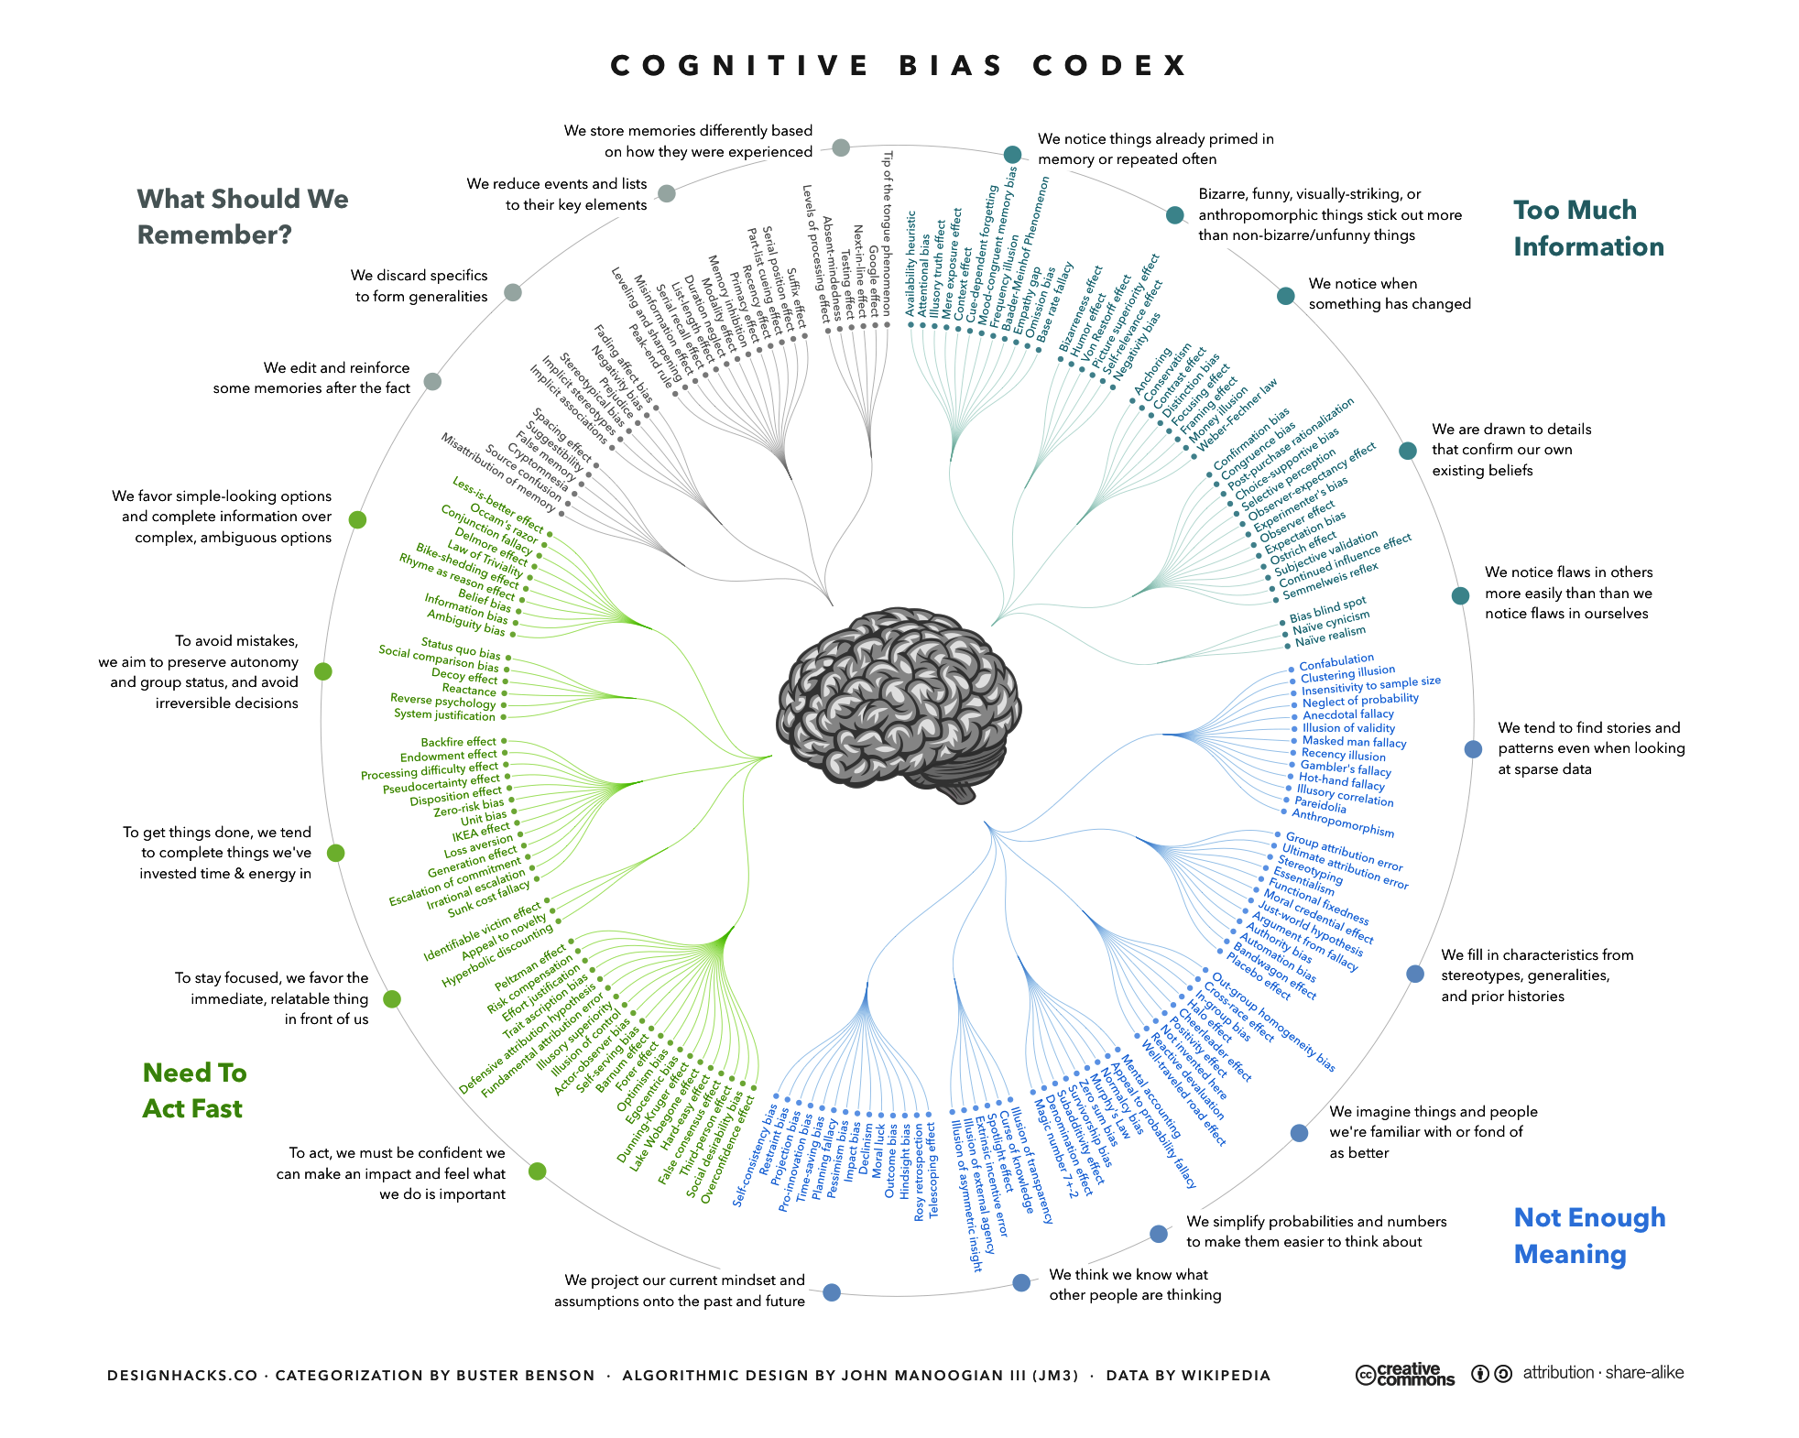

Slide 12
Cognitive Biases
Behavioral Biases
Social Biases
Memory Biases
Automation bias
Belief bias
Confirmation bias
Courtesy bias
Framing effect
Stereotyping
Authority bias
Halo effect
Ingroup bias
Context effect
Suggestibility

Slide 13
Behavioral Biases
Belief bias
Evaluation of an argument is based on the believability of the conclusion
Confirmation bias
Tendency to search out and interpret information that confirms existing preconceptions
Courtesy bias
Urge to avoid offending people
Framing effect
Drawing different conclusions from the same info, based on how it was presented
Stereotyping
Expecting members of groups to have certain characteristics

Slide 14
Social Biases
Authority bias
Tendency to believe and be influenced by authority figures, regardless of content
Halo effect
Tendency for positive personality traits from one area to “spill” into another
Ingroup bias
Tendency to give preferential treatment to others from your own group

Slide 15
Memory Biases
Context effect
Cognition and memory are dependent on context
Suggestibility
Misattributing ideas from the questioner as one’s own

Slide 16
Social Engineering Techniques
Research
Pretexting
Elicitation and Persuasion

Slide 17
From Vulnerabilities to Attacks
Social engineering
Psychological manipulation of people into performing actions or divulging confidential information
Techniques are extremely old
Confidence scams, con-men
Magicians
Military/intelligence psychological operations (PSYOPs)
Taken on new life in the information age
Remote attacks let adversaries stay anonymous
Connectivity makes reaching victims easier
Networks massively increase the scale of attacks

Slide 18
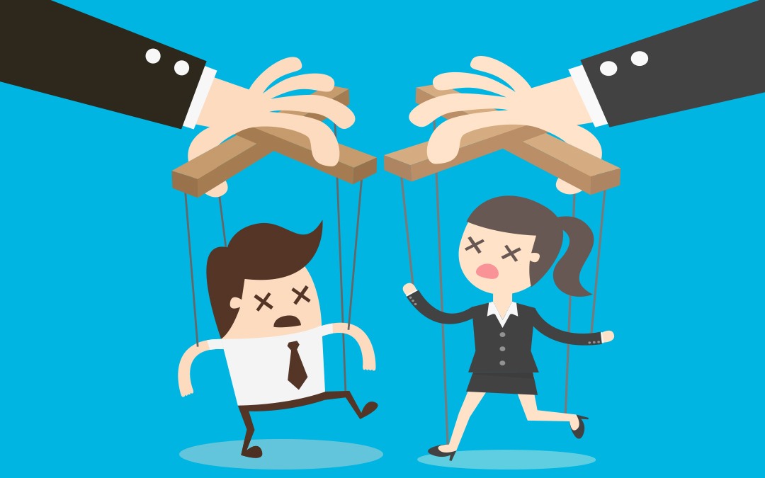
Social Engineering Basics
Successful attacks rely on:
Information asymmetry
Context construction
Elicitation
Persuasion
Cognitive biases are leveraged throughout

Slide 19
(1) Information Asymmetry
Know more about the target than they know about you
Less Info
Fake Antivirus, scareware
Phishing
Spear phishing
CEO fraud
More Info

Slide 20
Opposition Research
Who
Names and positions of targets
Name and position of the attacker's character?
Situational awareness
Where are things located?
When did key events happen?
Organizational structure
Technical background
Specific jargon and acronyms
Names of software and hardware systems

Slide 21
Information Resources
Public records
Mortgage, voter, criminal
Corporate websites
Social networks
Facebook, LinkedIn, Twitter, Instagram
Tinder, OK Cupid, Ashley Madison?
Background checks
Spokeo “whitepages”
Criminal background check
Credit report

Slide 22
(2) Context Construction
Design a frame that advances the attack
Context effect – triggers social and memory cues in the victim
Evokes advantageous cognitive vulnerabilities in the victim
Pretexting
Attacker’s “character” and background story
Opens cognitive bias attacks
Authority bias – “I’m from the internal cybersecurity department…”
Halo effect – “I’m a medical doctor, and I need you to help me with something…”
Ingroup bias – “You and I are alike, so trust me.”
Stereotyping – “I’m an intern from marketing, and I forgot my password…”
May create urgency and place pressure on the victim
Increases stress and cognitive load

Slide 23
Leveraging Cognitive Overload
Crafting a story isn’t just for pretexting
Useless details obfuscate true intentions
Increases cognitive load in the victim, increasing susceptibility
You are the bus driver. At your first stop, you pick up 29 people. On your second stop, 18 of those 29 people get off, and at the same time 10 new passengers arrive. At your next stop, 3 of those 10 passengers get off, and 13 new passengers come on. On your fourth stop 4 of the remaining 10 passengers get off, 6 of those new 13 passengers get off as well, then 17 new passengers get on.
What is the color of the bus driver’s eyes?

Slide 24
Kevin On Pretexting
Ingroup bias and stereotyping
Context and framing
“When you use social engineering, or ‘pretexting’, you become an actor playing a role… When you know the lingo and terminology, it established credibility—you’re legit, a coworker slogging in the trenches just like your targets, and they almost never question your authority… People in offices ordinarily give others the benefit of the doubt when the request appears to be authentic. People, as I learned at a very young age, are just too trusting.”
Authority bias
Courtesy bias
Suggestability
Quote from “Ghost in the Wires” by Kevin Mitnick

Slide 25
(3) Elicitation
Idea promoted by Christopher Hadnagy
The ability to draw people out and make them trust you
Leveraging elicitation techniques
Be polite
Professionals want to appear well informed and intelligent
People are compelled to reciprocate praise
People respond kindly to concern
Most people don’t routinely lie
Adapted from “Social Engineering: The Art of Human Hacking”

Slide 26
(4) Persuasion
Ultimately, the goal is to make the victim take an action or reveal confidential information
Psychological manipulation techniques
Appeals to ego
Making deliberate false statements
Volunteering information (credibility bias)
Assuming knowledge
Effective use of questions (suggestibility)
Quid pro quo: give something to get something in return
More effective when paired with cognitive biases
Authority bias
Belief bias
Confirmation bias
Ingroup bias

Slide 27
Follow-through
Suddenly dropping the victim arouses suspicion
Cutting off contact abruptly
“Ghosting”
Provide logical follow-through
Conversations should end normally
Emails should be answered cordially
Give the victim closure

Slide 28
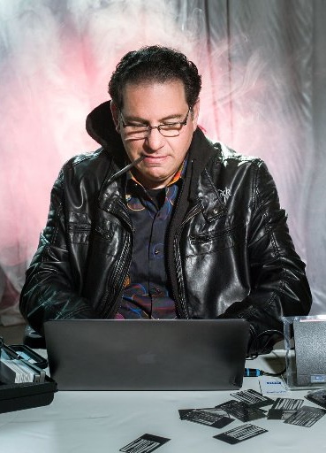
Kevin On Follow-through
“Chatting is the kind of extra little friendly touch that leaves people with a good feeling and makes after-the-fact suspicions that much less likely.”
Quote from “Ghost in the Wires” by Kevin Mitnick

Slide 29
Social Engineering Attacks
Physical Attacks
(Spear) Phishing
Scareware

Slide 30
Baiting
Mr. Robot FTW ;)
Very simple physical attack
Preload USB keys with malware
Drop the keys in public, near victims
Wait for victims to pick up and plug in
Victim executes malware
Either by accident due to curiosity
Or autorun by the OS (e.g. Windows)

Slide 31
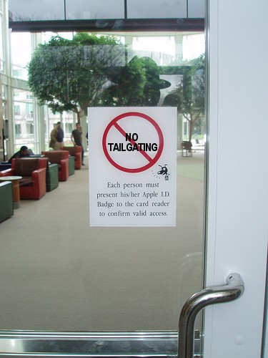
Tailgating
Technique used by penetration testers
Goal: break into a secure facility
Security guards at the main entrance
All doors have keycard access control
Idea:
Wait for an unsuspecting employee to open a door
Follow them inside
Leverages courtesy bias and ingroup bias

Slide 32
Scareware
Attempts to convince the victim to install malware on their system
Paradoxically, leverages people’s fears of security problems
Virus and malware infections
Data breaches
Distributed via online ads and compromised websites
Whole fake antivirus industry around these scams
Scareware companies have real customer support hotlines
Sometimes the products actually remove malware
But only from competing crime gangs ;)

Slide 33
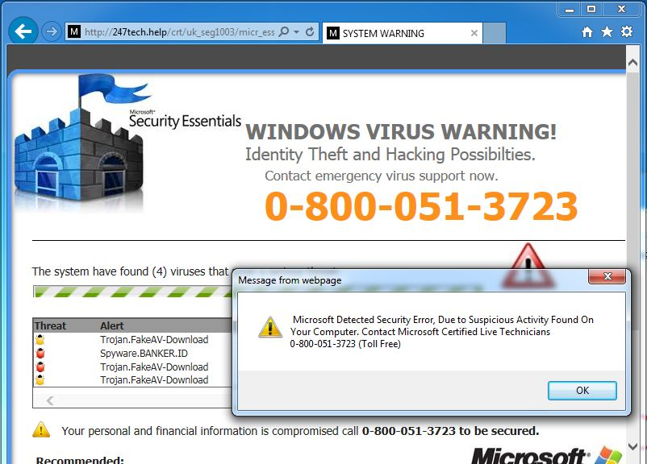
Context and framing: real security logos and product names
Familiarity: real-looking security dialogs
Urgency: you are infected!

Slide 34
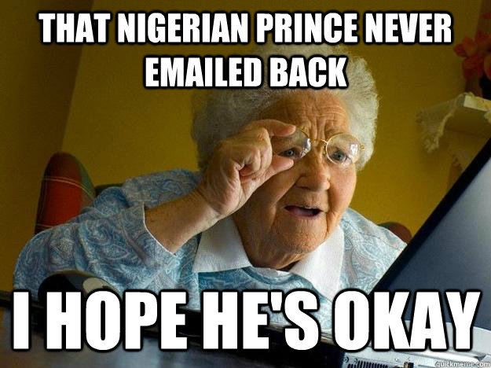
Advance-fee Scams
Also known as Nigerian prince or 419 scams
Known as the “Spanish prisoner” con in the 18th century
Attacker entices the victim with promise of huge financial reward
But victim must pay a small fee up-front

Slide 35
REQUEST FOR ASSISTANCE-STRICTLY CONFIDENTIAL
I am Dr. Bakare Tunde, the cousin of Nigerian Astronaut, Air Force Major Abacha Tunde. He was the first African in space when he made a secret flight to the Salyut 6 space station in 1979. He was on a later Soviet spaceflight, Soyuz T-16Z to the secret Soviet military space station Salyut 8T in 1989. He was stranded there in 1990 when the Soviet Union was dissolved. His other Soviet crew members returned to earth on the Soyuz T-16Z, but his place was taken up by return cargo. There have been occasional Progrez supply flights to keep him going since that time. He is in good humor, but wants to come home.
In the 14-years since he has been on the station, he has accumulated flight pay and interest amounting to almost $ 15,000,000 American Dollars. This is held in a trust at the Lagos National Savings and Trust Association. If we can obtain access to this money, we can place a down payment with the Russian Space Authorities for a Soyuz return flight to bring him back to Earth. I am told this will cost $ 3,000,000 American Dollars. In order to access the his trust fund we need your assistance.
Consequently, my colleagues and I are willing to transfer the total amount to your account or subsequent disbursement, since we as civil servants are prohibited by the Code of Conduct Bureau (Civil Service Laws) from opening and/ or operating foreign accounts in our names.
Needless to say, the trust reposed on you at this juncture is enormous. In return, we have agreed to offer you 20 percent of the transferred sum…
https://gizmodo.com/we-found-the-best-nigerian-prince-email-scam-in-the-gal-1758786973

Slide 36
Phishing
Attempts to coerce sensitive info from targets
Spread via email, SMS, messaging apps
Careful framing
Banks, social networks, webmail
Leverages urgency
“You will lose access to your account!”
Trick the victim into visiting a carefully constructed landing page
User inputs sensitive info
Passwords, social security numbers, credit cards, bank accounts, etc.

Slide 37
John Podesta Phishing Email
Sent by Russian intelligence to Clinton campaign staffers
Podesta (campaign manager) asked IT if the mail was legit
IT erroneously responded “this is a legitimate email”
Account compromised; emails dumped to Wikileaks
Massive political scandal

Slide 38
Spear Phishing
Advanced form of phishing
Highly targeted emails sent to high-value victims
Includes many details about the target
Does not trigger spam filters
Very challenging to detect by people and anomaly detectors
May be sent from hacked, legit email accounts
Or may use crafted domain names
E.g. googlemail.com

Slide 39
CEO Fraud
Specific type of spear phishing
Targets employees with access to corporate bank accounts
Attacker impersonates the company CEO
Asks that money be wired to the attacker’s bank account
Exploits many cognitive biases
Context and framing – Uses real names, jargon, and writing style
Authority bias – orders from the CEO
Creates a sense of urgency – “payment is late, send right away”
Attacker may follow-up with more emails or calls
Further increases the sophistication of the attack

Slide 40
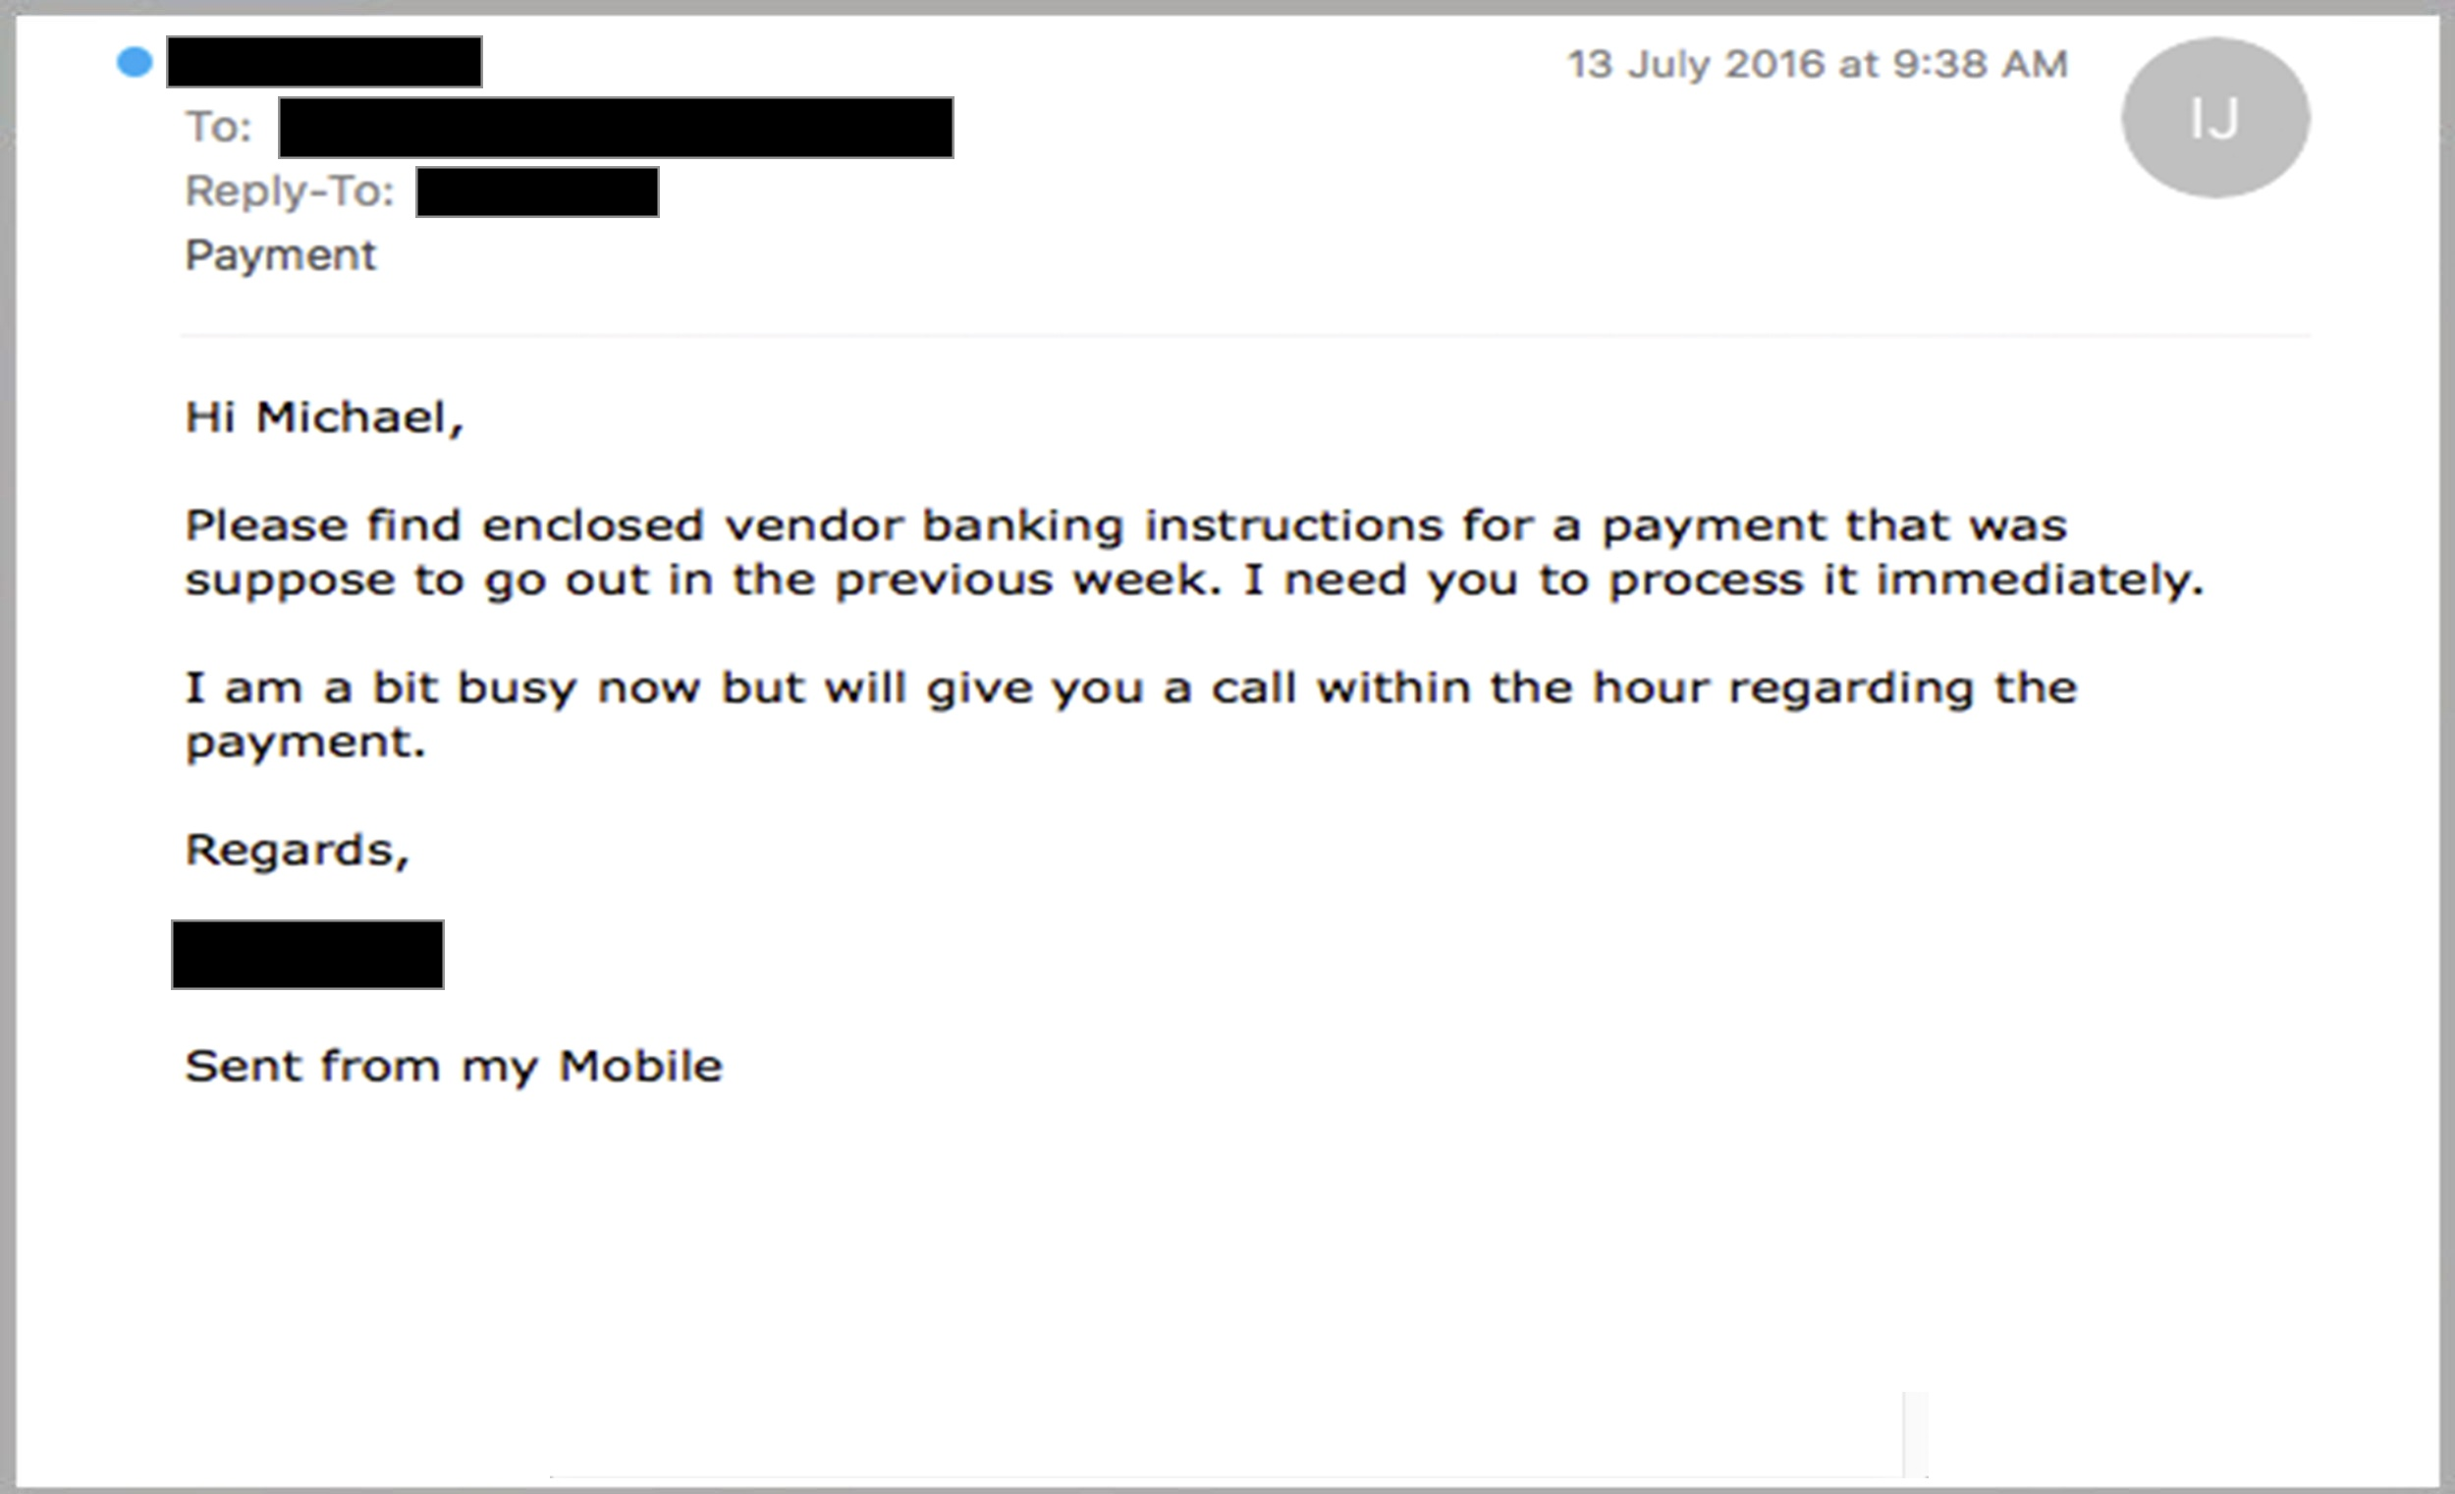

Slide 41
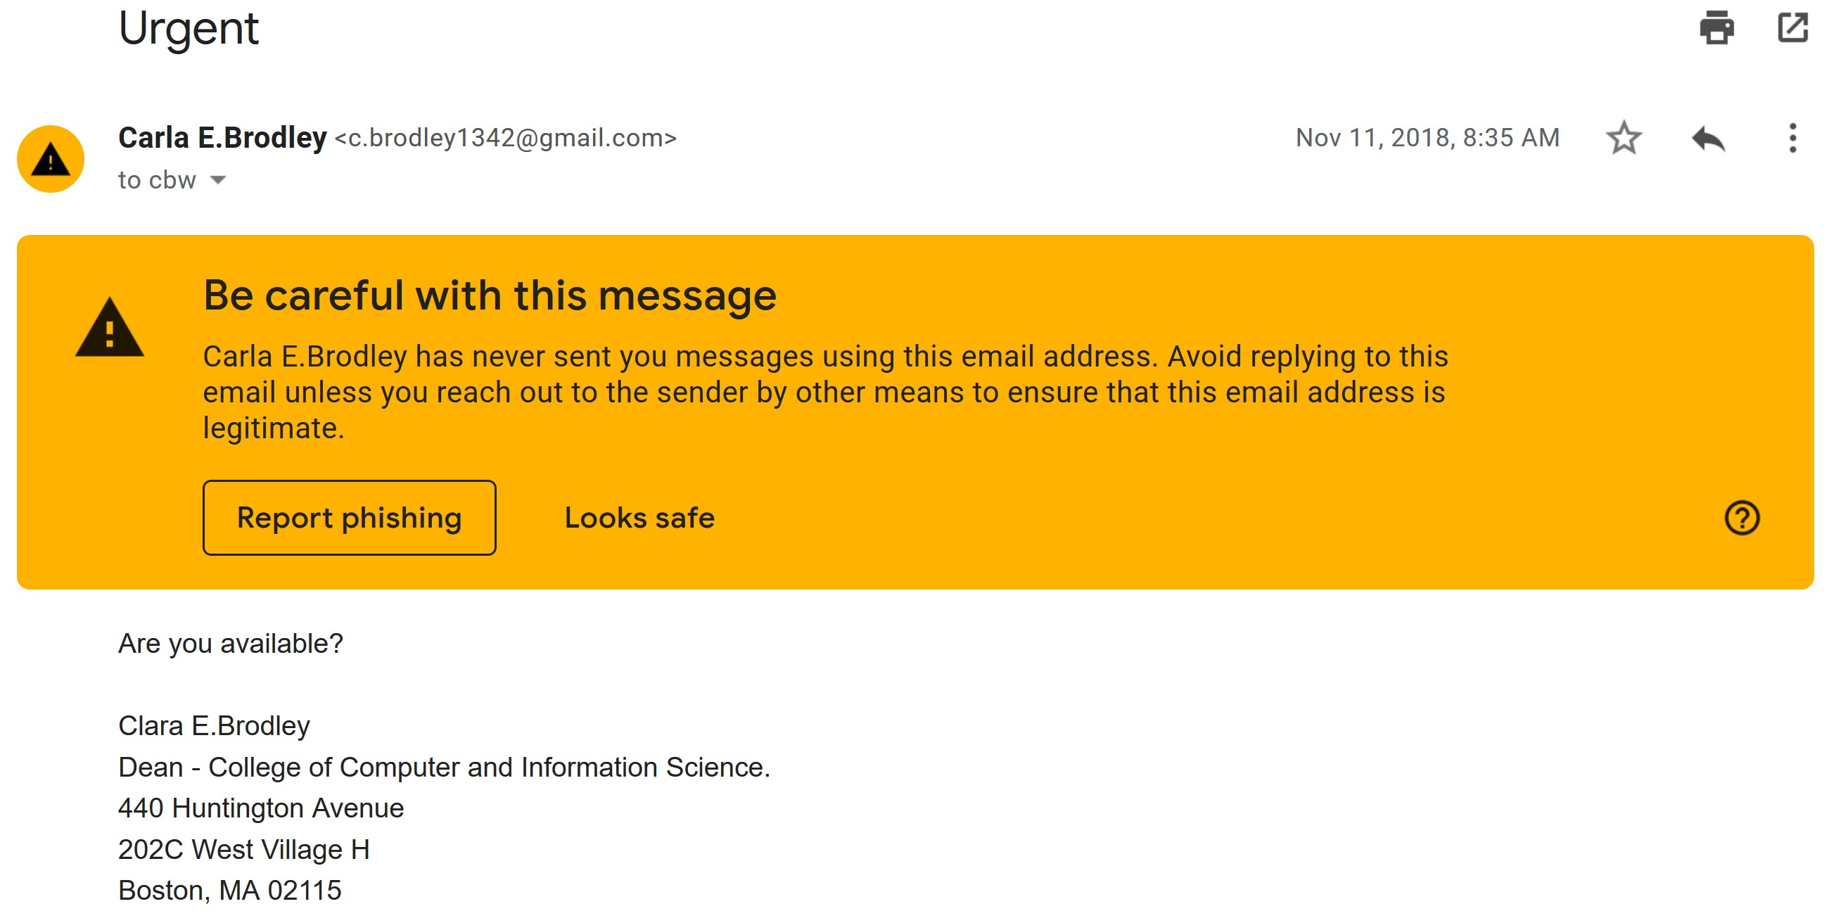
C

Slide 42
Sextortion
Relies on three generalizations:
People view porn on the internet
People assume their porn viewing habits are private
People reuse the same password across multiple services
Leverages several cognitive biases
Urgency – “pay the ransom in 24 hours or else!”
Fear of sexual intimacy violations
Belief bias – they have a password from one service, they must have it for all services

Slide 43
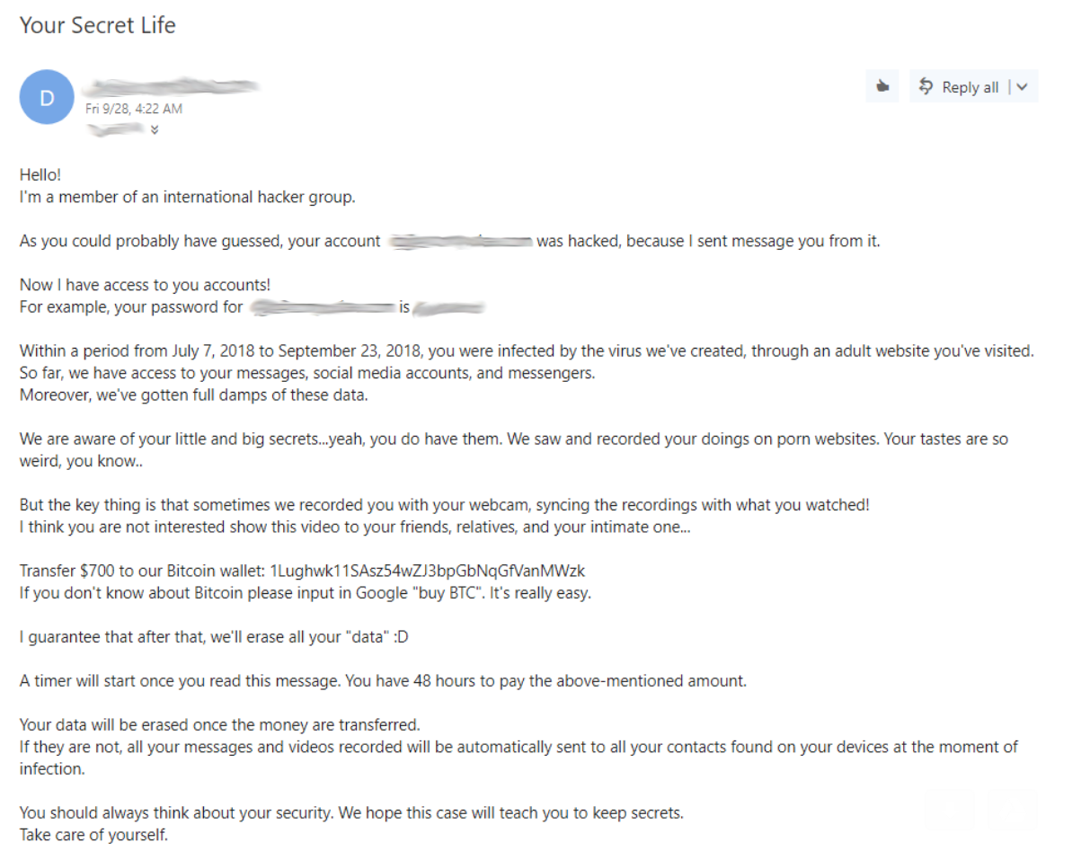
Sent from “your email address” via spoofing
Actual password taken from a pre-existing website breach

Slide 44
Bespoke Attacks
Attackers are constantly innovating new social engineering methods
The Internet makes information easily accessible…
… and people easily reachable

Slide 45
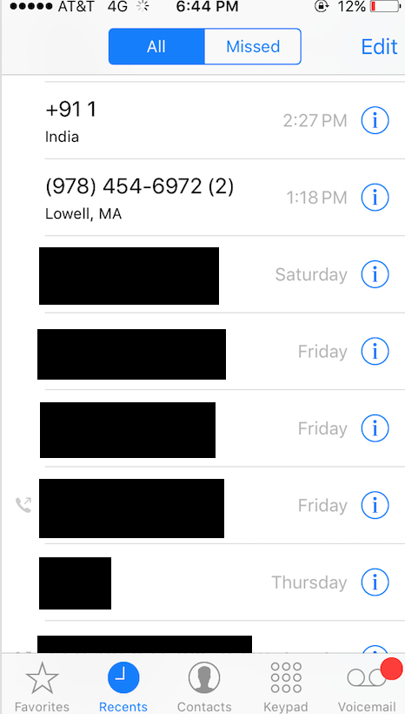
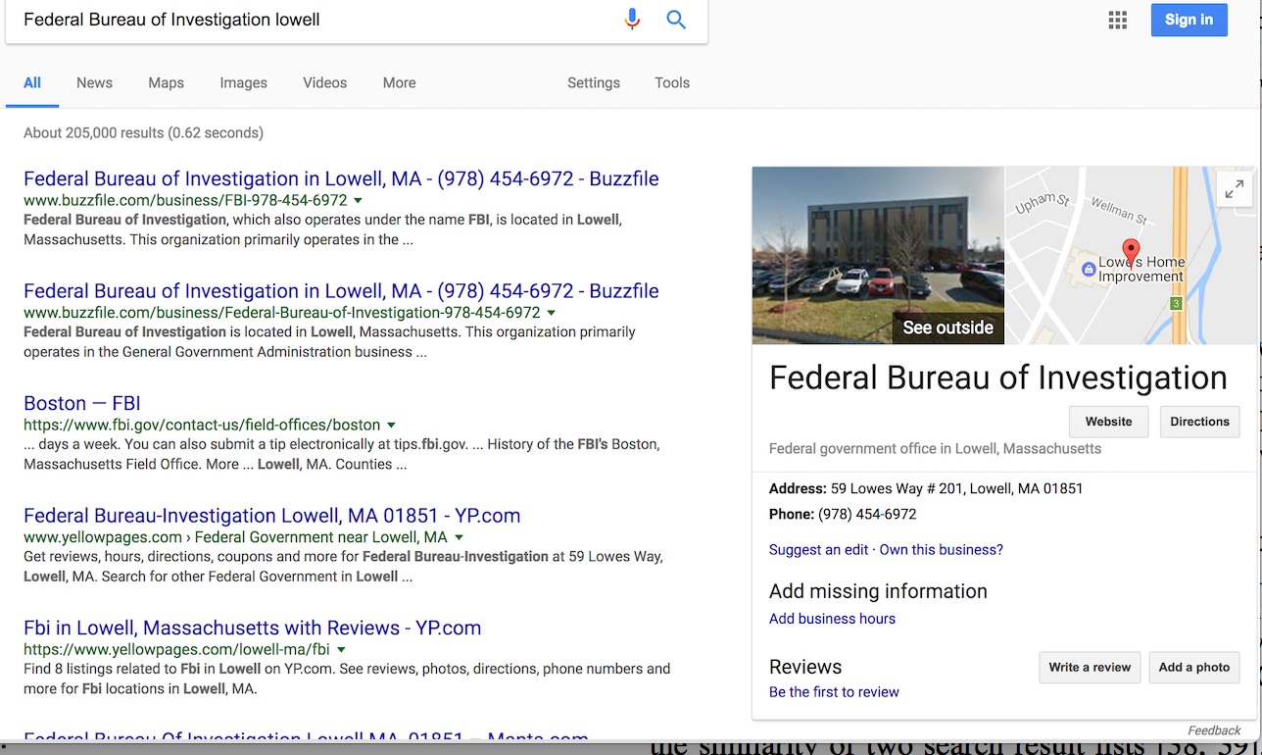

Slide 46
Case Study: 419 Scams

Slide 47
A Closer Look at 419 Scams
We laugh when we talk about “Nigerian Prince” scams
The emails appear laughably crude
Why even use “Nigerian Price” as the pretext anyway?
And yet, these attacks remain widespread today
Criminal gangs aren’t stupid
They abandon tactics that don’t make money
Key problem: these scams must work if they persist
Who is falling for them?
Why?
What can be done to stop them?

Slide 48
“Why do Nigerian Scammers Say They are From Nigeria?”
2012 paper from noted security researcher Cormac Herley
Attempts to mathematically explain why 419 scams continue to rely upon completely ridiculous pretexts

Slide 49
Attacker’s Assumptions
N is the set of people on the internet
M is the set of viable targets (i.e. they fall for the scam)
d = |M|/|N| is the victim density
G is the profit from each successful attack ($$$)
C is the cost of each unsuccessful attack
i.e. people who respond to initial email, but don’t eventually pay
Corresponding with these people wastes time and effort
The attacker faces a binary decision problem
For any given person $p∈N$, figure out if $p∈M$
True positive → G profit
False positive → C loss

Slide 50
Confusion Matrix
Predicted Classifications
Victimizable
Immune
True Positives
(These earn $$$)
False Negatives
(These could have earned $$$)
Victimizable
|M|
True
Classifications
(Unknown to
The attacker)
False Positives
(These lose $$$)
True Negatives
Immune
|N|-|M|

Slide 51
Possible Strategy: Attack Everyone
What if C = 0 (no cost for false positives)
Ideal strategy: attack everyone with a strong pretext
Maximize the number of true positives
What if C > 0, and you want to earn money?
Expected return E = (d * G – (1 – d) * C) * N
To achieve E > 0, then $\frac{M}{N}>\frac{C}{G+C}$
Example: assume 1% of people are viable victims
$\frac{1}{100}>\frac{C}{G+C}$ → G + C > 100C → G > 99C
Profit must be 99x the cost of each attack for this to be profitable
This is not a reasonable assumption!

Slide 52
Selective Attacking
Predicted Classifications
|N| = 10,000
1% of people are victimizable
5% false positive rate
0% false negative rate
Profitable if G > 4.94*C
True positives are worth ~5x false positives
Victimizable
Immune
100
True
Positives
0
False Negatives
Victimizable
100
True Classifications
495
False Positives
9,405
True Negatives
Immune
9,900

Slide 53
Density vs. FPR vs. Profitability
False Positive Rate

Slide 54
Base Rate Fallacy
We tend to assume that the false negative rate is most important
“I don’t want to miss potential victims”
In reality, the false positive rate is much more important
Classes are highly imbalance
Immune people far outnumber potential victims
False positives will vastly outnumber true positives
So what is a scammer to do?
Vastly increase profit per victim
Dramatically reduce the false positive rate

Slide 55
ROC Curves
Attack everyone
100% true positives (good)
100% true negatives (bad)
Intelligent Attack Strategy
Later, the “cost” of locating more true positives increases
1
Terrible, losing strategies
false positives > true positives
Attacker loses $$$
Initially, true positives increase much faster than false positives
Random Attack Strategy:
Attack each person with probability 1/N
0.75
True Positive Rate
0.5
Ideal tradeoff point for the attacker is somewhere in here
0.25
Attack zero people
No false positives (good)
No true positives (bad)
0
0
0.25
0.5
0.75
1
False Positive Rate

Slide 56
A Smarter Strategy?
81.8% of attacks succeed
Only attack “sure things”
Maximize true positives while…
Minimizing false positives
Problem, as victim density d decreases, it is much harder to achieve profitability
Example: assume $\frac{G}{C}=9$, i.e. profit is 9x cost
X=Y
1
0.75
Assume a classifier with 90% accuracy
True Positive Rate
0.5
0.25
18.2% of attacks fail
Victim Density d | % of total population N attacked | % of people successfully attacked
10% | 24.6% | 8.18%
1% | 1.63% | 0.34%
0
0
0.25
0.5
0.75
1
False Positive Rate

Slide 57
How to Identify Sure Things?
In reality, victim density is extremely low (definitely <<1%)
How can an attacker predict with very, very high accuracy, who is a viable victim?
Gullibility is not observable ahead of time
Two step strategy:
Spam everyone
Use an extremely low quality pretext (i.e. Nigerian Prince)
Rationale:
Vast majority of people will ignore the message
These people are true negatives and false negatives
Only extremely gullible people are likely to respond
i.e. lots of true positives, very few false positives
Get likely victims to self-identify themselves!

Slide 58
Country of claimed origin for 419 emails
Attackers can lie and claim to be from anywhere
Yet, they consistently choose Nigeria, or other African countries
Attackers aren’t stupid, or lazy
This is an intentional choice to use a poor quality pretext

Slide 59
Countermeasures
Reduce the victim density d
Spam filters
Education campaigns
Reduce profit margin G
Hard limits on wire transfer sizes
Training for bank and Western Union employees to spot fraud
Intentionally increase the false positive rate
Engage with attackers and waste their time
There are people who actually do this for lulz

Slide 60
Sent from “your email address” via spoofing
Actual password taken from a pre-existing website breach

Slide 61
Contrasting 419 and Sextortion
Sextortion uses a much stronger pretext than 419
Why?
Monetization method is fully automated
Pay a ransom in Bitcoin
No cost of interacting with victims
Since cost C = 0, the ideal strategy is to attack everyone
Maximize true positives, minimize false negatives
False positives do not matter

Slide 62
Case Study: Phishing
Evaluating emails
Evaluating websites
Does training work?

Slide 63
John Podesta Phishing Email

Slide 64
Test Your Skills!
https://www.phishingbox.com/phishing-test

Slide 65
Why Do People Fall Prey to Phishing?
Evaluating the veracity of emails is challenging
Non-spoofed header?
Security indicators like DKIM and SPF?
Personalization, e.g. your name?
Quality of the text?
Evaluating the veracity of a website is challenging
Realistic domain name?
SSL/TLS lock icon?
“Professional” layout and images?
Quality and quantity of links?

Slide 66
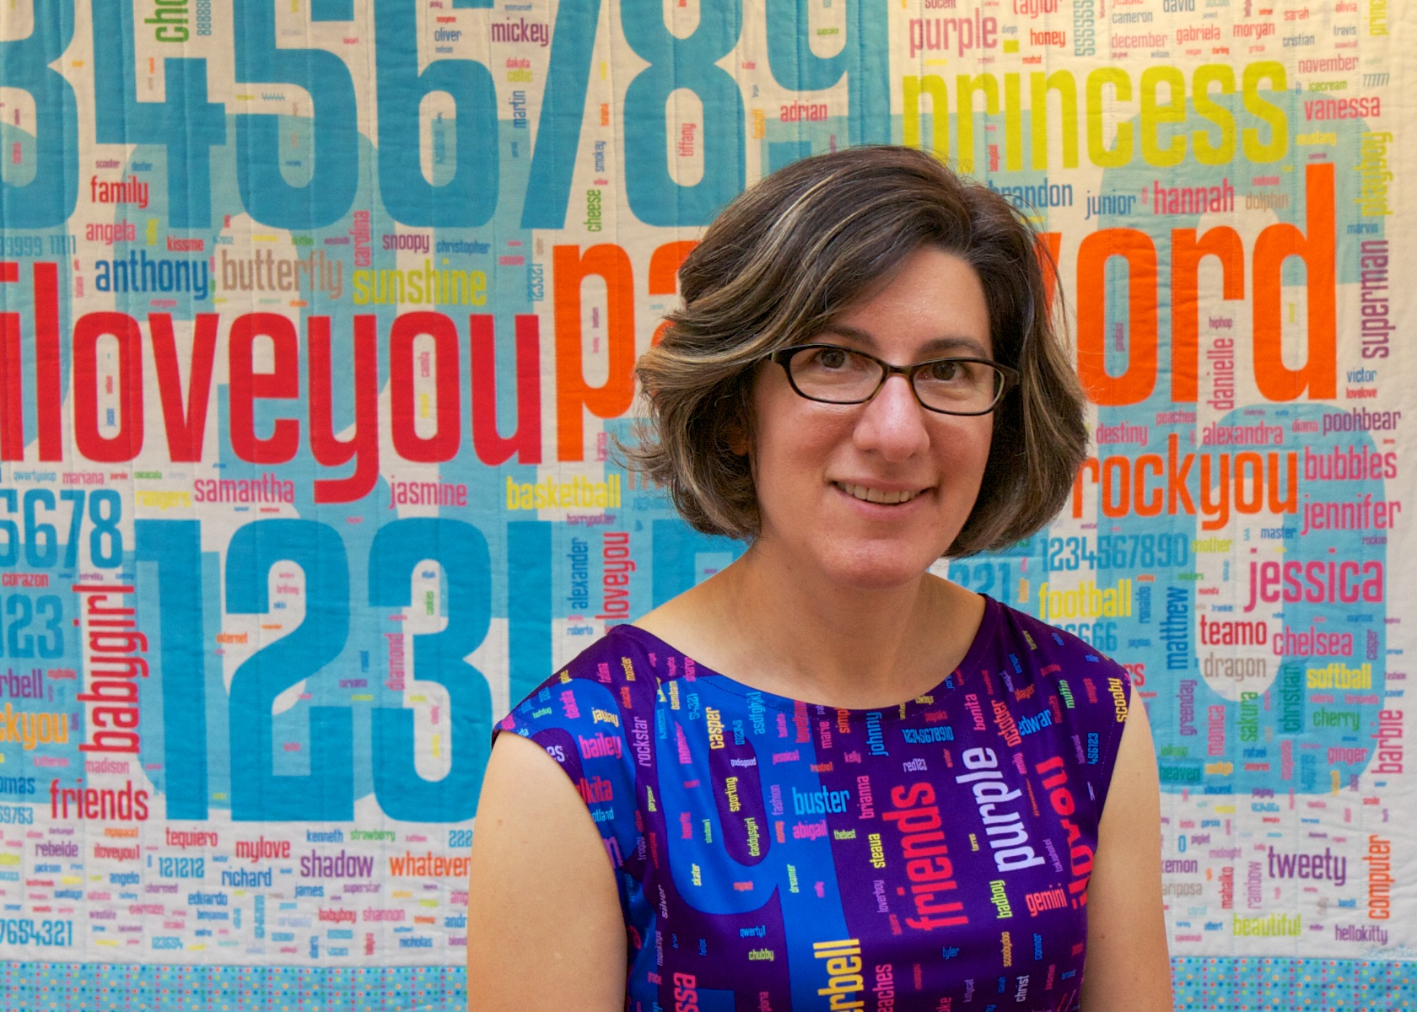
“Decision Strategies and Susceptibly to Phishing”
Julie Downs, Mandy Holbrook, and Lorrie Faith Cranor
2006
Interviewed 20 normal people about their strategies for identifying phishing emails
Quilt and dress containing the most frequently used (i.e. terrible) passwords

Slide 67
Methodology
20 participants were asked to role play as another person
Given this fake person’s wallet, containing ID, a credit card, a social security card, and a note containing login credentials for Amazon and Paypal
Told to read this person’s email and respond to them normally
Inbox contents: Eight total messages
Three phishing
Urgent request from “Citibank”, link www.citicard.com, actual URL www.citibank-accountonline.com
Reset password from “Paypal”, link “Click here to activate”, actual URL www.payaccount.me.uk
One 419 scam

Slide 68
Participants
20 total
15 females
Age 18 – 65 (mean 27)
50% white, 25% African American, 15% Asian
95% used e-commerce sites
70% used online banking
25% reported being victims of fraud in the past

Slide 69
Email Decision Strategies
Three identified strategies
Is the email personalized and grammatically correct?
Somewhat good at identifying malicious email
Do I have an account with this business?
Not a good strategy
Companies send email
Extremely naïve, terrible strategy
Email | Legit? | % Suspicious
Meeting | Real | 0%
“Cool Pic” | Real | 15%
Amazon | Real | 25%
Citibank | Phishing | 74%
“Great Article” | Malware | 85%
Paypal | Phishing | 70%
Amazon | Phishing | 47%
“Katrina” | 419 Scam | 95%

Slide 70
Sensitivity to Phishing Cues
Cue | % Sensitive | Takeaway
Spoofed “from” address | 95% | Good – strange email sources are suspicious
Broken image links on the website | 80% | Not good – decent phishing pages will look correct
Strange URL | 55% | Good – odd spelling or TLDs are indicative of phishing sites
Awareness of HTTPS | 35% | Not good – any website, including phishing sites, can use TLS

Slide 71
Interpretation of Security Warnings
Message | Seen? | Proceed | Stop | Depends
Leaving secure site | 71% | 58% | 0% | 42%
Insecure form submission | 65% | 45% | 35% | 20%
Self-signed certificate | 42% | 32% | 26% | 42%
Entering secure site | 38% | 82% | 0% | 18%
Overall, people tend to ignore warnings
Participants were often inured
“I get these warnings on my school website, so I just ignore them”
“Entering secure site” sometimes made people more suspicious!
The paradox of security

Slide 72
“Why Phishing Works”
Rachna Dhamija, J. D. Tygar, Marti Hearst
2006
Similar study: showed 20 websites to 22 participants, asked them to identify phishing sites and explain why they thought so

Slide 73
Methodology
20 websites, first 19 in random order
7 legit
9 representative, real phishing sites
3 phishing sites crafted by the researchers
Final site: self-signed SSL certificate
All websites were fully functional

Slide 74
Participants and Overall Results
22 participants
45.5% female
Age 18—56 (mean 30)
73% had a bachelors degree
50% used Internet Explorer (remember, its 2006)
Results: correct identifications ranged from 6—18 (out of 19)
No correlation with sex, age, education level, hours of computer experience, or browser choice

Slide 75
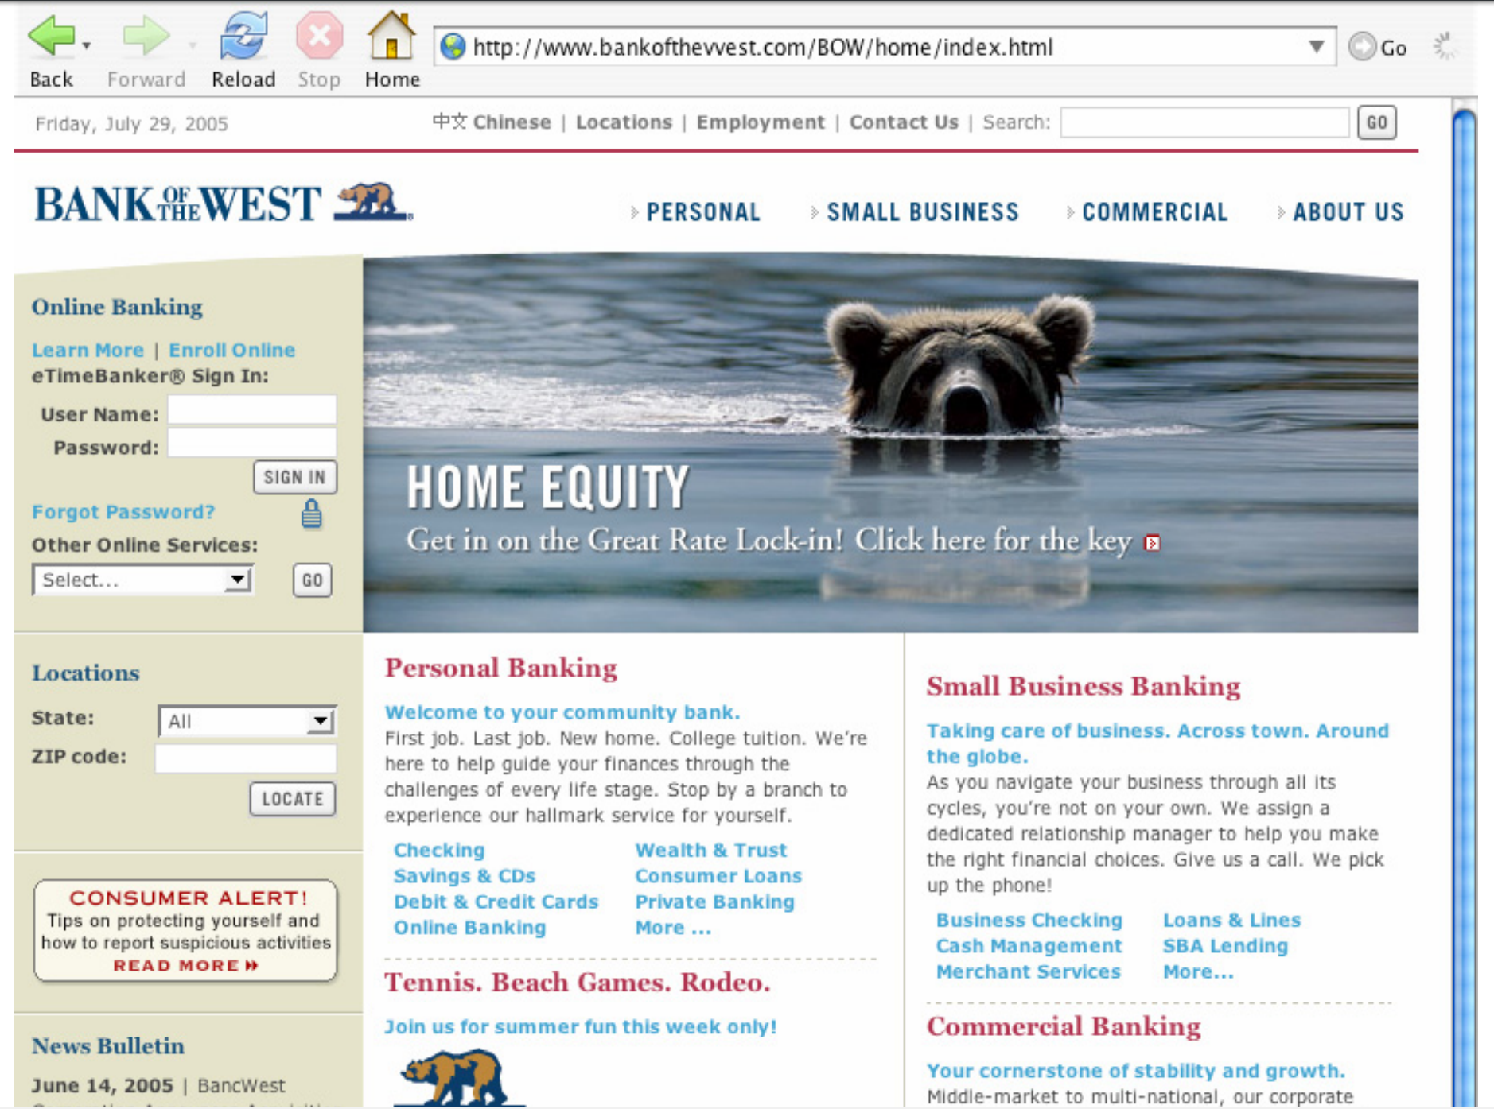
“vv” instead of “w”

Slide 76
Identification Strategies
Strategy | # of Participants | Correct Judgements
Website content only | 5 | 6—9
+ Domain name | 8 | 10—13
+ HTTPS | 2 | 8—16
+ Padlock icon | 5 | 12—17
+ Checked the certificate | 2 | 10—18

Slide 77
“Social Phishing”
Problem: the prior study was conducted in a lab
Subjects knew they were participating in an experiment
May impact ecological validity of results
i.e. would people have behaved differently under real-world circumstances?
Tom Jagatic, Nathaniel Johnson, Markus Jakobsson, and Filippo Menczer, 2005
Sent actual phishing emails to 581 Indiana University undergrads
Deception study – students were unaware of the experiment
Hugely controversial study

Slide 78
Methodology
Students were sent a typical phishing email
“Hey, check out this cool link!”
Link appeared to point to a university website
Actual URL was www.whuffo.com
Site asked user to input their university username and password
Credentials were checked against the actual university system
Tested two treatments for email origin
A generic U. of Indiana email address
Spoofed from an actual friend of the victim (scraped from Facebook)

Slide 79
Results
 | # of Targeted Students | % Success | 95% C.I.
Generic email | 94 | 16% | 9-23%
“From a friend” | 487 | 72% | 68-76%
Generic attacks were quite successful
Agrees with results from other studies
Socially augmented attacks were devastatingly effective
Friendship information is widely available on the web
People do not understand that emails are easy to spoof
Social attacks were more effective if the “friend” was of the opposite sex

Slide 80
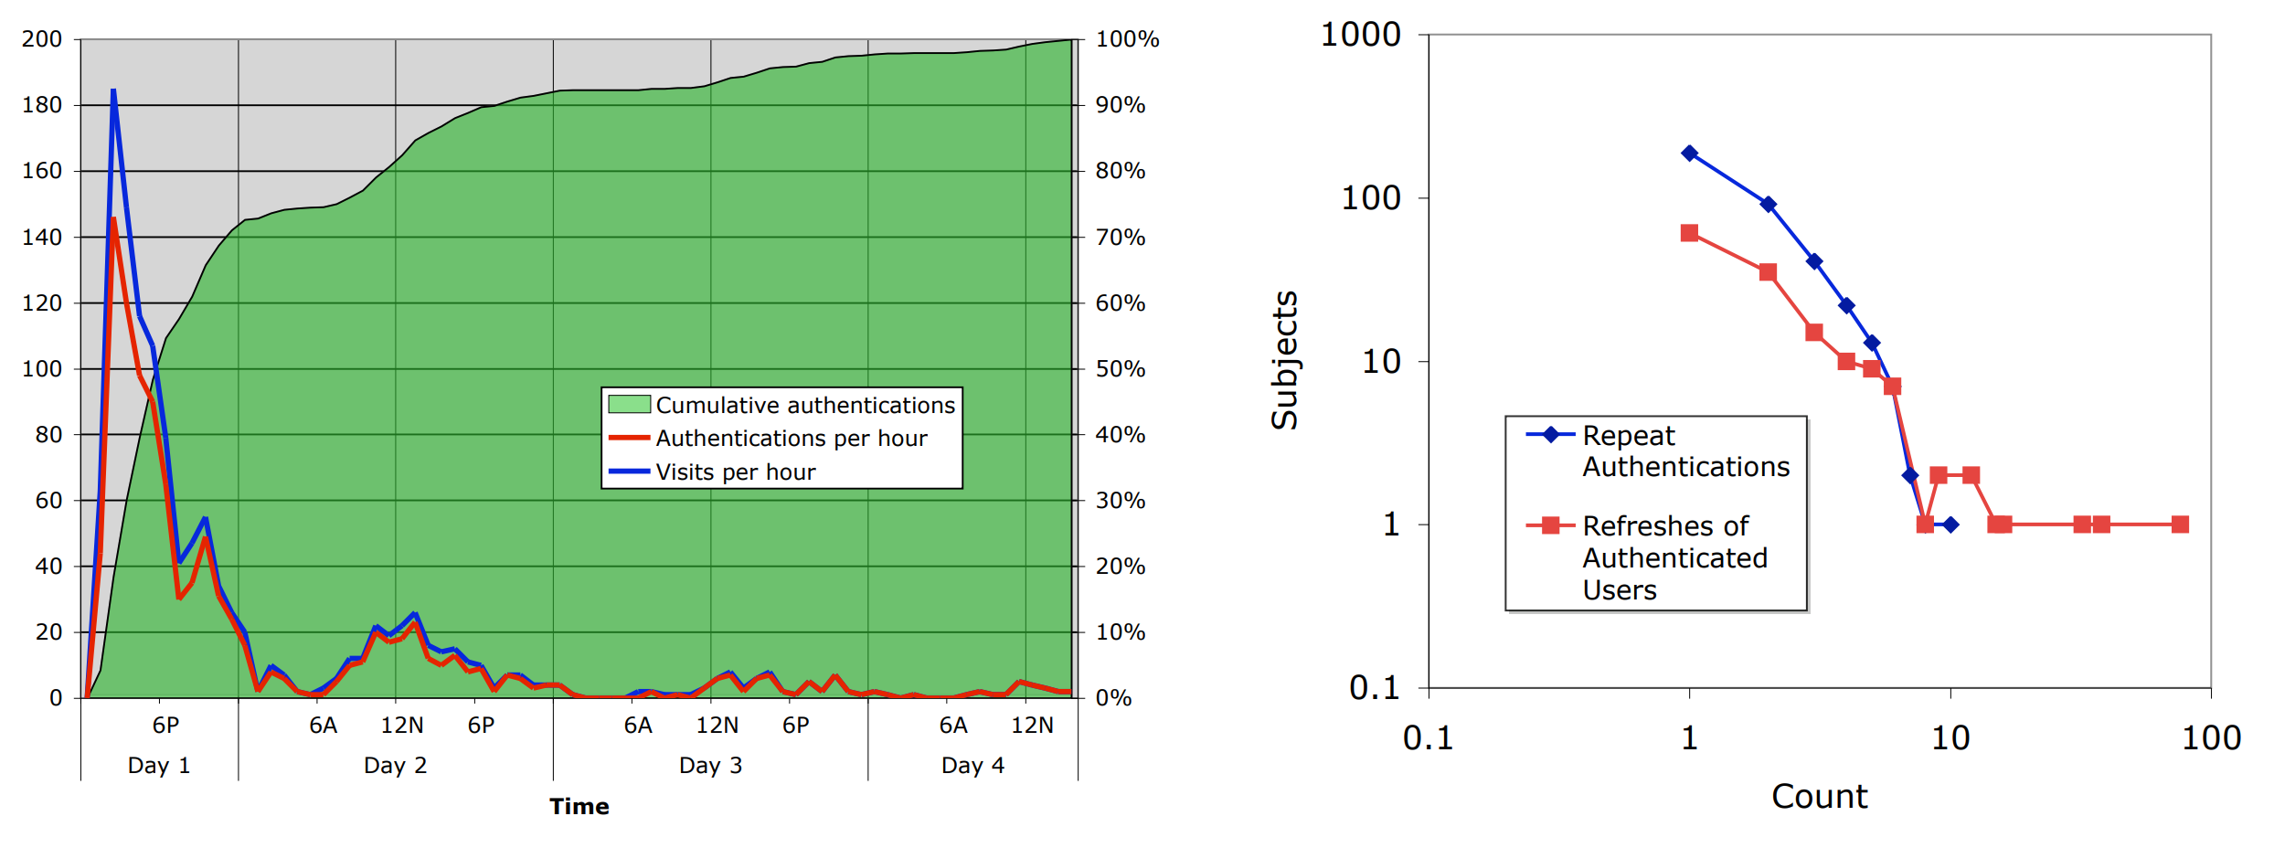
Early takedowns of phishing websites are crucial
Some victims visited and logged in multiple times!

Slide 81
Debriefing
For ethical reasons, deception studies always debrief participants
Explain how and why they have been experimented on
Give them a chance to ask questions, learn, and just vent
Study authors set up a forum for participants to leave comments
440 total comments
Most comments were supportive of the experiment and the learning experience
However, a small number of very vocal complaints

Slide 82
Analysis of Comments
Anger
Called the experiment unethical, inappropriate, illegal, unprofessional, fraudulent, self-serving, and/or useless
Called for the researchers to be fired, prosecuted, expelled, or otherwise reprimanded
Demonstrates the psychological toll phishing attacks can have
Denial
Zero comments included an admission of culpability
Many complaints were posted “on behalf of friends who were phished”
Many people find it hard to admit their vulnerability

Slide 83
Analysis of Comments
Misunderstanding of email
Many subjects were convinced the researchers had hacked their inbox
People don’t understand that email spoofing is easy
Underestimation of privacy risks
Many subjects didn’t know how the researchers new their friends
Others were mad that public information from their Facebook had been used
People severely underestimate the privacy risks of social networking

Slide 84
“Who Falls for Phish? A Demographic Analysis of Phishing Susceptibility and Effectiveness of Interventions”
Steve Sheng, Mandy Holbrook, Ponnurangam Kumaraguru, Lorrie Cranor, Julie Downs
2010
Recruited 1000 people to role play as another person
Look through an inbox and deal with the mail
Possibly receive an educational intervention
Look through a second inbox and deal with it

Slide 85
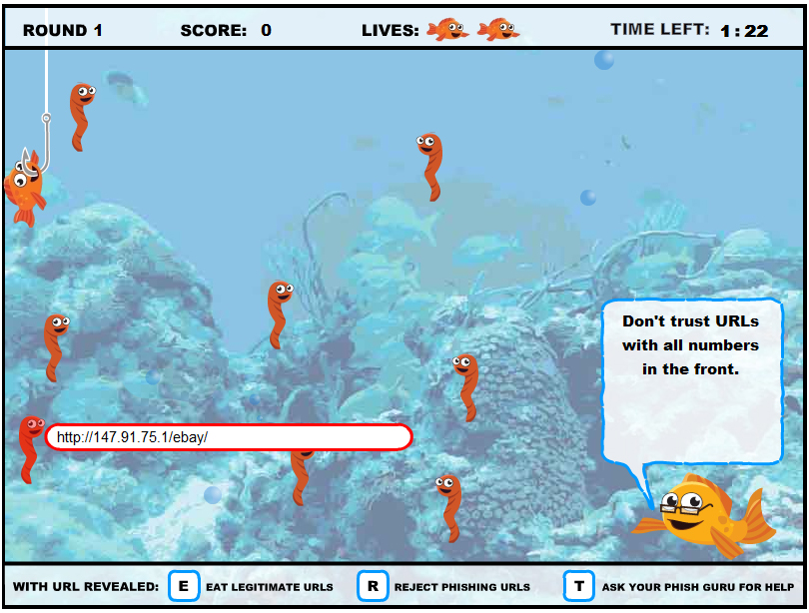

Slide 86
Results
Condition | Falling for phishing attacks |  | Clicking on legit websites
 | 1st role play | 2nd role play | 1st role play | 2nd role play
No training | 50% | 47% | 70% | 74%
Popular training | 46% | 26% | 67% | 61%
Anti-Phishing Phil | 46% | 29% | 73% | 73%
PhishGuru Cartoon | 47% | 31% | 70% | 64%
Phil+PhishGuru | 47% | 26% | 68% | 59%
Before training: 47% of attacks were successful, on average
After training: only 28% were successful on average (40% improvement)
But willingness to click on real links also dropped slightly

Slide 87
Sources
Kevin Mitnick, “Ghost in the Wires: My Adventures as the World’s Most Wanted Hacker”
Christopher Hadnagy, “Social Engineering: The Art of Human Hacking”
Cormac Herley, “Why do Nigerian Scammers Say They are from Nigeria?”, WEIS 2012.
Julie Downs, Mandy Holbrook, and Lorrie Faith Cranor, “Decision Strategies and Susceptibly to Phishing”, CHI 2006.
Tom Jagatic, Nathaniel Johnson, Markus Jakobsson, and Filippo Menczer, “Social Phishing”, Communications of the ACM 2005.
Rachna Dhamija, J. D. Tygar, Marti Hearst, “Why Phishing Works”, CHI 2006

