Slide 1
CY 2550 Foundations of Cybersecurity
Systems Security

Slide 3
Threat Modeling
Threat modeling is the process of systematically identifying the threats faced by a system
Identify things of value that you want to protect
Enumerate the attack surfaces
Hypothesize attackers and map them to
Things of value they want from (1)
Their ability to target vulnerable surfaces from (2)
Survey mitigations
Balance costs versus risks

Slide 4
Identify Things of Value
Sensitive data
Saved passwords
Monetizable credentials (webmail, social networks)
Access to bank accounts, paypal, venmo, credit cards, or other financial services
Pics, messages, address book, browsing/search history (for blackmail)
Sensitive business documents
Privacy/anti-surveillance
Sensors (camera, mic, GPS)
Network traffic
The device itself
Steal it and sell it
Use the CPU and network for other criminal activity

Slide 5
Enumerate Attack Surfaces
Supply chain attacks
Intercept and compromise the handset in transit
Backdoor the OS
Physical attacks
Steal the device and use it
Direct connection via USB
Close proximity radios (Bluetooth, NFC)
Social engineering, e.g. trick the user into installing malicious app(s)
Exploit vulnerabilities in the OS or apps (e.g. email clients, web browsers)
Network attacks
Passive eavesdropping
Active network attacks (e.g. mmonster-in-the-middle, SMS of death)

Slide 6
Cybercriminal
High-level goal: $$$ profit $$$
Immediate goal: running a process on a victim’s computer
Ransomware
Botnet
Spyware
Adware
How to do this?
Infected storage media (e.g. USB keys)
Malicious attachments or downloads
Exploits targeting the OS or common apps
Guess or crack passwords for remote desktop, etc.

Slide 7
Mitigations
Authentication
Physical and remote access is restricted
Access control
Processes cannot read/write any file
Users may not read/write each other’s files arbitrarily
Modifying the OS and installing software requires elevated privileges
Firewall
Unsolicited communications from the internet are blocked
Only authorized processes may send/receive messages from the internet
Anti-virus
All files are scanned to identify and quarantine known malicious code
Logging
All changes to the system are recorded
Sensitive applications may also log their activity in the secure system log

Slide 8
Question: how do you build these mitigations?
In other words, how do you build secure systems?

Slide 9
ISOLATION

Slide 10
Intro to System Architecture

Slide 11
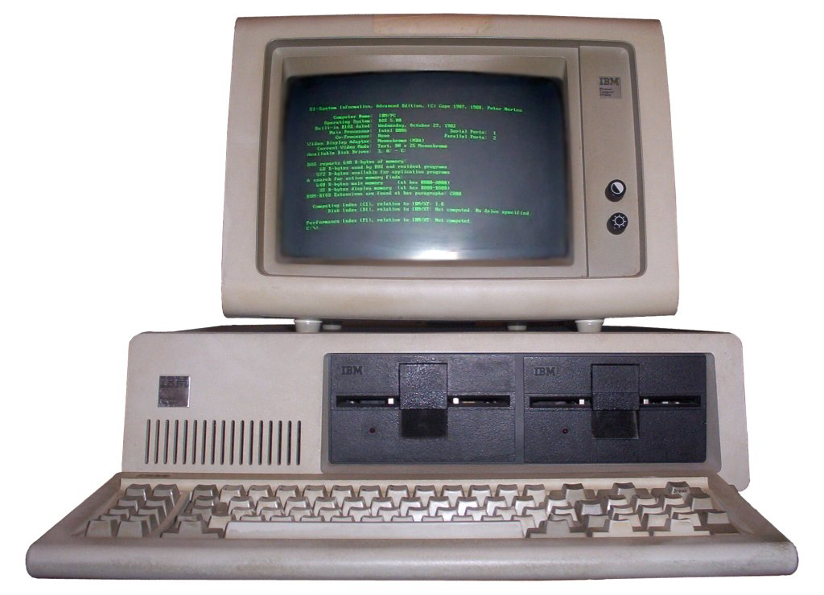

Slide 12
System Model
Ethernet/Wifi
Memory
Hard Drive
128 MB
OS
On bootup, the Operating System (OS) loads itself into memory
DOS or Windows 3.1
Typically places itself in high memory
What is the role of the OS?
Allow the user to run processes
Often comes with a shell
Text shell like bash
Graphical shell like the Windows desktop
Provides APIs to access devices
Offered as a convenience to application developers
open(“file”)
Process 2
Process 1
(Shell)
CPU
0

Slide 13
What is Memory?
Address | Contents
114
113 | 0
112 | 0
111 | 0
110 | 8
109
108 | 0
107 | C
106 | B
105 | A
104
103 | 0xAF
102 | 0x3C
101 | 0x91
100 | 0xE3
Memory is essentially a spreadsheet with a single column
Every row has a number, called an address
Every cell holds 1 byte of data
All data and running code are held in memory
int my_num = 8;
String my_str = “ABC”;
while (my_num > 0) my_num--;
Integers are typically four bytes
Each ASCII character is one byte, Strings are null terminated
CPUs understand instructions in assembly language

Slide 14
Memory Unsafety
Ethernet/Wifi
Memory
Hard Drive
128 MB
OS
Process 1
Problem: any process can read/write any memory
Process 2
I’m reading from your process, stealing your data ;)
0

Slide 15
Memory Unsafety
Ethernet/Wifi
Memory
Hard Drive
128 MB
OS
Infect the OS code with malicious code
Problem: any process can read/write any memory
Scan memory to find usernames, passwords, saved credit card numbers, etc.
0

Slide 16
Controlling the CPU
Consider the following C code:
int foo(int a, int b) { return a * b – a / b; }
The compiler turns this into assembly language, like this:
000004ed <foo>:
4ed: 55 push ebp
4ee: 89 e5 mov ebp,esp
4fa: 8b 45 08 mov eax,DWORD PTR [ebp+0x8]
4fd: 0f af 45 0c imul eax,DWORD PTR [ebp+0xc]
501: 89 c1 mov ecx,eax
503: 8b 45 08 mov eax,DWORD PTR [ebp+0x8]
506: 99 cdq
507: f7 7d 0c idiv DWORD PTR [ebp+0xc]
50a: 29 c1 sub ecx,eax
50c: 89 c8 mov eax,ecx
50e: 5d pop ebp
50f: c3 ret

Slide 17
Accessing Devices
Indirect Access
Direct Access
OS provides APIs for accessing devices
Examples:
int fd = open(“filename”,
O_RDONLY);
int s = socket(PF_INET,
SOCK_STREAM,
IPPROTO_TCP);
CPU provides assembly instructions for accessing devices
Example:
mov eax, 1
mov dx, 0x3F8
start: out dx, al
inc eax
cmp eax, 32
jne start
…
Send data to the device on port 0x3F8

Slide 18
Device Unsafety
Ethernet/Wifi
Memory
Hard Drive
128 MB
OS
Error: no permission to read file
Access control is enforced by the OS, but OS APIs can be bypassed
Problem: any process can access any hardware device directly
Process 1
Read/write/delete files owned by other users or the OS
Process 2
CPU
0

Slide 19
Device Unsafety
Ethernet/Wifi
Memory
Hard Drive
128 MB
OS
Problem: any process can access any hardware device directly
Access control is enforced by the OS, but OS APIs can be bypassed
Send stolen data to the thief, attack other computers, etc.
Read/write/delete any file
CPU
0

Slide 20
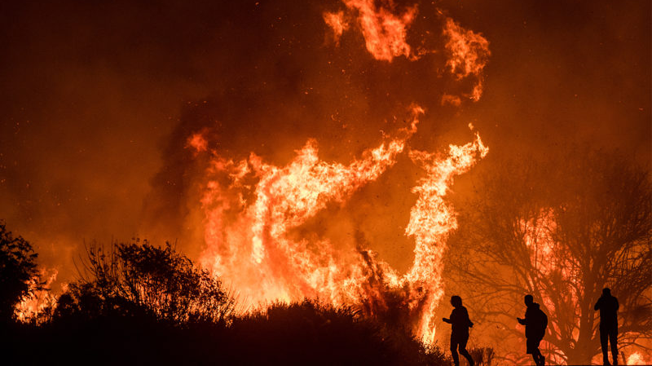
Review
Old systems did not protect memory or devices
Any process could access any memory
Any process could access any device
Problems
No way to enforce access controls on users or devices
Processes can steal from or destroy each other
Processes can modify or destroy the OS
On old computers, systems security was literally impossible

Slide 21
Protected Mode

Slide 23
Towards Modern Architecture
To achieve systems security, we need process isolation
Processes cannot read/write memory arbitrarily
Processes cannot access devices directly
How do we achieve this?
Hardware support for isolation
Protected mode execution (a.k.a. process rings)
Virtual memory

Slide 24
Protected Mode
Most modern CPUs support protected mode
x86 CPUs support four rings with different privileges
Ring 0: Operating System
Code in this ring may directly access any device
May change protection level of the CPU
Ring 1, 2: device drivers
Code in these rings may directly access some devices
May not change the protection level of the CPU
Ring 3: userland
Code in this ring may not directly access devices
All device access must be via OS APIs
May not change the protection level of the CPU
Most OSes only use rings 0 and 3
Ring 3
Ring 2
Ring 1
Ring 0
OS
Device Drivers
Device Drivers
Applications
24

Slide 25
System Boot Sequence
On startup, the CPU starts in 16-bit real mode
Protected mode is disabled
Any process can access any device
BIOS executes, finds and loads the OS
OS switches CPU to 32- or 64-bit protected mode
OS code is now running in Ring 0
OS decides what Ring to place other processes in
Shell gets executed, user may run programs
User processes are placed in Ring 3

Slide 26
Restriction on Privileged Instructions
What CPU instructions are restricted in protected mode?
Any instruction that modifies the CR0 register
Controls whether protected mode is enabled
Any instruction that modifies the CR3 register
Controls the virtual memory configuration
More on this later…
hlt – Halts the CPU
sti/cli – enable and disable interrupts
in/out – directly access hardware devices
If a Ring 3 process tries any of these things, it immediately crashes

Slide 27
Changing Modes
Applications often need to access the OS APIs
Writing files
Displaying things on the screen
Receiving data from the network
etc…
But the OS is Ring 0, and processes are Ring 3
How do processes get access to the OS?
Invoke OS APIs with special assembly instructions
Interrupt: int 0x80
System call: sysenter or syscall
int/sysenter/syscall cause a mode transfer from Ring 3 to Ring 0

Slide 28
Mode Transfer
Application executes trap (int) instruction
EIP, CS, and EFLAGS get pushed onto the stack
Mode switches from ring 3 to ring 0
Save the state of the current process
Push EAX, EBX, …, etc. onto the stack
Locate and execute the correct syscall handler
Restore the state of process
Pop EAX, EBX, … etc.
Place the return value in EAX
Use iret to return to the process
Switches back to the original mode (typically 3)
Userland
Kernel Mode

Slide 29
Protection in Action
Ethernet/Wifi
Memory
Hard Drive
128 MB
OS
Ring 3 = protected mode. No direct device access
Ring 3 = protected mode. Cannot change protection state
Subject to access controls checks, e.g. file permissions and firewalls
Protected mode stops direct access to devices
All device access must go through the OS
OS will impose access control checks
CPU Ring
0
3
0

Slide 30
Virtual Memory

Slide 31
Status Check
Ethernet/Wifi
Memory
4 GB
Hard Drive
OS
Infect the OS code with malicious code
At this point we have protected the devices attached to the system…
… But we have not protected memory
Scan memory to find usernames, passwords, saved credit card numbers, etc.
CPU Ring
3
0

Slide 32
Virtual Memory
Modern CPUs support virtual memory
Creates the illusion that each process runs in its own, empty memory space
Processes can not read/write memory used by other processes
Processes can not read/write memory used by the OS
In other courses, you will learn how virtual memory is implemented
Base and bound registers
Segmentation
Page tables
Today, we will do the cliffnotes version…

Slide 33
Physical
Memory
Virtual Memory
Process 1
Virtual Memory
Process 2
4 GB
4 GB
4 GB
OS
In fact, they are loaded at completely different addresses
Both processes believe they are loaded at the same place in memory
Chrome believes it is the only thing in memory
Skype believes it is the only thing in memory
0
0
0

Slide 34
Virtual Memory
Process 1
Physical
Memory
Page Table
4 GB
Virtual Addr. | Physical Addr.
16732 | 81100
16734 | 81102
16736 | 93568
16738 | 93570
4 GB
OS
Physical Address: 81102
Read Address 16734
CPU
0
0

Slide 35
Virtual Memory Implementation
Each process has its own virtual memory space
Each process has a page table that maps is virtual space into physical space
CPU translates virtual address to physical addresses on-the-fly
OS creates the page table for each process
Installing page tables in the CPU is a protected, Ring 0 instruction
Processes cannot modify their page tables
What happens if a process tries to read/write memory outside its page table?
Segmentation Fault or Page Fault
Process crashes
In other words, no way to escape virtual memory

Slide 36
VM in Action
Ethernet/Wifi
Memory
4 GB
Hard Drive
OS
Memory appears to be empty
Processes can only read/write within their own virtual memory
Processes cannot change their own page tables
Ring 3 = protected mode. Cannot change page table.
CPU Ring
3
Page Table
0

Slide 37
Building Security Systems

Slide 38
Review
At this point, we have achieved process isolation
Protected mode execution prevents direct device access
Virtual memory prevents direct memory access
Requires CPU support
All modern CPUs support these techniques
Requires OS support
OS controls process rings and page tables
All modern OS support these techniques
Warning: bugs in the hardware and OS may compromise process isolation

Slide 39
Towards Secure Systems
Now that we have process isolation, we can build more complex security features
File Access Control
Anti-virus
Firewall
Secure Logging

Slide 40
File Access Control
All disk access is mediated by the OS
OS enforces access controls
Process 1
Process 2
Process 3
OS
Hard Drive

Slide 41
Limitations
Malware can still cause damage
Discretionary access control means that isolation is incomplete
OS
Hard Drive

Slide 42
Anti-virus
Anti-virus process is privileged
Often runs in Ring 0
Scans all files looking for signatures
Each signature uniquely identifies a piece of malware
Files scanned on creation and access
OS
Anti-virus
Hard Drive

Slide 43
Anti-virus
Process 1
Anti-virus process is privileged
Typically runs in Ring 0
Scans all files looking for signatures
Each signature uniquely identifies a piece of malware
Files scanned on creation and access
OS
Anti-virus
Hard Drive

Slide 44
Signature-based Detection
Key idea: identify invariants that correspond to malicious code or data
List of code and data snippets that are unique to known malware
Problems with signatures
Must be updated frequently
May cause false positives
Accidental overlaps with good programs and benign network traffic

Slide 45
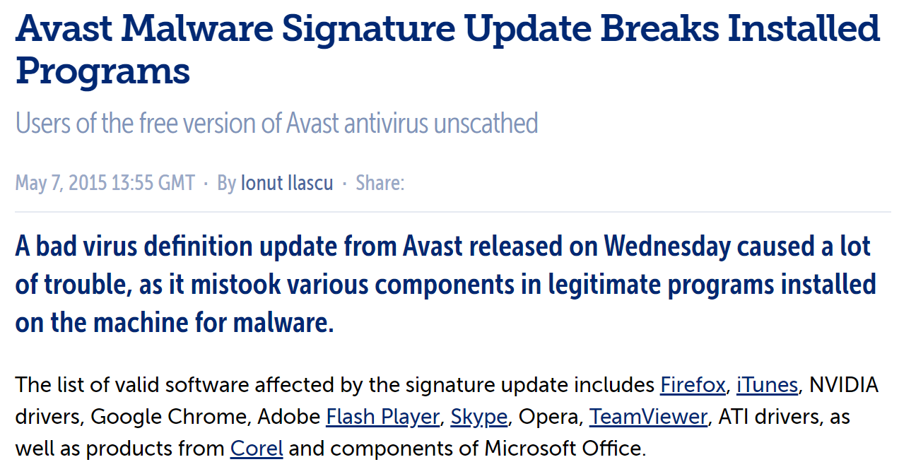

Slide 46
Signature-based Detection
Key idea: identify invariants that correspond to malicious code or data
Example – anti-virus signatures
List of code snippets that are unique to known malware
Problems with signatures
Must be updated frequently
May cause false positives
Accidental overlaps with good programs and benign network traffic
Attacks try to avoid detection by anti-virus signatures
Polymorphism – viral code mutates after each infection
Packing – viral code is encrypted using unique keys for each infection

Slide 47
Avoiding Anti-virus
Malware authors go to great length to avoid detection by AV
Polymorphism
Viral code mutates after every infection
b = a + 10
b = a + 5 + 5
b = (2 * a + 20) / 2
Packing
Malware code is encrypted, key is changed every infection
Decryption code is vulnerable to signature construction
Polymorphism may be used to mutate the decryption code

Slide 48
Firewall
Firewall process is privileged
Often runs in Ring 0
Selectively blocks network traffic
By process
By port
By IP address
By packet content
Inspects outgoing and incoming network traffic
OS
Firewall
Ethernet/Wifi

Slide 49
Network Intrusion Detection Systems
NIDS for short
Snort
Open-source intrusion prevention system capable of real-time traffic analysis and packet logging
Identifies malicious network traffic using signatures
Bro
Open-source network monitoring, analysis, and logging framework
Can be used to implement signature-based detection
Capable of more complex analysis

Slide 50
Insecure Logging
Suppose Process 1 writes information to a log file
Malware can still destroy the log
Add or remove entries
Add fake entries
Delete the whole log
Process 1
OS
Hard Drive

Slide 51
Secure Logging
OS maintains a system log
Processes may write entries to the log using an OS API
Processes may not delete entries or the log
Process 1
Process 3
OS
Hard Drive

Slide 52
Principles

Slide 53
Security Principles
At this point, we’ve explored the basics of secure systems architecture
Device and memory isolation
Basis for all higher-level functionality
But designing secure systems (and breaking them) remains an art
Security principles help bridge the gap between art and science
Developed by Saltzer and Schroeder
“The Protection of Information in Computer Systems”, 1975

Slide 54
Defense in Depth
High walls
Don't depend on a single protection mechanism, since they are apt to fail
Even very simple or formally verified defenses fail
Layering defenses increases the difficulty for attackers
Defenses should be complementary!
Drawbridge
Dude with a crossbow
Moat

Slide 55
Example
Built-in security features of Windows 10
Secure boot: cryptographically verified bootup process
Bitlocker full-drive encryption
Kernel protections, e.g. Address Space Layout Randomization (ASLR)
Cryptographic signing for device drivers
User authentication
User Account Control: permission check for privileged operations
Anti-virus and anti-malware
Firewall
Automated patching
System logs

Slide 56
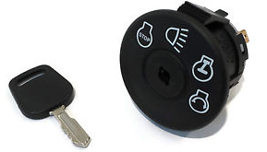
Fail-safe Defaults
The absence of explicit permission is equivalent to no permission
Systems should be secure "out-of-the-box"
Most users stick with defaults
Users should "opt-in" to less-secure configurations
Examples. By default…
New user accounts do not have admin or root privileges
New apps cannot access sensitive devices
Passwords must be >8 characters long
Etc.

Slide 57
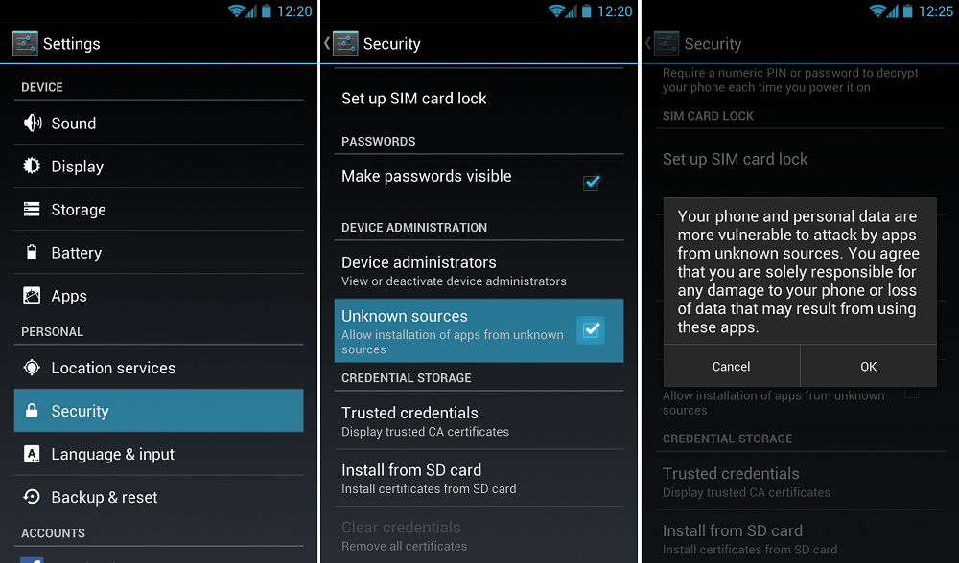

Slide 58
Separation of Privilege
Privilege, or authority, should only be distributed to subjects that require it
Not all system components require access to everything
Users may only access their own home directories
Web server needs access to HTML files, but nothing else

Slide 59
Least Privilege
Subjects should possess only that authority that is required to operate successfully
Closely related to separation of privilege
Not only should privilege be separated, but subjects should have the least amount necessary to perform a task
Not every user needs root access
Most applications do not write access to system directories
Vulnerable apps (e.g., web browsers) should have as little privilege as possible

Slide 60
Privilege Over Time
Win NT, XP, 7, 8, 10
Linux, BSD, OSX
DOS, Windows 3.1
Win 95 and 98
All users and processes
OS
Users and Processes with System Privileges
OS
Users and Processes with System Privileges
Users and Processes
Unprivileged Processes

Slide 61
Privilege Hierarchy
OS
Users and Processes with System Privileges
Users and Processes
Unprivileged Processes
Device drivers, kernel modules, etc.
Ring 0
sudo, “administrator” accounts, OS services
Everything that is isolated and subject to access control
Ring 3
chroot jails, containers, low-integrity processes

Slide 62
Example: Chrome Multiprocess Architecture
Chrome is split across many processes
“Core” process has user-level privileges
May read/write files
May access the network
May render to screen
Each tab, extension, and plugin has its own process
Parse HTML, CSS, JS
Execute JS
Large attack surface!
Thus, have no privileges
All I/O requests are sent to the core process

Slide 63
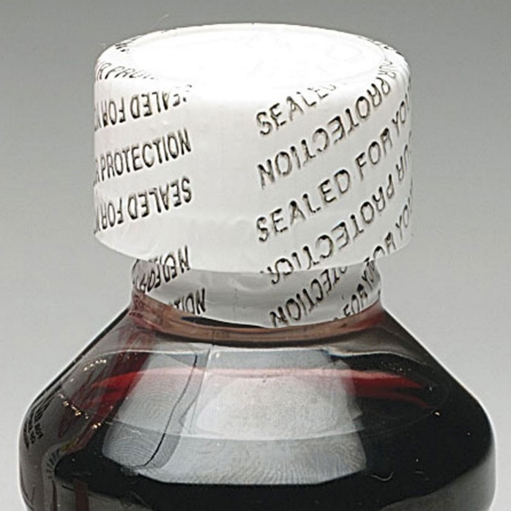
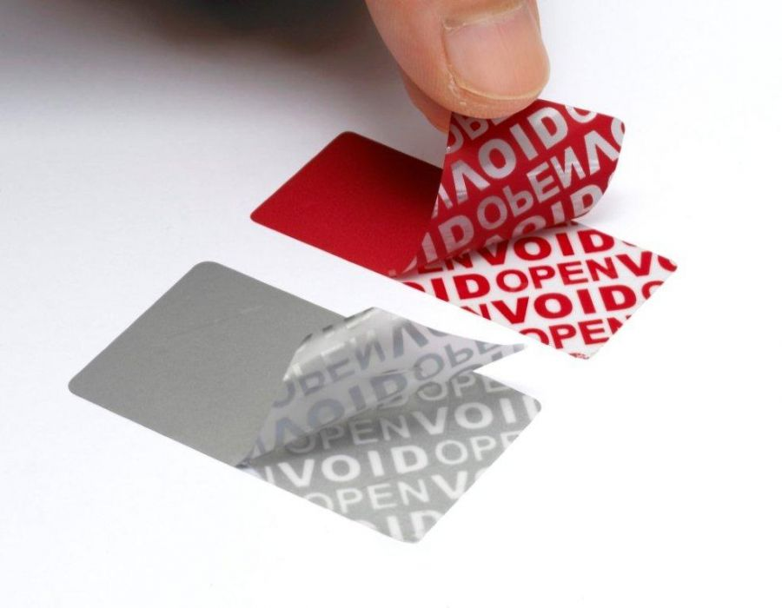
Compromise Recording
Concede that attacks will occur, but record the fact
Auditing approach to security
Detection and recovery
"Tamper-evident" vs. "tamper-proof"

Slide 64
Logging
Log everything
Better yet, use remote logging
Ensures that attacker with local access cannot erase logs
Logs are useless if they aren’t monitored
Advanced approaches
Intrusion Detection Systems (IDS)
Anomaly detection
Machine learning-based approaches

Slide 65
Work Factor
Increase the difficulty of mounting attacks
Sometimes utilizes non-determinism
e.g. increasing entropy used in ASLR
Sometimes utilizes time
Increase the lengths of keys
Wait times after failed password attempts

Slide 66
bcrypt Example
Python example; install the bcrypt package
[cbw@localhost ~] python
>>> import bcrypt
>>> password = “my super secret password”
>>> fast_hashed = bcrypt.hashpw(password, bcrypt.gensalt(0))
>>> slow_hashed = bcrypt.hashpw(password, bcrypt.gensalt(12))
>>> pw_from_user = raw_input(“Enter your password:”)
>>> if bcrypt.hashpw(pw_from_user, slow_hashed) == slow_hashed:
… print “It matches! You may enter the system”
… else:
… print “No match. You may not proceed”
Work factor

Slide 67
Authentication Rate Limiting
Short delay after each failed authentication attempt
Delays may increase as the consecutive failed attempts increase
Does not prevent password cracking attempts, but slows them down

Slide 68
Open Design
Kerckhoff's Principle: A cryptosystem should be secure even if everything about the system, except the key, is public knowledge
Generalization: A system should be secure even if the adversary knows everything about its design
Design does not include runtime parameters like secret keys
Contrast with “security through obscurity”

Slide 69
Economy of Mechanism
Would you depend on a defense system designed like this?

Slide 70
Economy of Mechanism
Simplicity of design implies a smaller attack surface
Correctness of protection mechanisms is critical
"Who watches the watcher?"
We need to be able to trust our security mechanisms
(Or at least quantify their efficacy)
Essentially the KISS principle
Keep it simple, stupid

Slide 71
Monolithic vs. Micro Kernels
Existing operating systems are monolithic
Kernel contains all critical functionality
Process and memory management, file systems, network stack, etc…
Micro-kernel OS
Kernel only contains critical functionality
Direct access to hardware resources
Process and memory management
Small attack surface
All other functionality runs in separate processes
File systems, network stack, device drivers
Examples
GNU Hurd
seL4 – formally verified!

Slide 72
Complete Mediation

Slide 73
Complete Mediation
Every access to every object must be checked for authorization
Incomplete mediation implies that a path exists to bypass a security mechanism
In other words, isolation is incomplete

Slide 74
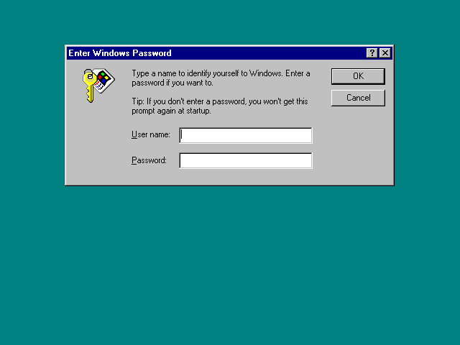
By default, user could click Cancel to bypass the password check :(

Slide 75
