Slide 1
CY 2550 Foundations of Cybersecurity
Web Privacy

Slide 2
Web Security
Attacks that violate authenticity, confidentiality, integrity of web applications
E.g., implemented using XSS, Cross Site Request Forgery, and SQL injection
What about privacy?
Attacks may result in data breaches and account compromise
Web privacy goes beyond what is exposed by web security violations

Slide 3
What is Privacy?
The ability to restrict access to intimate or sensitive information
Frames privacy in terms of control
Loss of autonomy over your information
Intrusions into spaces deemed personal or sensitive
Frames privacy in terms of trespass
E.g., the “peeping tom” who peers in your window
Based on a separation between public and privacy spaces

Slide 4
Privacy on the Web
Perception that you are in control
You choose what pages to visit
You choose whether to sign up for accounts with services
Perception that you are in a private space
Your computer, possibly browsing from within your home
Both perceptions are false
Your actions on the web are visible to a variety of third-parties
You have limited-to-no ability to control who records your actions on the web

Slide 5
Tracking
Websites (and apps) routinely track their users
What you do, where you go, what you search for, what you buy
This data is monetized to target advertising
Thousands of companies are involved
Able to observe >90% of all the actions you take on the web
Mitigations to protect privacy exist, but are imperfect
“Simple” mitigations are not entirely effective
Hard-core mitigations break many websites, make browsing painful

Slide 6
Online Advertising

Slide 7
Content (First Party)
Advertisements (Third Party)
Social Widgets
(Third Party)

Slide 8
The Cost of the “Free” Web
The Web has allowed free, convenient services to proliferate
Google, Gmail, Android, Chrome
Facebook, Instagram
News and journalism
Millions of smartphone apps
Who pays for the costs of all these services?
Advertisers

Slide 9
Surveillance Capitalism
Google - $46B in revenue in Q4 2019, >$1 trillion market cap
Facebook - $21B in revenue in Q4 2019
Total money spent on digital ads - $333B in 2019
Roughly half of all spending on ads globally
Why is online advertising worth so much money?
Data

Slide 10
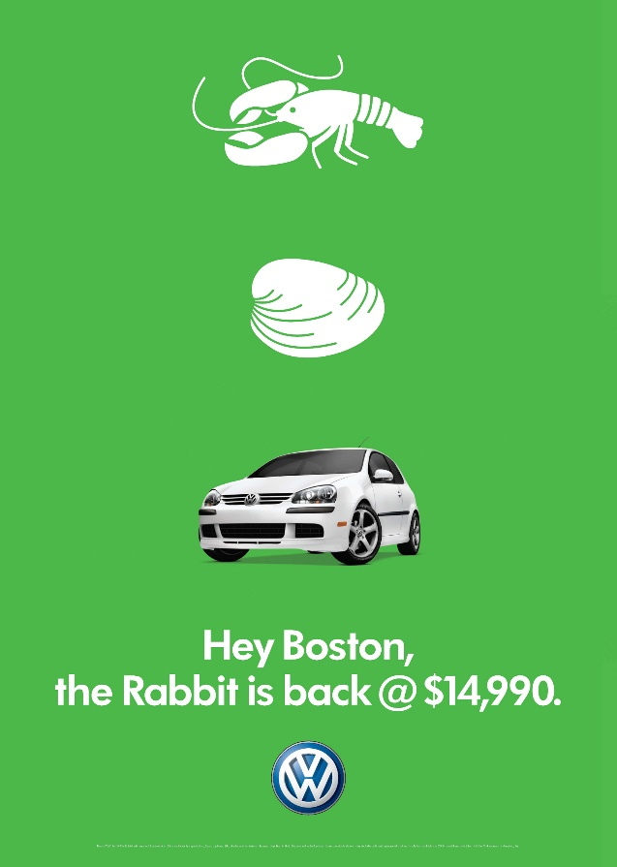
Advertising on the Web
Pre-web advertising → Branding
Web advertising → Targeting

Slide 11
"I have come to believe that advertising is the original sin of the web"
Ethan Zuckerman, inventor of the pop-up ad and former Director of the MIT Center for Civic Media

Slide 12
“If you are not paying for it, you're not the customer; you're the product being sold”
blue_beetle/Andrew Lewis

Slide 14
Who Tracks You
Online advertising companies
Google is the largest tracker by far
Online data brokers
Experian, Equifax
Axciom
Offline data brokers
Datalogix
Rubicon, OpenX, Media Math, Appnexus, AOL, Amazon…
Oracle Datacloud, formerly Bluekai

Slide 15
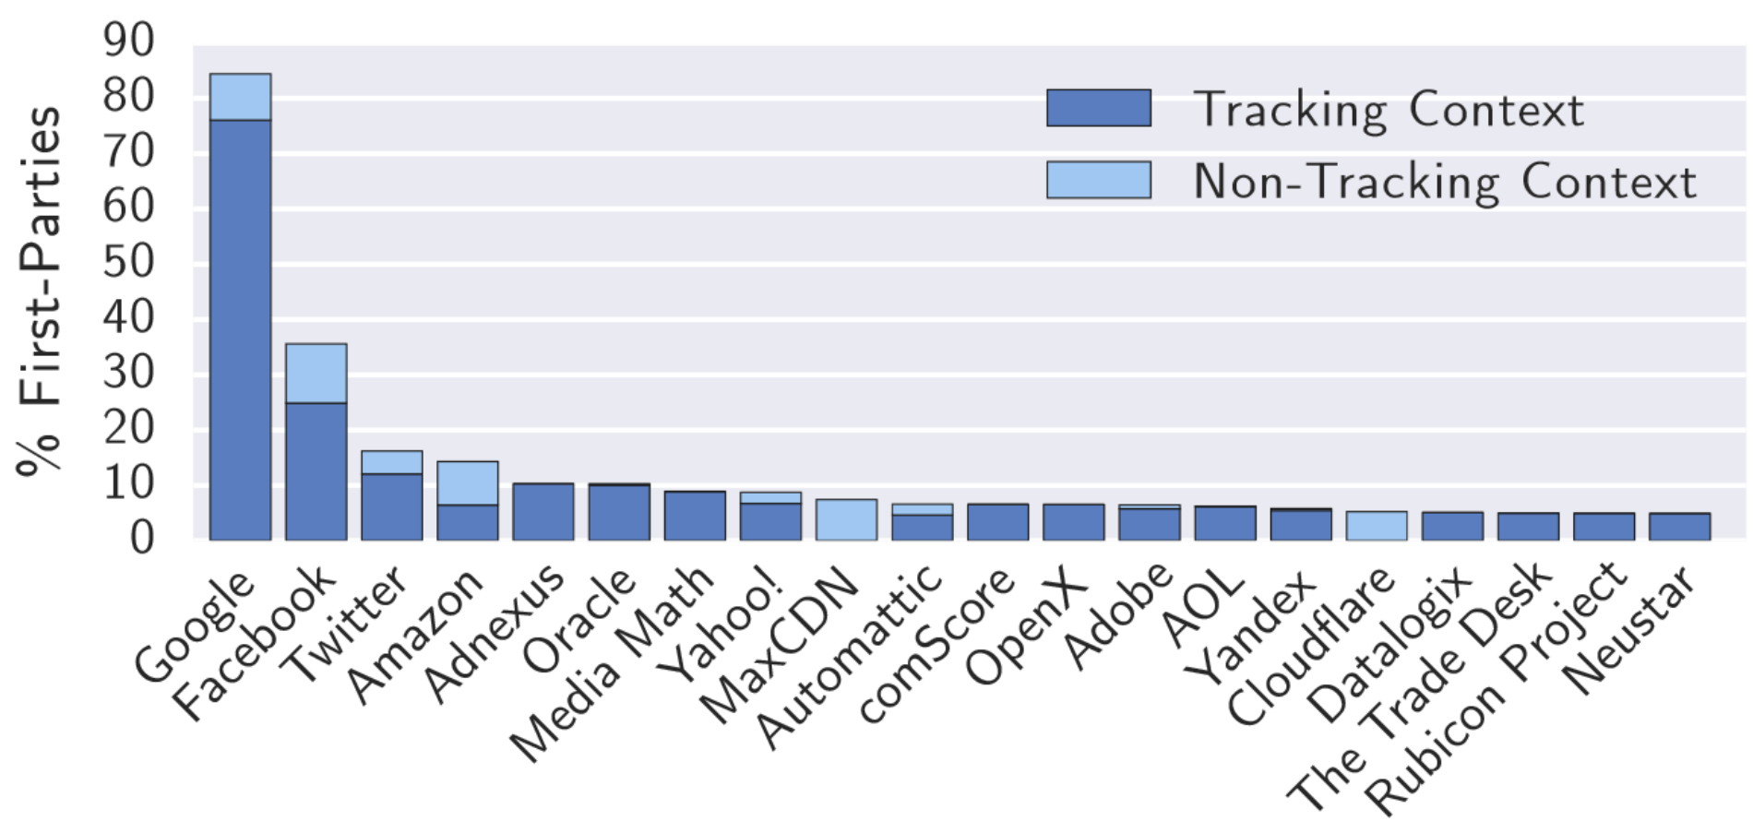
Prevalence of Trackers
Based on visits to the top 1 million websites, circa 2016
https://www.cs.princeton.edu/~arvindn/publications/OpenWPM_1_million_site_tracking_measurement.pdf

Slide 16
Stateful Tracking

Slide 17
Hundreds of third-parties may observe you when you visit a website
But a single observation of an individual isn’t useful
How do third-parties track your browser across websites and pages?
Stateful Identifiers
Stateless Fingerprints
IP address
Cookies
Locally Shared Objects (LSOs)
E-Tags
JavaScript LocalStorage
Etc.
Browser and OS version
Fonts
JavaScript API availability
Plugins and extensions
HTML5 Canvas
Audio and Battery

Slide 18
IP Address Tracking
IP address is the most basic mechanism for tracking on the Internet
Everybody must have an IP address
Every packet you send contains your IP address
Your IP address remains relatively constant over time
However, IP address is not as useful as it once was. Why?
NATs are ubiquitous; multiple people behind a single IP
Cell networks employ many layers of NATs and proxies
Users split their time across multiple devices with separate IPs

Slide 19
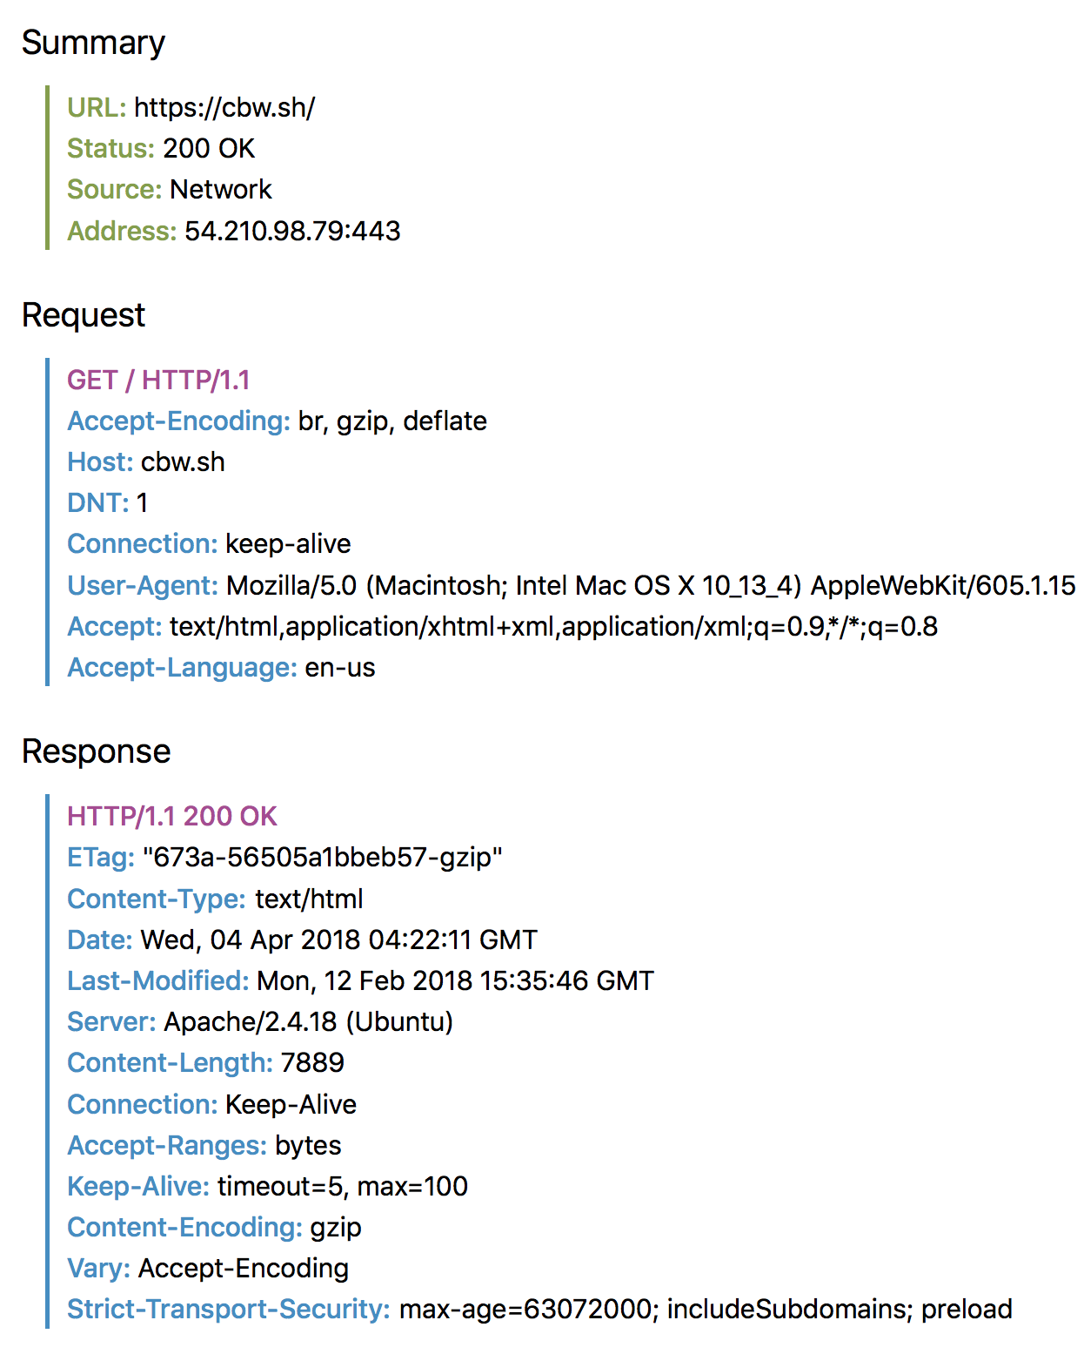
Fetching A Web Page

Slide 20
Web Pages
4 total objects:
1 HTML,
1 JavaScript,
2 images
http://www.example.com/
<html>
<head>
<title>Hello World</title>
<script src=“../jquery.js”></script>
</head>
<body>
<h1>Hello World</h1>
<img src=“/img/my_face.jpg"></img>
<p>
I am 12 and what is
<a href="wierd_thing.html">this</a>?
</p>
<img src=“http://www.images.com/cat.jpg"/>
</body>
</html>
Multiple objects per page
E.g., each image, JS, CSS, etc. downloaded separately
Single page can have 100s of HTTP transactions!
Objects can come from first-party and third-parties

Slide 21
Cookies
Introduced in 1994, cookies are a basic mechanism for persistent state
Allows services to store a small amount of data at the client (usually ~4K)
Meant to be used for authentication
But may also be used for user tracking
Every cookie is associated with the domain that set it

Slide 22
Login Cookie Example
User
Cookie Jar
facebook.com session=S3if7&gb
GET /profile.html
Error: you must login
POST /login.html username:password
200 Success
GET /profile.html
200 Success <html>…</html>
GET /friend.html&name=Christo

Slide 23
Tracking Cookie Example
History for id=wU!1d7Pb
User
Nike
CNN
Cookie Jar
nike.com id=E1j5&VTQ
doubleclick.com id=wU!1d7Pb
cnn.com id=f2N0@2fj

Slide 24
Locally Shared Objects (LSOs)
Flash Cookies
Used by Flash player to store information
They do not expire
Domain can only read data that it has stored
How can an advertiser use this information?
They can re-generate your profile by storing cookie in Flash storage
Other similar plugins
Microsoft Silverlight, Java

Slide 25
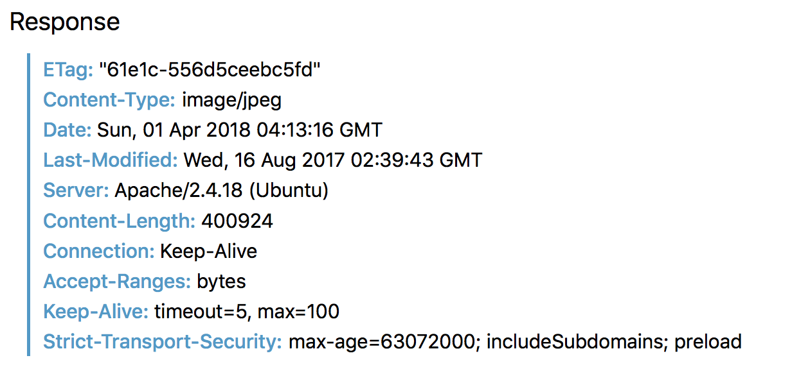
Cache Based Tracking (E-Tags)
Fetching static content repeatedly is slow and expensive
Caching — Saves bandwidth
GET /pixel.jpeg HTTP/1.1 E-Tag=61e1c-556d5ceebc5fd
GET /pixel.jpeg HTTP/1.1
200 OK
304 Not Modified
Cache
pixel.jpeg=61e1c-556d5ceebc5fd
Advertisers can embed 1x1 tracking pixels on the page
Your browser downloads them and stores the associated E-Tag
E-Tag is unique to your browser

Slide 26
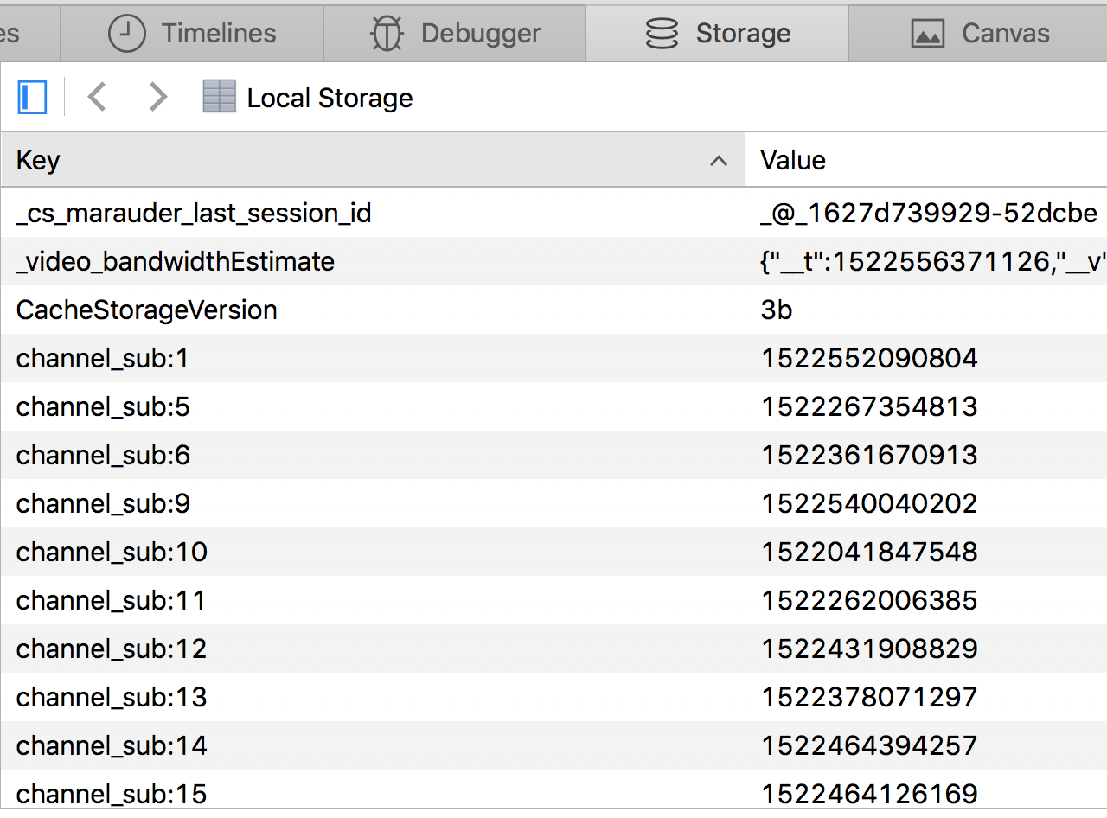
Local Storage
Developers sometime want to store some state in the browser
JavaScript in HTML5 provides access to key-value local storage
localStorage.setItem(‘name’, ‘christo’)
var name = localStorage.getItem(‘name’)
localStorage.removeItem(‘name’)
Advertisers can set cookie in local storage

Slide 27
Evercookies
Key idea: trackers will set their unique identifier in all available stateful storage locations
Cookie, E-Tag, LSOs, LocalStorage, IndexDB, etc.
Deleting any one of these identifiers is insufficient
Tracker will regenerate any missing values from the others
Ridding your browser of tracking identifiers is very hard

Slide 28
Stateless Tracking

Slide 29
Dozens of third-parties may observe you when you visit a website
But a single observation of an individual isn’t useful
How do third-parties track your browser across websites and pages?
Stateful Identifiers
Stateless Fingerprints
IP address
Cookies
Locally Shared Objects (LSOs)
E-Tags
JavaScript LocalStorage
Etc.
Browser and OS version
Fonts
JavaScript API availability
Plugins and extensions
HTML5 Canvas
Audio and Battery

Slide 30
Your Browser is Unique
GET / HTTP/1.1
Host: www.google.com
Connection: keep-alive
Cache-Control: max-age=0
Accept: text/html
User-Agent: Mozilla/5.0 (Windows NT 6.3; Win64; x64) AppleWebKit/537.36 (KHTML, like Gecko) Chrome/42.0.2311.68 Safari/537.36
Accept-Encoding: gzip,deflate,sdch
Accept-Language: en-US,en;q=0.8
Cookie: _session=aAB4m3rf8weG224

Slide 31
Fingerprinting
Cookies rely on storing a unique identifier in your browser
Cookies can be deleted
Incognito/private browsing mode removes pre-existing cookies
Fingerprinting relies on the intrinsic characteristics of your computer and browser
Fingerprint = cryptographic hash of high-entropy characteristics that can be read from within the browser
Combination of characteristics can uniquely identify your browser with high probability

Slide 32
High-entropy Browser Characteristics
HTTP request header values, e.g., browser and OS version
Order of HTTP headers
System clock and time zone
Supported language(s)
Fonts
Plugins and extensions + version information
Screen resolution and color depth
Availability of specific JavaScript APIs
Reveal browser vendor, version, and platform
Hardware-level characteristics like CPU ID and frequency (MHz)

Slide 33
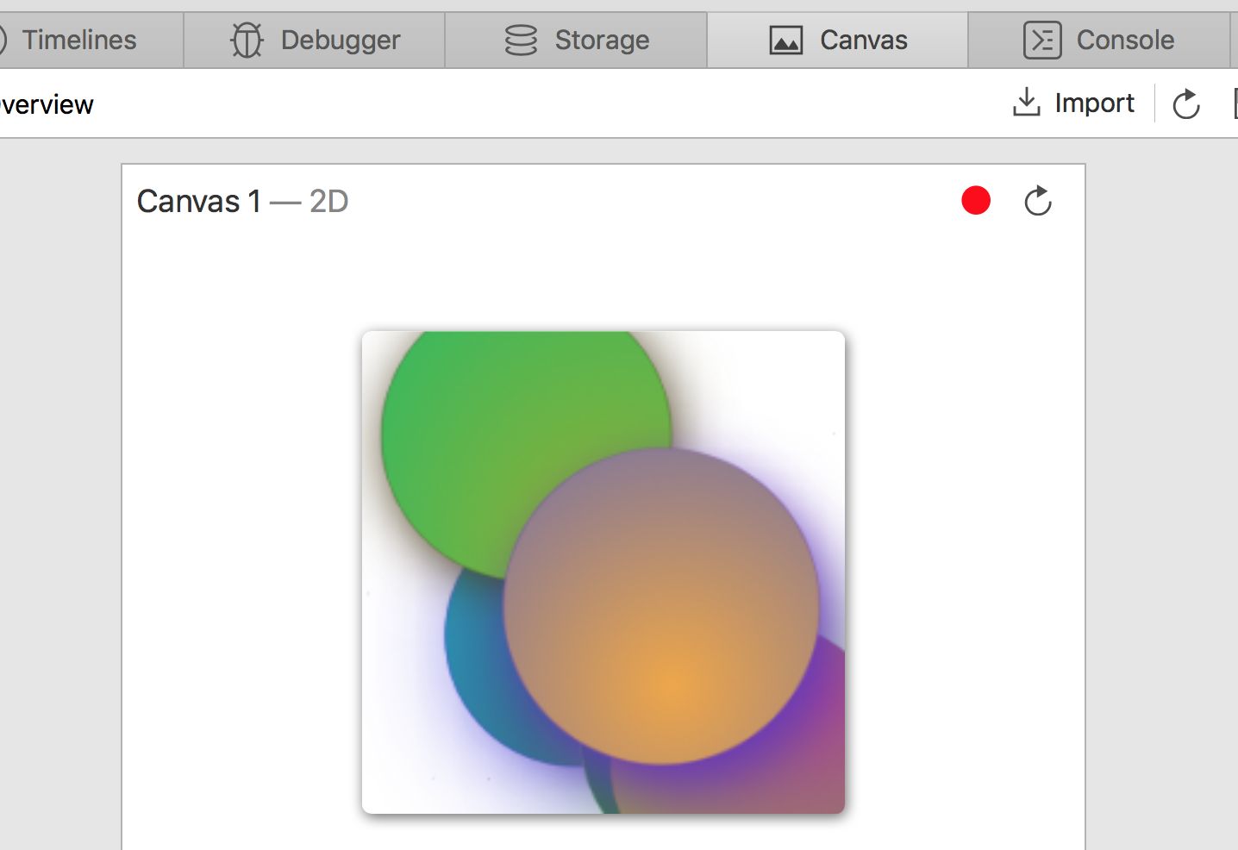
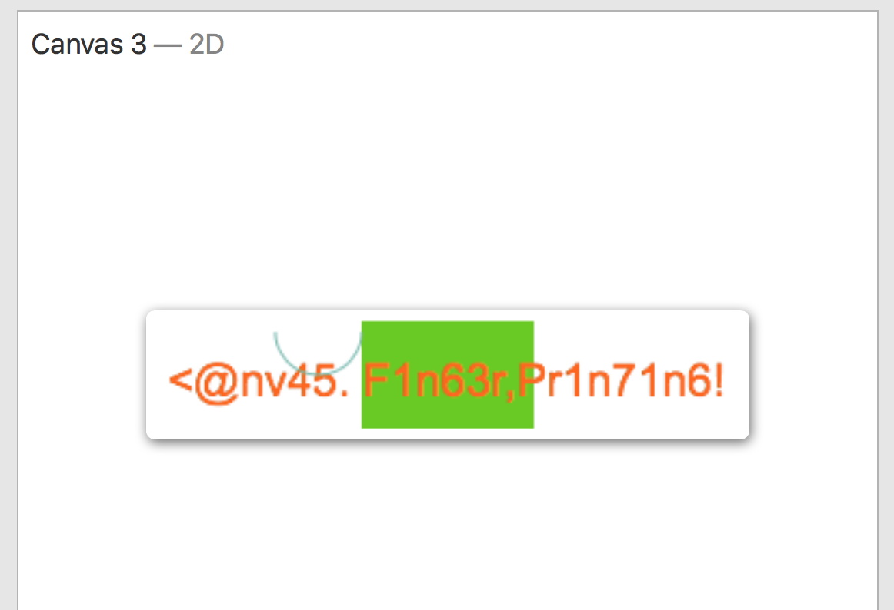
Canvas Fingerprinting
Browser’s Canvas API allows rendering of custom shapes, images, and fonts
Rendered output is not “pixel perfect”
Slight variations based on OS and hardware
E.g., GPU a driver for 3D graphics
Canvas objects are thus sources of entropy

Slide 34
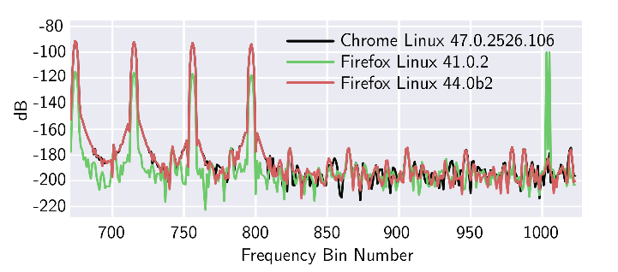
Audio and Battery
Use JavaScript AudioContext and OscillatorNode APIs to fingerprint the device.
Like canvas fingerprinting
Process an audio signal for fingerprinting
Battery Status API can be leveraged for fingerprinting as well.
Mozilla removed it from Firefox

Slide 35
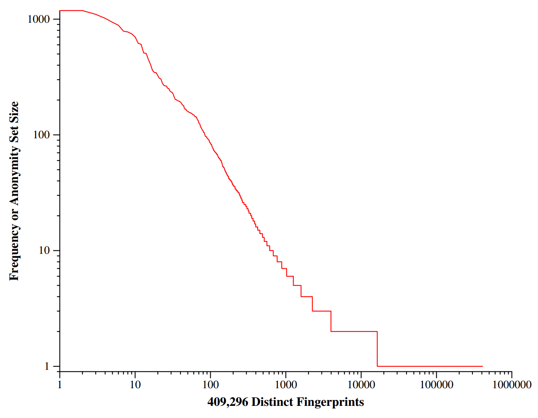
83.6% of users have a unique fingerprint

Slide 36
Real-Time Bidding and Cookie Matching

Slide 37
How Do Ads Get Served?
User
Publisher
Ad Network
Advertiser
GET, CNN’s Cookie
<html>
GET, DoubleClick’s Cookie
301 Redirect
Advertisement
GET, Criteo’s Cookie
Advertisement

Slide 38
Real Time Bidding (RTB)
Supply-Side
Platform (SSP)
Demand-Side
Platforms (DSPs)
User
Publisher
Ad Exchange
GET, CNN’s Cookie
DSPs cannot read their cookie!
How can they bid if they cannot identify the user?
GET, Rubicon’s Cookie
GET, DoubleClick’s Cookie
Solicit bids, DoubleClick’s Cookie
Bid
GET, RightMedia’s Cookie
Advertisement

Slide 39
Cookie Matching
Key problem: DSPs cannot read their cookies in the RTB auction
How can they submit reasonable bids if they cannot identify the user?
Solution: cookie matching
Also known as cookie syncing
Process of linking the identifiers used by two ad exchanges
GET, Cookie=12345
301 Redirect, Location=http://criteo.com/?dblclk_id=12345
GET ?dblclk_id=12345, Cookie=ABCDE
Partner | Partner ID | My ID
Doubleclick | 12345 | ABCDE

Slide 40
Real Time Bidding (RTB)
Supply-Side
Platform (SSP)
Demand-Side
Platforms (DSPs)
User
Publisher
Ad Exchange
Ptnr ID | My ID
12345 | ABCDE
GET, CNN’s Cookie
Ptnr ID | My ID
12345 | H&J!D
GET, Rubicon’s Cookie
GET, DoubleClick’s Cookie
Solicit bids, DoubleClick’s Cookie
Bid
GET, RightMedia’s Cookie
Advertisement

Slide 41
Your Privacy Footprint
Cookie matching

Slide 42
What Goes On Out of Sight
Ad Exchange/Ad Platform | # of Partners/Bidders
Doubleclick | 398
Google Ad Services | 380
Appnexus | 293
Rubicon Project | 191
Media Math | 182
OpenX | 170
Pubmatic | 157
Casale Media | 136
Yahoo | 124
What is visible from within your browser
Invisible third-parties that get to observe your browsing history

Slide 43
Impact of RTB on Privacy
Top 10 domains and the % of impressions they observe
Domain | w/o RTB
Doubleclick | 90%
Criteo | 90%
Quantcast | 90%
Google Syndication | 89%
Flashtalking | 89%
Mediaforge | 89%
Adsrvr | 89%
Dotomi | 89%
Steel House Media | 89%
Adroll | 89%
Domain | w/ RTB
Google Analytics | 97%
Quantcast | 97%
Scorecard Search | 97%
Youtube | 96%
Skim Resources | 96%
Twitter | 96%
Pinterest | 96%
Criteo | 96%
Add This | 96%
Serving | 96%
https://cbw.sh/static/pdf/bashir-pets18.pdf

Slide 44
Prevention and Mitigation

Slide 45
Basic Mitigation Tactics
Incognito/private browsing
Cookies are deleted within the private window
Does not defeat fingerprinting
If you log-in (e.g., to Google), you are reidentified
Virtual Private Network (VPN)
Hides your true IP address, protects your physical location
Cookies and fingerprinting still work
Pick a more secure browser
Firefox, Safari, and Brave all block trackers and fingerprinting by default
Warning: not as strong as dedicated blocking tools

Slide 46
Clearing Stateful Trackers
What if users periodically delete cookies?
Doesn’t help much :(
Flash cookies, LocalStorage, Cache
These need to be deleted as well
Fingerprinting is still an issue!

Slide 47
Ad & Tracker Blocking
Blocking extensions are becoming more popular.
Roughly 37% users have AdBlock Plus
By default allow-lists some ad networks (Acceptable ads)
What’s the downside of using these extensions?
Eliminate or reduce revenue for publishers
Trade-off between your privacy and publisher revenue
Some extensions just block tracking and not ads — e.g., Ghostery, Disconnect

Slide 48
Ad & Tracker Blocking
DoubleClick
OpenX PubMatic

Slide 49
Browser Extensions
Many browser extensions are available that block trackers and advertisers
Adblock Plus – most popular
Warning: advertisers can pay to be added to an allow-list, bypass blocking
Disconnect, Ghostery, Privacy Badger – block trackers
Do not block advertisers (who, unfortunately, are also trackers)
uBlock Origin – the best by far
Pro-tip: go into the settings and enable all the additional block lists
uMatrix – for the truly paranoid
Extremely powerful web firewall, but hard to use

Slide 50
Efficacy of Blocking Extensions
Top 10 domains and the % of impressions they observe
Domain | No Blocking | With Ghostery | With Disconnect | With uBlock
Google Analytics | 97.2 | 83.1 | 45.2 | ~0
Quantcast | 96.5 | 76.1 | 45.8 | ~0
Scorecard Search | 96.5 | 76.1 | 45.8 | ~0
Youtube | 96.3 | 77.4 | 45.28 | ~0
Skim Resources | 96.3 | 74.7 | 45.2 | ~0
Twitter | 95.7 | 76.1 | 45.6 | ~0
Pinterest | 95.7 | 76.1 | 45.2 | ~0
Criteo | 95.6 | 75.0 | 45.7 | ~0
Add This | 95.6 | 73.5 | 45.3 | ~0
Serving | 95.6 | 76.1 | 45.8 | ~0
Adblock Plus is similar to ‘No Blocking’ because of the Acceptable Ads whitelist
https://cbw.sh/static/pdf/bashir-pets18.pdf

Slide 51
Avoiding Fingerprinting
Firefox and Brave now attempt to block fingerprinting by default
Leverages a deny-list, coverage will never be perfect
Use Tor Browser
Disables JavaScript, and Internet will be slow
Disable JavaScript
Will probably break the functionality on many web pages
Use uMatrix extension.
You’ll have to manually disable JS from particular domains
uMatrix can also help with randomizing User-Agent

Slide 52
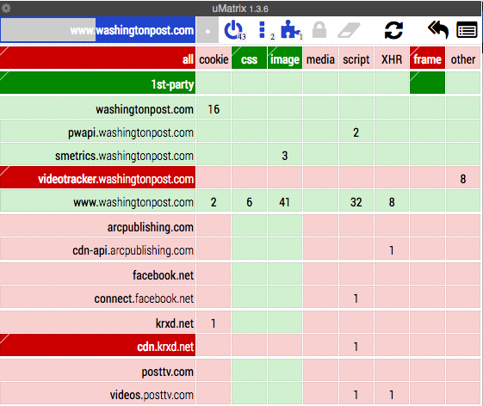
uMatrix UI is Complicated

Slide 53
Defense In Depth
Layer multiple protections for the best results!

Slide 54
Online Privacy Regulation

Slide 55
Notice and Consent
Historically, privacy policies were the only requirement
Common misnomer: privacy policies are not meant to protect your privacy
More accurately called a data collection and use policy
Notice and consent framework
Privacy policy notifies you of data collection and use
By agreeing to the policy, you consent to collection and use
Many well-known problems
Policies are hidden using tiny, obscured fonts
Policies are long and written in dense, vague, legalese
Assume consent, data collection happens immediately
No requirement to read the policy, so nobody does
Nobody is informed, therefor consent is meaningless

Slide 56
Regulating Data Collection
New laws are giving people more rights regarding data collection
Europe’s General Data Protection Regulations (GDPR)
California Consumer Privacy Act (CCPA)
Two broad classes of rights
Subject Access Rights – the ability to see, modify, and delete data collected about you
Affirmative notice and consent – prominent disclosure of collection and ability to opt-out

Slide 57
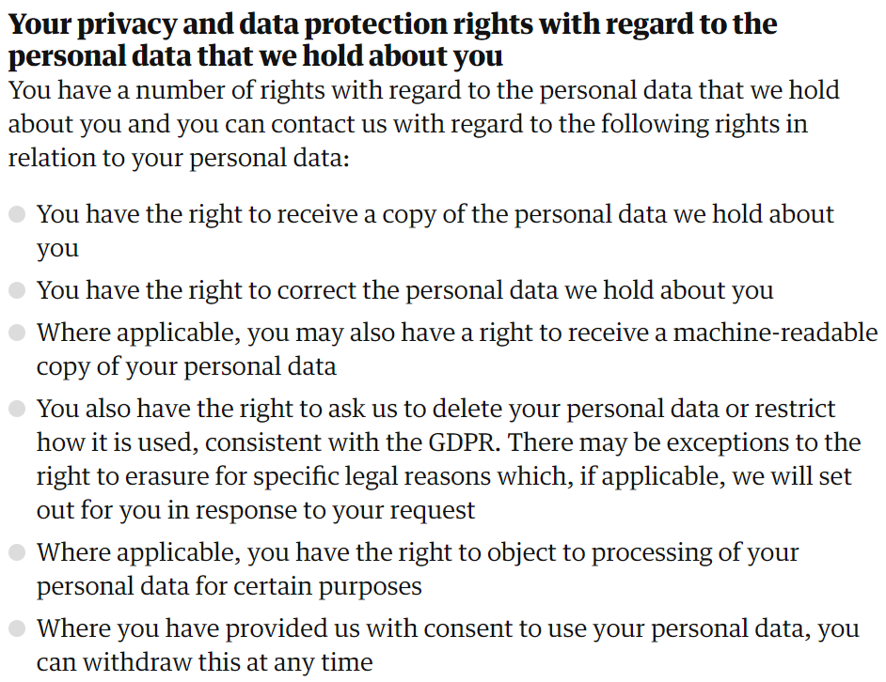
Subject Access Rights
The ability to see, modify, and delete data collected about you

Slide 58
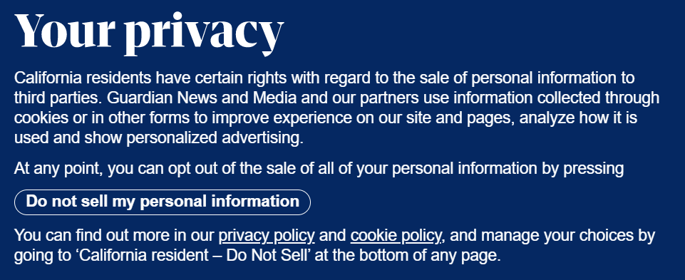
Affirmative Notice and Consent
Prominent consent notices with an opt-out capability
GDPR goes further:
You must be informed about what data will be collected about you, by whom, and for what purposes the data will be used
Data cannot be collected until consent is given

Slide 59
Issues
No federal-level privacy law in the US
CCPA is opt-out, not opt-in
Compliance with these laws is still spotty
Very few enforcement actions
No jurisprudence

