Slide 1
CS 4700 / CS 5700 Network Fundamentals
Lecture 13: Beyond TCP Congestion Control
(a.k.a. how to get a job at MIT)

Slide 2
In Between Network and Transport…
Goals:
Replace TCP congestion control
Keep queues/delay short
Drop ~0 (data) packets
Key challenge:
How to estimate network congestion better than TCP
How to make the solutions practical
Application
Presentation
Session
Transport
Network
Data Link
Physical

Slide 3
Issues with TCP CC
Fairness: throughput depends on RTT
High speed networks: slow start is too slow @10Gbps
Short flows: how to set the initial cwnd?
Lossy links: poor performance over wireless
Synchronization and Oscillations
Can’t sustain throughput near capacity
Periods of high queuing delay
Guaranteed to drop packets
Full buffers: queues are usually full, no burst tolerance
Lock out: queue space is monopolized by few flows

Slide 4
Outline
ECN
Explicit Congestion Notification
XCP
eXplicit Congestion Control Protocol
PCP
Probe Control Protocol

Slide 5
Active Queue Management (AQM)
Detect “incipient” (early) congestion in the router
Try to keep average queue size in “good” range
Randomly choose flows to notify about congestion
E.g. RED, packet drops are implicit notification
Randomly “notify” flow via packet drop
queue_len
max
min

Slide 6
Explicit Congestion Notification
ECN is an AQM mechanism
Use TCP/IP headers to send ECN signals
Router sets ECN bit in header if there is congestion
Host TCP treats ECN marked packets the same as packet drops (i.e. congestion signal)
But no packets are dropped :)
Sender receives feedback
No Congestion
Congestion
ECN-bit set in ACK

Slide 7
ECN Implementation
Uses two 1-bit flags in the TCP header
Congestion Window Reduce (CWR): slow down
ECN-Echo (ECE): feedback in the ACK
Also uses two bits in the IP header ToS field
01/10 – ECT, indicates ECN compatibility
11 – CE, indicates congestion
Supported by…
Windows (Vista+), OS X (10.5+), Linux
Cisco routers, *BSD
… but usually turned off by default

Slide 8
Is the Internet ECN-Ready?
As of 2011, not really
Measuring the State of ECN Readiness (IMC 2011)
ECN incompatible servers: 83-86%
ECN incompatible clients: 96-100%
… but results are better than for 2004 and 2008
Caught many routers mangling ECN bits!
Typically done by ISP border routers
Legacy routers clear IP ToS field, destroy ECN bits

Slide 9
Outline
ECN
Explicit Congestion Notification
XCP
eXplicit Congestion Control Protocol
PCP
Probe Control Protocol

Slide 10
Settings the Stage for XCP
ECN uses a 1-bit congestion indicator
Is there congestion: yes or no?
Does not indicate amount of congestion
TCP combines utilization and fairness control
AIMD
Probes for bandwidth (utilization)
Converges to fairness (if we ignore RTT…)

Slide 11
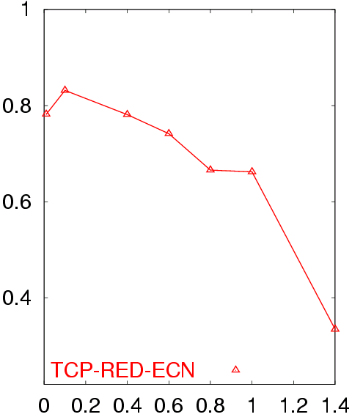
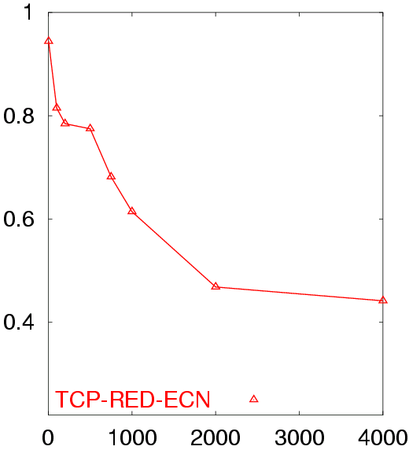
Poor Performance of TCP CC
50 flows in both directions
Buffer = BW x Delay
RTT = 80 ms
50 flows in both directions
Buffer = BW x Delay
BW = 155 Mb/s
Avg. TCP Utilization
Avg. TCP Utilization
Bottleneck Bandwidth (Mb/s)
Round Trip Delay (sec)

Slide 12
Key Observations
Packet loss is a poor signal of congestion
Why?
Congestion is not only source of loss (i.e. wireless)
Loss takes time to detect
By the time you see loss, congestion has already occurred
Relies on timeouts, which are slow
Loss/no-loss a binary value: are you at the cliff?
Result: slowly and blindly walk towards cliff

Slide 13
Key Observations
Rate of feedback is a function of delay to source
Congestion control as control loop w/ feedback delay
Large delays → instability. Why?
TCP couples congestion control and fairness
High utilization,
Small queues,
Few drops
Bandwidth allocation policy

Slide 14
eXplicit Control Protocol (XCP)
Uses multi-bit, explicit congestion feedback
Improves congestion control
Small queues at routers
Almost zero drops
Decouples congestion control from fairness
MIMD for congestion control
AIMD for fairness
Fair even when RTTs differ
Scalable: no per flow state in routers

Slide 15
XCP Implementation
Keep some TCP functionality
Keep most of the TCP header
Sequence numbers, reliable in-order delivery
Retransmit timers
Replace TCP’s cwnd functionality
Add additional fields to the TCP header
Modify routers to compute feedback
Like ECN and CSFQ

Slide 16
XCP Example
RTT
cwnd
feedback
RTT
cwnd
+0.1 packets
RTT
cwnd
-0.3 packets
Feedback copied into ACK
cwnd = cwnd + feedback
Congestion
Header
XCP extends ECN and CSFQ
Routers compute feedback without any per flow state

Slide 17
Feedback Computation
Congestion Controller
Fairness Controller
Goals
Match input traffic to link capacity
Drain the queue
Looks at aggregate traffic and queue
Δ = α d_{avg} Spare - β Queue
d_{avg} is avg. RTT
Spare capacity
Queue length
α and β are const. parameters
Goal: divide Δ fairly among flows
Looks at each flow’s state in their congestion header
Algorithm:
If Δ > 0 → divide Δ equally between flows
If Δ < 0 → divide Δ between flows proportionally to their current rate
Need to estimate N, number of flows…

Slide 18
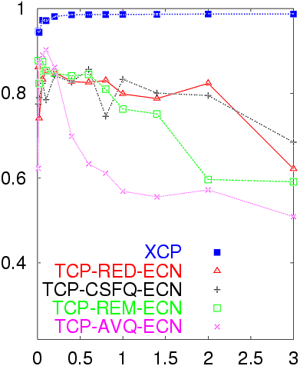
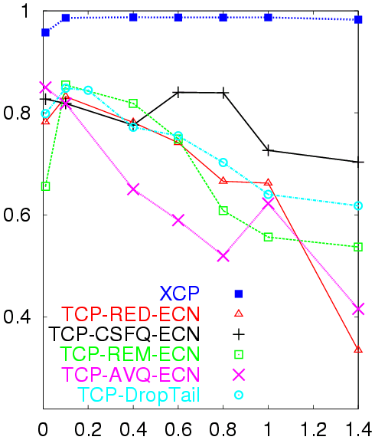
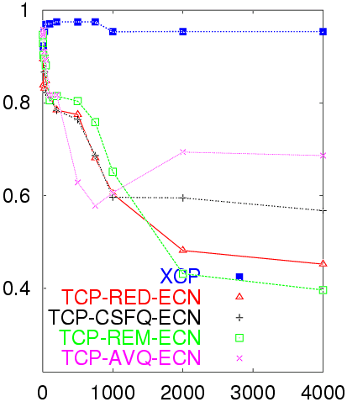
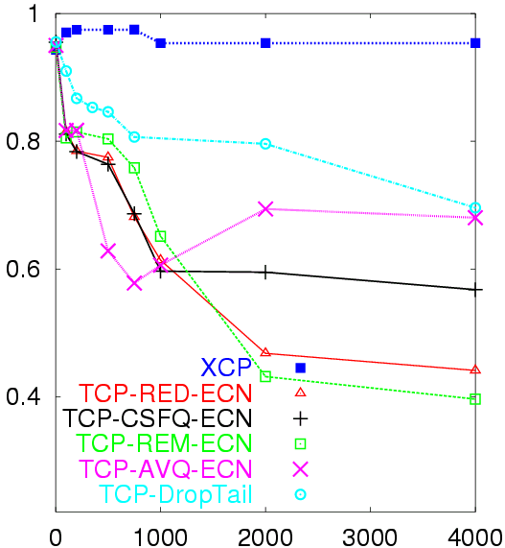
Utilization vs. B/W and Delay
Utilization as a func. of B/W
Utilization a func. of Delay
Avg. Utilization
Avg. Utilization
XCP increases proportionally to spare bandwidth
α and β chosen to make XCP robust to delay
Bottleneck Bandwidth (Mb/s)
Round Trip Delay (sec)
Notes:
Change circles to rectangles, don’t block the text

Slide 19
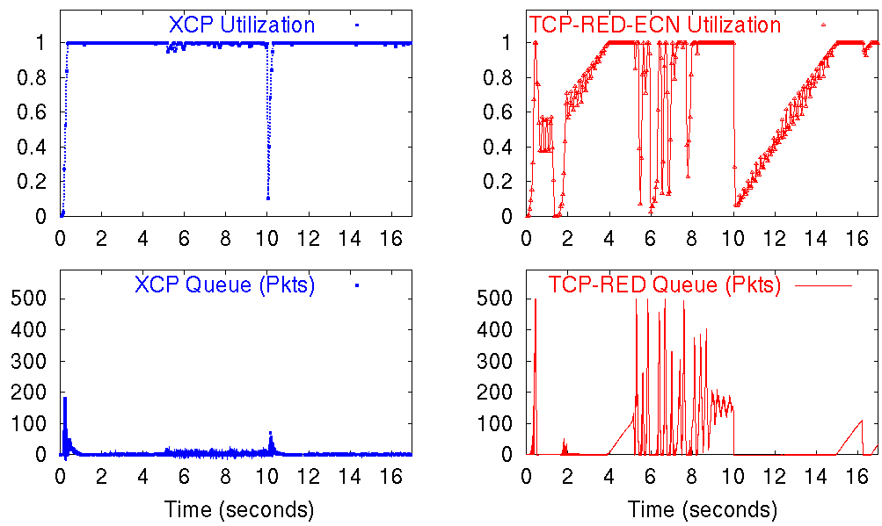
Response to Flow Dynamics
40 flows start
40 flows stop
Notes:
Change circles to rectangles, don’t block the text

Slide 20
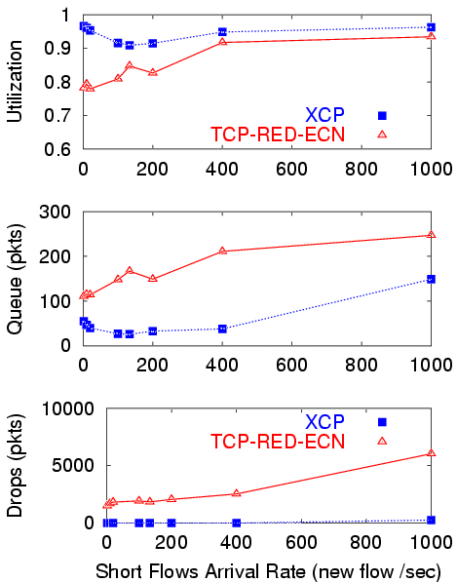
High utilization with few short flows
Short Flows
Utilization
Significantly shorter queues
Queue Length
(Packets)
Drops
(Packets)
Almost zero drops!
Short Flow Arrival Rate (New Flows per Second)
Notes:
Change circles to rectangles, don’t block the text

Slide 21
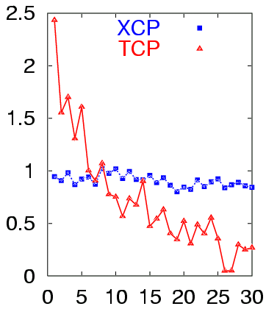
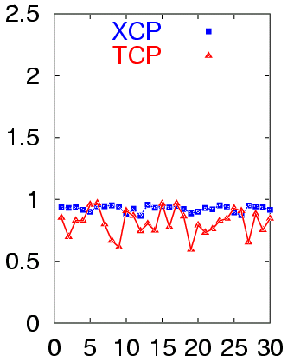
Fairness
Same RTT
Different RTT
Avg. Throughput
Avg. Throughput
Flow ID
Flow ID
(RTT is 40 ms → 330 ms )
Notes:
Change circles to rectangles, don’t block the text

Slide 22
XCP Bonus Prizes
Differentiating error loss from congestion loss
How?
Easy to differentiate unresponsive flows
How?
Easy to do differential bandwidth allocation
How?
What about performance metrics like queuing delay and jitter?
Question: are there any weaknesses to XCP?

Slide 23
Other Thoughts
The XCP paper is exceptionally good
Innovative ideas
Challenges entrenched preconceptions
Other goodness metrics
SIGCOMM best paper award
Got Dina Katabi a faculty job at MIT
Inspired me to get a PhD
Originally, I was just a Masters student
My first paper ever was on XCP security

Slide 24
Outline
ECN
Explicit Congestion Notification
XCP
eXplicit Congestion Control Protocol
PCP
Probe Control Protocol

Slide 25
Network-Assisted CC
Routers provide feedback to end-systems
Add TCP-specific support to routers
Signal end-hosts to reduce their sending rates
Problems
Makes routers complicated/expensive
Hinders adoption
How can we improve congestion control without requiring network support?

Slide 26
Context
 | Endpoint | Router Support
Try and Backoff | TCP, Vegas, RAP, FastTCP, Scalable TCP, HighSpeed TCP | DecBit, ECN, RED, AQM
Request and Set | ? | ATM, XCP, WFQ, RCP

Slide 27
Probe Control Protocol (PCP)
Test for bandwidth using short, non-intrusive probes
If bandwidth is available, send at the desired rate
Sending at desired rate is “safe”
Probe is a request
Successful probe sets the sending rate
Other flows cannot acquire the allocated bandwidth
Probe
Channel
Capacity
Rate
Probe
Probe
Time

Slide 28
PCP Mechanisms
Probes: how to check for available bandwidth
Probe control: how to vary the requests?
Rate compensation: deal with queue build-ups

Slide 29
Probes
Send packet train spaced at an interval to achieve desired rate
Currently, five packets whose size could be varied
Check for queuing based on time delays

Slide 30
Probe Control
Base protocol:
Start with a baseline rate:
One maximum sized packet per round-trip
If probe succeeds, double the requested bandwidth
If probe fails, halve the requested bandwidth
If probed rate falls below baseline rate:
Keep probed rate constant
Issue probes less frequently (exponential back-off)
Augmented with history:
Endpoint keeps track of previously used rates for different paths
Directly jumps to probe for a rate based on history

Slide 31
Rate Compensation
Queue build-ups could occur:
Even short probes, can trigger queuing
Simultaneous probes could allocate the same bandwidth to two flows
Measurement errors could result in too much load
Solution: rate compensation
Monitor packet delays
Notice queue-buildups
Slow down the transmission rate to drain queue

Slide 32
Performance
PCP vs. TCP vs. 4 concurrent PCP flows

Slide 33
Is PCP Fair vs. TCP?
Is PCP getting its performance gains by being aggressive to TCP traffic?

Slide 34
Another View on PCP
PCP decouples B/W estimation from data traffic
Control traffic now more light-weight
Probe more often
Minimal impact on data flows
No need to incur data loss
Probe loss is OK

Slide 35
Different Perspectives on CC
Three very different approaches to congestion control
Implicit router feedback (RED)
Explicit router feedback (ECN, XCP)
Light-weight bandwidth measurements (PCP)
Which approach is best?
Ease of deployment?
Stability?
Fairness?
Utilization?

