Slide 1
CS 4700 / CS 5700
Network Fundamentals
Lecture 19: Overlays
(P2P DHT via KBR FTW)
Revised 4/1/2013

Slide 2
Network Layer, version 2?
Function:
  Provide natural, resilient routes
  Enable new classes of P2P applications
Key challenge:
  Routing table overhead
  Performance penalty vs. IP
Application
Network
Transport
Network
Data Link
Physical

Slide 3
Abstract View of the Internet
A bunch of IP routers connected by point-to-point physical links
Point-to-point links between routers are physically as direct as possible

Slide 4
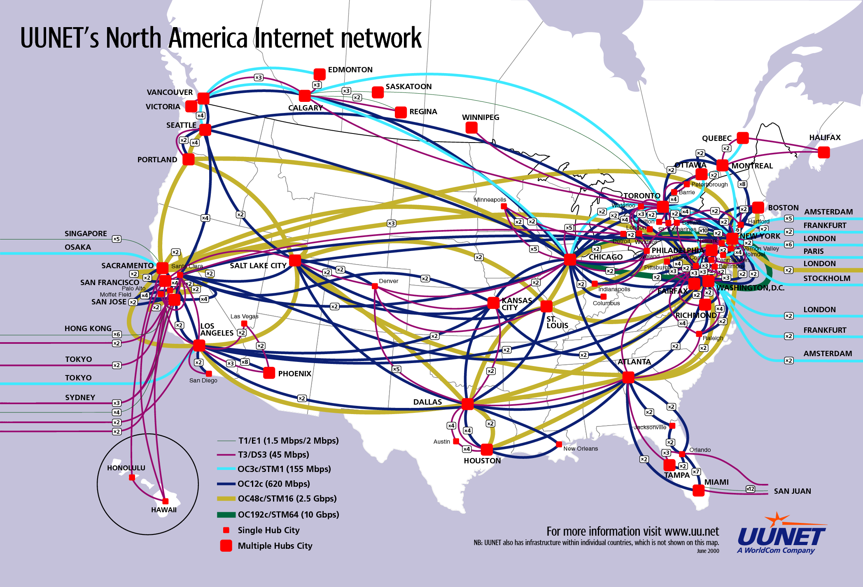

Slide 5
Reality Check
Fibers and wires limited by physical constraints
  You can’t just dig up the ground everywhere
  Most fiber laid along railroad tracks
Physical fiber topology often far from ideal
IP Internet is overlaid on top of the physical fiber topology
  IP Internet topology is only logical
Key concept: IP Internet is an overlay network

Slide 6
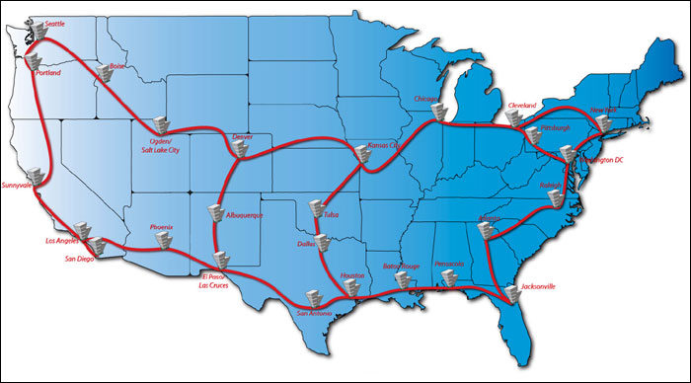
National Lambda Rail Project
IP Logical Link
Physical Circuit

Slide 7
Made Possible By Layering
Layering hides low level details from higher layers
  IP is a logical, point-to-point overlay
  ATM/SONET circuits on fibers
Host 1
Router
Host 2
Application
Application
Transport
Transport
Network
Network
Network
Data Link
Data Link
Data Link
Physical
Physical
Physical

Slide 8
Overlays
Overlay is clearly a general concept
  Networks are just about routing messages between named entities
IP Internet overlays on top of physical topology
  We assume that IP and IP addresses are the only names…
Why stop there?
  Overlay another network on top of IP

Slide 9


Example: VPN
Virtual Private Network
Private
Public
Private
34.67.0.1
34.67.0.3
VPN is an IP over IP overlay
Not all overlays need to be IP-based
Internet
74.11.0.1
74.11.0.2
34.67.0.2
34.67.0.4
Dest: 74.11.0.2
Dest: 34.67.0.4

Slide 10
VPN Layering
Host 1
Router
Host 2
Application
Application
P2P Overlay
P2P Overlay
Transport
Transport
VPN Network
VPN Network
Network
Network
Network
Data Link
Data Link
Data Link
Physical
Physical
Physical

Slide 11
Advanced Reasons to Overlay
IP provides best-effort, point-to-point datagram service
  Maybe you want additional features not supported by IP or even TCP
Like what?
  Multicast
  Security
  Reliable, performance-based routing
  Content addressing, reliable data storage

Slide 12
Outline
Multicast
Structured Overlays / DHTs
Dynamo / CAP

Slide 13
Unicast Streaming Video
Source
This does not scale

Slide 14
IP Multicast Streaming Video
IP routers forward to multiple destinations
Source
Much better scalability
IP multicast not deployed in reality
  Good luck trying to make it work on the Internet
  People have been trying for 20 years
Source only sends one stream

Slide 15
End System Multicast Overlay
This does not scale
How to build an efficient tree?
Enlist the help of end-hosts to distribute stream
Scalable
Overlay implemented in the application layer
  No IP-level support necessary
But…
Source
How to rebuild the tree?
How to join?

Slide 16
Outline
Multicast
Structured Overlays / DHTs
Dynamo / CAP

Slide 17

Unstructured P2P Review
Redundancy
What if the file is rare or far away?
Search is broken
  High overhead
  No guarantee is will work
Traffic Overhead

Slide 18
Why Do We Need Structure?
Without structure, it is difficult to search
  Any file can be on any machine
  Example: multicast trees
    How do you join? Who is part of the tree?
    How do you rebuild a broken link?
How do you build an overlay with structure?
  Give every machine a unique name
  Give every object a unique name
  Map from objects → machines
    Looking for object A? Map(A)→X, talk to machine X
    Looking for object B? Map(B)→Y, talk to machine Y

Slide 19
Hash Tables
Array
“A String”
“Another String”
Memory
Address
“Another String”
Hash(…) →
“One More String”
“A String”
“One More String”

Slide 20
(Bad) Distributed Hash Tables
Mapping of keys to nodes
Network
Nodes
“Google.com”
Machine
Address
“Britney_Spears.mp3”
Hash(…) →
“Christo’s Computer”
Size of overlay network will change
Need a deterministic mapping
As few changes as possible when machines join/leave

Slide 21
Structured Overlay Fundamentals
Deterministic Key→Node mapping
  Consistent hashing
  (Somewhat) resilient to churn/failures
  Allows peer rendezvous using a common name
Key-based routing
  Scalable to any network of size N
    Each node needs to know the IP of log(N) other nodes
    Much better scalability than OSPF/RIP/BGP
  Routing from node A→B takes at most log(N) hops

Slide 22
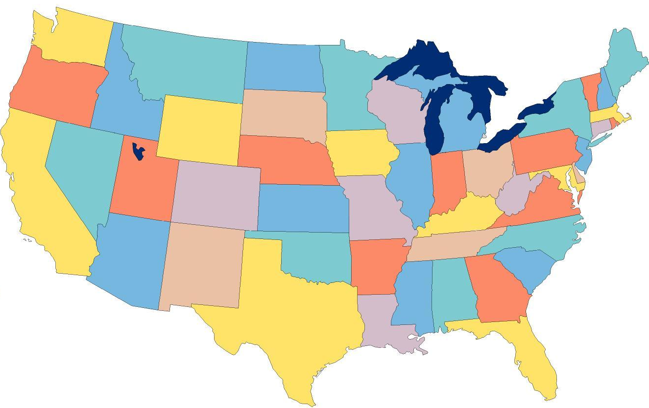

Structured Overlays at 10,000ft.
Node IDs and keys from a randomized namespace
  Incrementally route towards to destination ID
  Each node knows a small number of IDs + IPs
    log(N) neighbors per node, log(N) hops between nodes
ABCE
Each node has a routing table
ABC0
Forward to the longest prefix match
To: ABCD
AB5F
A930

Slide 23
Structured Overlay Implementations
Many P2P structured overlay implementations
  Generation 1: Chord, Tapestry, Pastry, CAN
  Generation 2: Kademlia, SkipNet, Viceroy, Symphony, Koorde, Ulysseus, …
Shared goals and design
  Large, sparse, randomized ID space
  All nodes choose IDs randomly
  Nodes insert themselves into overlay based on ID
  Given a key k, overlay deterministically maps k to its root node (a live node in the overlay)

Slide 24
Similarities and Differences
Similar APIs
  route(key, msg) : route msg to node responsible for key
    Just like sending a packet to an IP address
  Distributed hash table functionality
    insert(key, value) : store value at node/key
    lookup(key) : retrieve stored value for key at node
Differences
  Node ID space, what does it represent?
  How do you route within the ID space?
  How big are the routing tables?
  How many hops to a destination (in the worst case)?

Slide 25
Tapestry/Pastry
Node IDs are numbers in a ring
  128-bit circular ID space
Node IDs chosen at random
Messages for key X is routed to live node with longest prefix match to X
  Incremental prefix routing
  1110: 1XXX→11XX→111X→1110
1111 | 0
To: 1110
0
1110
0010
1100
0100
1010
0110
1000

Slide 26
Physical and Virtual Routing
1111 | 0
To: 1110
1101
0
1110
0010
To: 1110
1100
0100
0010
1100
1010
0110
1010
1000

Slide 27
Tapestry/Pastry Routing Tables
Incremental prefix routing
How big is the routing table?
  Keep b-1 hosts at each prefix digit
  b is the base of the prefix
  Total size: b * log_{b} n
log_{b} n hops to any destination
1111 | 0
1110
0
1110
0011
0010
1100
0100
1011
1010
0110
1010
1000
1000

Slide 28
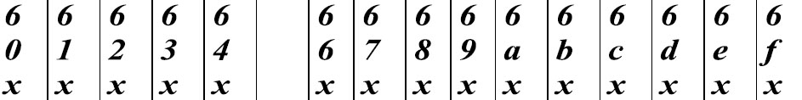
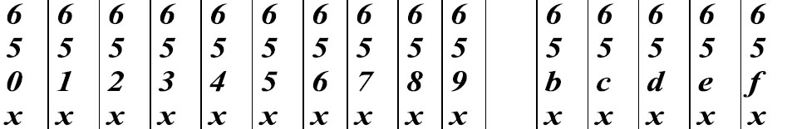
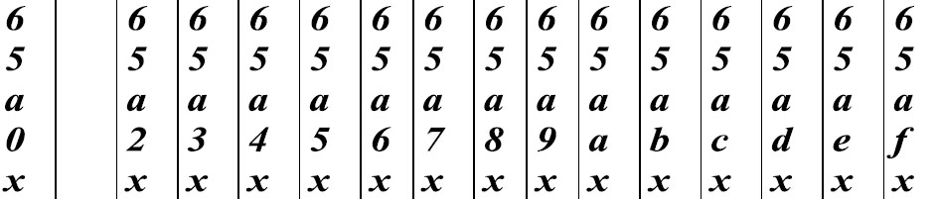
Routing Table Example
Hexadecimal (base-16), node ID = 65a1fc4
Row 0
Row 1
Row 2
Row 3
log₁₆ n
rows

Slide 29
Routing, One More Time
Each node has a routing table
Routing table size:
  b * log_{b} n
Hops to any destination:
  log_{b} n
1111 | 0
To: 1110
0
1110
0010
1100
0100
1010
0110
1000

Slide 30
Pastry Leaf Sets
One difference between Tapestry and Pastry
Each node has an additional table of the L/2 numerically closest neighbors
  Larger and smaller
Uses
  Alternate routes
  Fault detection (keep-alive)
  Replication of data

Slide 31
Joining the Pastry Overlay
Pick a new ID X
Contact a bootstrap node
Route a message to X, discover the current owner
Add new node to the ring
Contact new neighbors, update leaf sets
1111 | 0
0
1110
0010
1100
0100
1010
0110
0011
1000

Slide 32
Node Departure
Leaf set members exchange periodic keep-alive messages
  Handles local failures
Leaf set repair:
  Request the leaf set from the farthest node in the set
Routing table repair:
  Get table from peers in row 0, then row 1, …
  Periodic, lazy

Slide 33
Consistent Hashing
Recall, when the size of a hash table changes, all items must be re-hashed
  Cannot be used in a distributed setting
  Node leaves or join → complete rehash
Consistent hashing
  Each node controls a range of the keyspace
  New nodes take over a fraction of the keyspace
  Nodes that leave relinquish keyspace
… thus, all changes are local to a few nodes

Slide 34

DHTs and Consistent Hashing
Mappings are deterministic in consistent hashing
  Nodes can leave
  Nodes can enter
  Most data does not move
Only local changes impact data placement
  Data is replicated among the leaf set
1111 | 0
To: 1110
0
1110
0010
1100
0100
1010
0110
1000

Slide 35
Content-Addressable Networks (CAN)
d-dimensional hyperspace with n zones
y
Peer
Keys
Zone
x

Slide 36
CAN Routing
d-dimensional space with n zones
Two zones are neighbors if d-1 dimensions overlap
d*n^{1/d} routing path length
y
[x,y]
Peer
Keys
lookup([x,y])
x

Slide 37
CAN Construction
Joining CAN
Pick a new ID [x,y]
Contact a bootstrap node
Route a message to [x,y], discover the current owner
Split owners zone in half
Contact new neighbors
y
[x,y]
x
New Node

Slide 38
Summary of Structured Overlays
A namespace
  For most, this is a linear range from 0 to 2¹⁶⁰
A mapping from key to node
  Chord: keys between node X and its predecessor belong to X
  Pastry/Chimera: keys belong to node w/ closest identifier
  CAN: well defined N-dimensional space for each node

Slide 39
Summary, Continued
A routing algorithm
  Numeric (Chord), prefix-based (Tapestry/Pastry/Chimera), hypercube (CAN)
  Routing state
  Routing performance
Routing state: how much info kept per node
  Chord: Log₂N pointers
  i^{th} pointer points to MyID+ ( N * (0.5)^{i} )
  Tapestry/Pastry/Chimera: b * Log_{b}N
  i^{th} column specifies nodes that match i digit prefix, but differ on (i+1)^{th} digit
  CAN: 2*d neighbors for d dimensions

Slide 40
Structured Overlay Advantages
High level advantages
  Complete decentralized
  Self-organizing
  Scalable
  Robust
Advantages of P2P architecture
  Leverage pooled resources
    Storage, bandwidth, CPU, etc.
  Leverage resource diversity
    Geolocation, ownership, etc.

Slide 41
Structured P2P Applications
Reliable distributed storage
  OceanStore, FAST’03
  Mnemosyne, IPTPS’02
Resilient anonymous communication
  Cashmere, NSDI’05
Consistent state management
  Dynamo, SOSP’07
Many, many others
  Multicast, spam filtering, reliable routing, email services, even distributed mutexes!

Slide 42


Trackerless BitTorrent
Torrent Hash: 1101
1111 | 0
Tracker
0
Leecher
Tracker
1110
0010
Swarm
Initial Seed
1100
0100
1010
0110
1000
Leecher
Initial Seed

Slide 43
Outline
Multicast
Structured Overlays / DHTs
Dynamo / CAP

Slide 44
DHT Applications in Practice
Structured overlays first proposed around 2000
  Numerous papers (>1000) written on protocols and apps
  What’s the real impact thus far?
Integration into some widely used apps
  Vuze and other BitTorrent clients (trackerless BT)
  Content delivery networks
Biggest impact thus far
  Amazon: Dynamo, used for all Amazon shopping cart operations (and other Amazon operations)

Slide 45
Motivation
Build a distributed storage system:
  Scale
  Simple: key-value
  Highly available
  Guarantee Service Level Agreements (SLA)
Result
  System that powers Amazon’s shopping cart
  In use since 2006
  A conglomeration paper: insights from aggregating multiple techniques in real system

Slide 46
System Assumptions and Requirements
Query Model: simple read and write operations to a data item that is uniquely identified by key
  put(key, value), get(key)
Relax ACID Properties for data availability
  Atomicity, consistency, isolation, durability
Efficiency: latency measured at the 99.9% of distribution
  Must keep all customers happy
  Otherwise they go shop somewhere else
Assumes controlled environment
  Security is not a problem (?)

Slide 47
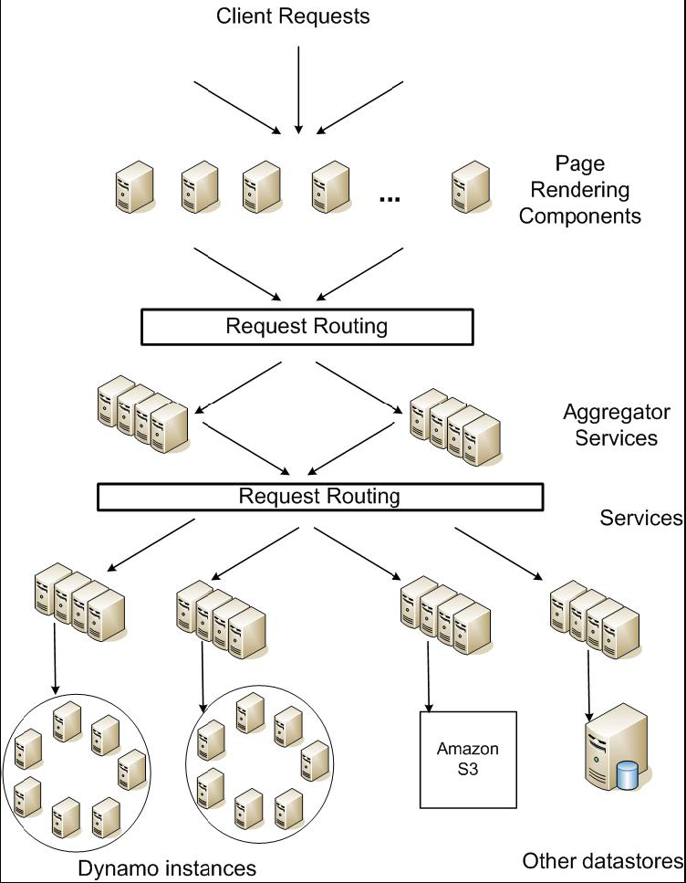
Service Level Agreements (SLA)
Application guarantees
  Every dependency must deliver
  functionality within tight bounds
99% performance is key
Example: response time w/in
300ms for 99.9% of its requests for peak load of
500 requests/second
Amazon’s Service-Oriented Architecture

Slide 48
Design Considerations
Sacrifice strong consistency for availability
Conflict resolution is executed during read instead of write, i.e. “always writable”
Other principles:
  Incremental scalability
    Perfect for DHT and Key-based routing (KBR)
  Symmetry + Decentralization
    The datacenter network is a balanced tree
  Heterogeneity
    Not all machines are equally powerful

Slide 49
KBR and Virtual Nodes
Consistent hashing
  Straightforward applying KBR to key-data pairs
“Virtual Nodes”
  Each node inserts itself into the ring multiple times
  Actually described in multiple papers, not cited here
Advantages
  Dynamically load balances w/ node join/leaves
    i.e. Data movement is spread out over multiple nodes
  Virtual nodes account for heterogeneous node capacity
    32 CPU server: insert 32 virtual nodes
    2 CPU laptop: insert 2 virtual nodes

Slide 50
Data Replication
Each object replicated at N hosts
  “preference list” → leaf set in Pastry DHT
  “coordinator node” → root node of key
Failure independence
  What if your leaf set neighbors are you?
    i.e. adjacent virtual nodes all belong to one physical machine
  Never occurred in prior literature
  Solution?
Notes:
Soln: use more replicas and skip over sibling nodes

Slide 51
Eric Brewer’s CAP theorem
CAP theorem for distributed data replication
  Consistency: updates to data are applied to all or none
  Availability: must be able to access all data
  Partitions: failures can partition network into subtrees
The Brewer Theorem
  No system can simultaneously achieve C and A and P
  Implication: must perform tradeoffs to obtain 2 at the expense of the 3rd
  Never published, but widely recognized
Interesting thought exercise to prove the theorem
  Think of existing systems, what tradeoffs do they make?

Slide 52

CAP Examples
A+P
(key, 1)
  Availability
  Client can always read
Impact of partitions
  Not consistent
(key, 1)
Read
Write
(key, 1)
Replicate
(key, 2)
What about C+A?
Doesn’t really exist
Partitions are always possible
Tradeoffs must be made to cope with them
C+P
(key, 1)
Consistency
  Reads always return accurate results
Impact of partitions
  No availability
Error: Service
Unavailable
Read
Write
(key, 1)
Replicate
(key, 2)

Slide 53
CAP Applied to Dynamo
Requirements
  High availability
  Partitions/failures are possible
Result: weak consistency
  Problems
    A put( ) can return before update has been applied to all replicas
    A partition can cause some nodes to not receive updates
  Effects
    One object can have multiple versions present in system
    A get( ) can return many versions of same object

Slide 54
Immutable Versions of Data
Dynamo approach: use immutable versions
  Each put(key, value) creates a new version of the key
One object can have multiple version sub-histories
  i.e. after a network partition
  Some automatically reconcilable: syntactic reconciliation
  Some not so simple: semantic reconciliation
Key | Value | Version
shopping_cart_18731 | {cereal} | 1
shopping_cart_18731 | {cereal, cookies} | 2
shopping_cart_18731 | {cereal, crackers} | 3
Q: How do we do this?

Slide 55
Vector Clocks
General technique described by Leslie Lamport
  Explicitly maps out time as a sequence of version numbers at each participant (from 1978!!)
The idea
  A vector clock is a list of (node, counter) pairs
  Every version of every object has one vector clock
Detecting causality
  If all of A’s counters are less-than-or-equal to all of B’s counters, then A is ancestor of B, and can be forgotten
  Intuition: A was applied to every node before B was applied to any node. Therefore, A precedes B
Use vector clocks to perform syntactic reconciliation

Slide 56
Simple Vector Clock Example
Write by Sx
Key features
  Writes always succeed
  Reconcile on read
Possible issues
  Large vector sizes
  Need to be trimmed
Solution
  Add timestamps
  Trim oldest nodes
  Can introduce error
D1 ([Sx, 1])
Write by Sx
D2 ([Sx, 2])
Write by Sy
Write by Sz
D3 ([Sx, 2],
[Sy, 1])
D4 ([Sx, 2],
[Sz, 1])
Read → reconcile
D5 ([Sx, 2],
[Sy, 1],
[Sz, 1])

Slide 57
Sloppy Quorum
R/W: minimum number of nodes that must participate in a successful read/write operation
  Setting R + W > N yields a quorum-like system
Latency of a get (or put) dictated by slowest of R (or W) replicas
  Set R and W to be less than N for lower latency

Slide 58
Measurements
Average and 99% latencies for R/W requests during peak season

Slide 59
Measurements
Can buffer writes to improve write performance (trading durability for performance). 30m/tick on X-axis.

Slide 60
Dynamo Techniques
Interesting combination of numerous techniques
  Structured overlays / KBR / DHTs for incremental scale
  Virtual servers for load balancing
  Vector clocks for reconciliation
  Quorum for consistency agreement
  Merkle trees for conflict resolution
  Gossip propagation for membership notification
  SEDA for load management and push-back
  Add some magic for performance optimization, and …
Dynamo: the Frankenstein of distributed storage

Slide 61
Final Thought
When P2P overlays came out in 2000-2001, it was thought that they would revolutionize networking
  Nobody would write TCP/IP socket code anymore
  All applications would be overlay enabled
  All machines would share resources and route messages for each other
Today: what are the largest P2P overlays?
  Botnets
Why did the P2P overlay utopia never materialize?
  Sybil attacks
  Churn is too high, reliability is too low

