Slide 1
CS 4740/6740 Network Security
Lecture 10: Privacy on the Web
(History stealing, Fingerprinting, DNT, etc.)

Slide 2
Webonomics
The Web has allowed free, convenient services to proliferate
Google, Android
Facebook, Instagram
Millions of smartphone apps
Who pays for the costs of all these services?
You do.
Not in cash, but in personal information
“If you are not paying for it, you're not the customer;
you're the product being sold” – Andrew Lewis, 2002

Slide 3
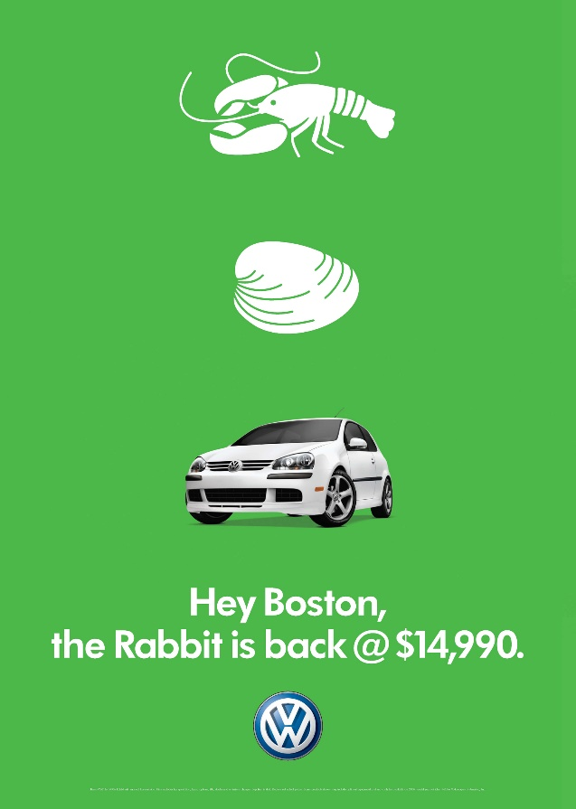
Advertising on the Web
By and large, advertising provides the money for web services and apps
90% of Google’s $6 Billion in revenue came from ads in 2014
Pre-Web advertising → Branding
Web advertising → Targeting

Slide 4
Your Personal Information is Valuable
Information | Google | Facebook
Search Keywords | Google Search | (Not yet, but soon)
Browsing History | Chrome, Google Analytics | Like Buttons
Social network profile and friend connections | Google+ | Obviously.
Geolocation | Google Maps, Android | Facebook for Android/iPhone
Contents of messages | Gmail, Hangouts | Facebook Messenger
How is this information collected, shared, and used for targeted advertising?

Slide 5
Tracking
Cookies, Flash Cookies, E-tags, Evercookies, Supercookies!
DNT
Fingerprinting

Slide 6
IP Address Tracking
IP address is the most basic mechanism for tracking on the Internet
Everybody must have an IP address
Every packet you send contains your IP address
Your IP address remains relatively constant over time
However, IP address is not as useful as it once was. Why?
NATs are ubiquitous; multiple people behind a single IP
Cell networks employ many layers of NATs and proxies
Users split their time across multiple devices with separate IPs

Slide 7
Cookies
Allows servers to store state on client web browsers
Originally, invented for storing authentication information (session cookies)
Today, routinely used to implement tracking cookies
Tracking cookies are so pervasive that they are now legislated
EU e-Privacy Directive (Cookie Law)
Requires that sites disclose if they use cookies and what they are used for
Users must opt-in before cookies can be set
Google was fined $22.5 Million by the FTC for circumventing cookie restrictions in Safari
Safari did not accept third-party cookies by default…
… unless they were received after a POST
Google used Ajax to send a POST to circumvent Safari’s restriction

Slide 8
Third-party Cookie Tracking
Google (and its services like Doubleclick) are embedded in 40-60% of all web pages
<script src=“http://www.googletagservices.com/tag/js/gpt.js?id=yelp”>
yelp.com
Cookie: _gads=saf9vDFDsP0w3
Set-Cookie: _gads=saf9vDFDsP0w3
Cookie: _gads=saf9vDFDsP0w3
<script src=“http://www.googletagservices.com/tag/js/gpt.js?id=gmaps”>
maps.google.com

Slide 9
Social Widgets
<iframe src=“http://www.facebook.com/button.html”>
yelp.com
Cookie: presence=saf9vDFDsP0w3
Set-Cookie: presence=saf9vDFDsP0w3
Cookie: presence=saf9vDFDsP0w3
facebook.com
<iframe src=“http://www.facebook.com/button.html”>
maps.google.com

Slide 10
The Targeted Advertising Ecosystem
Target 18-25 year old males
Ad Exchanges &
Ad Auctions
Consumers
Publishers
Ad Networks
Companies
Ads
Cookie=A2f5g…
$0.003
Rubicon
Cookie=A2f5g…
coke_ad.gif
Cookie=A2f5g…
AdNexus
$0.001
Rocketfuel
People who browse the web
Websites that publish content
Services that match people to targeted ads
Services that manage ad campaigns and target users
People trying to sell you stuff

Slide 11
The Targeted Advertising Ecosystem
Ad Exchanges &
Ad Auctions
Consumers
Publishers
Ad Networks
Companies
$$$
Rubicon
Tracking data is stored and exchanged amongst these companies
AdNexus
Rocketfuel
People who browse the web
Websites that publish content
Services that match people to targeted ads
Services that manage ad campaigns and target users
People trying to sell you stuff

Slide 12
Users Against Tracking Cookies
Users did not respond well when they found out about tracking
Many started clearing their cookies to avoid tracking
Ad networks fought back using Evercookies
HTTP, HTML, and plugins provide many ways to store state on clients
Evercookies are placed in all available storage locations
If the cookie is deleted, it can be regenerated from the ‘backups’ in other locations

Slide 13
Evercookies
HTML features
window.name
HTML5 localstorage
HTML5 indexeddb
HTML5 web database
Web history (more on this later)
HTTP features
Cookies
E-tags – values set by the server that are supposed to be used for page caching
Cached HTTP authentication credentials
Plugins
Flash Local Shared Objects (LSOs)
Silverlight Isolated Storage
Java PersistenceService

Slide 14
Mitigations Against Tracking Cookies
Opting-out
In an effort to stave off regulation, many online ad networks have voluntarily joined the AdChoices program
AdChoices allows you to opt-out of some targeted advertising
Ironically, the opt-out is stored as a cookie in your browser
Incognito/Private browsing mode
Starts a fresh browser instance with no cookies
All cookies are erased when the instance closes
Warning: plugins may still persist evercookie information
Extensions
Adblock, Ghostery, Disconnect, PrivacyBadger, NoScript, uMatrix

Slide 15
Do Not Track
Proposed in 2009 by Christopher Soghoian, Sid Stamm, and Dan Kaminsky
HTTP header that informs third-parties you do not wish to be tracked
Supported by most modern browsers (but typically off by default)
The original aim was get buy in from regulators and advertisers
Instead, the whole effort became controversial and politicized
Today, no laws or regulations mandate compliance with DNT
Digital Advertising Alliance does not require its members to honor DNT
Issues
Microsoft attempted to set DNT: 1 by default in IE 10
Advertisers revolted and refused to support the initiative
What is the expected behavior of Do Not Track?
Can a third-party retain data for other purposes like analytics, debugging, or security audits?
Can an advertiser store data but simply not use it to target ads?

Slide 16
Beyond Tracking Cookies
Times are getting tough for cookie-based tracking
Tracker-blockers are proliferating
Anti-cookie legislation/regulation are increasing
Many advertisers are experimenting with cookie-less tracking
Otherwise known as browser fingerprinting

Slide 17
Your Browser is Unique
GET / HTTP/1.1
Host: www.google.com
Connection: keep-alive
Cache-Control: max-age=0
Accept: text/hmtl
User-Agent: Mozilla/5.0 (Windows NT 6.3; Win64; x64) AppleWebKit/537.36 (KHTML, like Gecko) Chrome/42.0.2311.68 Safari/537.36
Accept-Encoding: gzip,deflate,sdch
Accept-Language: en-US,en;q=0.8
Cookie: _session=aAB4m3rf8weG224

Slide 18
More Sources of Uniqueness
Many more high-entropy characteristics are observable via Javascript/plugins
What time zone are you in?
What fonts are installed on your machine?
What plugins are installed, and what are their versions?
What is your screen resolution and color depth?
Availability of specific JS APIs (i.e. browser version or platform dependent features)
Existence of specific browser extensions (e.g. AdBlock)
Order in which HTTP headers are sent
Hardware-level characteristics like CPU ID and frequency (MHz)

Slide 19
Browser Fingerprinting
Fingerprinting is a method of identifying individual users based on the specific characteristics of their browser/system
Each characteristic is encoded as having bits of entropy
15-20 total bits of entropy is enough to uniquely identify most people
Examples:
Is Javascript enabled? – Roughly .4 bits of entropy (on or off, but off is much less common)
User-Agent? – Roughly 19 bits of entropy (OS → browser → version)
Test yourself: https://panopticlick.eff.org/

Slide 20
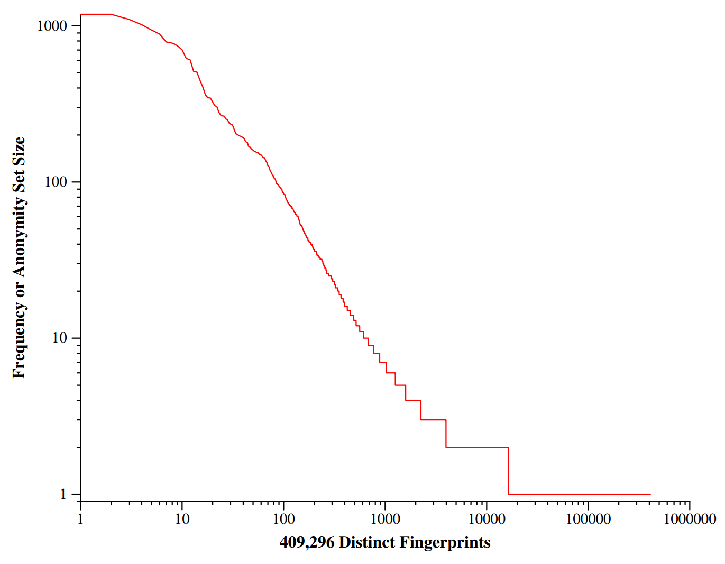
83.6% of users have a unique fingerprint

Slide 21
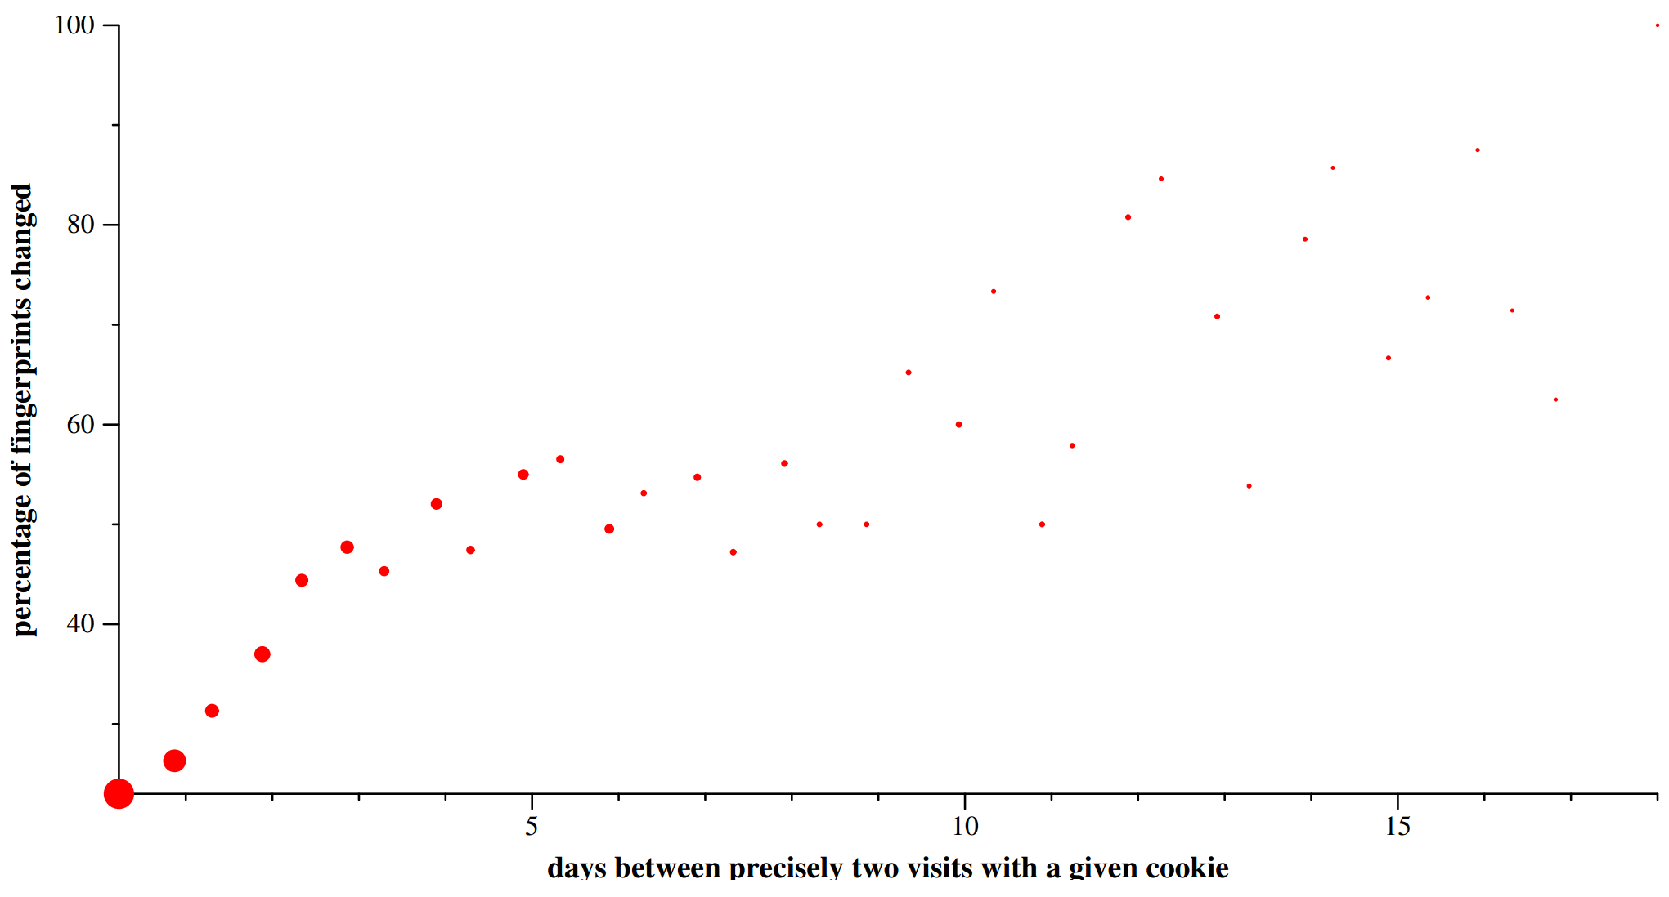
60% of users have the same fingerprint over several days
If you clear your cookies, they can precisely regenerated from your fingerprint
N = 4638
Notes:
Caveat: the nature of the Panopticlick test draws in a technically sophisticated crowd and encourages them to change their browser configuration. Thus, its likely that fingerprints are much more stable for average web users.

Slide 22
Canvas Fingerprinting
Fingerprinting techniques are becoming more sophisticated
Canvas fingerprinting
Leverages a hidden HTML5 <canvas>
Javascript renders text and drawing using various styles and fonts
The bitmap is then converted into a unique token
Entropy is due to OS, browser, GPU, and graphics driver
Experiments observed 5.7 bits of entropy via canvas fingerprinting
True entropy is likely higher
In 2014, many sites and ad trackers were caught using canvas fingerprinting

Slide 23
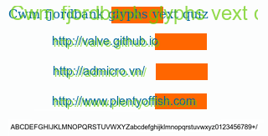
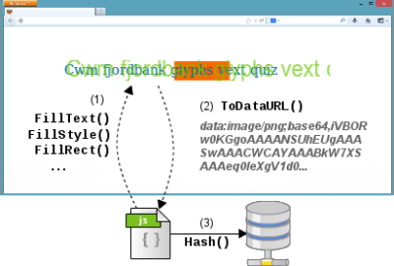
Canvas Fingerprinting Example

Slide 24
Mitigations Against Fingerprinting
Adding more entropy into the browser
Example: uMatrix can randomize your User-Agent
Randomize the order of HTTP headers
Reduce or restrict browser functionality
Cap the number of fonts a given page may query
Cap the number of plugins a given page may invoke
Problem: some things cannot be randomized, removed, or restricted
Time zone and language cannot be randomized in general
Access to new Javascript APIs

Slide 25
History Stealing
CSS :visited
Timing Attacks

Slide 26
Story So Far
Attacks thus far have been about inferring individual identity
Cookies and fingerprints
What about attacks that try to infer your behavior
Specifically, your browsing history
Useful information for marketers and traditional attackers
E.g. do you have an account at BofA or a credit card with Chase?

Slide 27
Let’s Talk About Hyperlinks
www.slashdot.org
www.reddit.com
www.webmd.com
www.chase.com
www.bankofamerica.com
var links = document.querySelectorAll('a');
for (var x = 0; x < links.length; ++x) {
console.log(
document.defaultView.getComputedStyle(
link[x], null
).color
);
}
>> rgb(85, 26, 139) # Purple
>> rgb(0, 0, 238) # Blue
>> rgb(85, 26, 139) # Purple
>> rgb(85, 26, 139) # Purple
>> rgb(0, 0, 238) # Blue
Visited Link
Unvisited Link

Slide 28
History Stealing via CSS :visited
Simple method to steal someone’s browsing history
Send the victim to a page that includes malicious JavaScript J
Alternatively: use XSS to inject malicious JS into a benign website
J creates a list of <a> tags on the page
List is composed of links to well known sites
List can be hidden off-screen or using Javascript so the user is unware
J iterates through the list of anchors and examines their colors
Any purple links have been browsed by the victim

Slide 29
History Stealing via Timing Attack
Observation: it takes browsers longer to render visited links than unvisited links
Unvisited: draw the link, has_link_been_visited() == false, move on
Visited: draw the link, has_link_been_visited() == true, draw the link again
Send the victim to a page that includes malicious JavaScript J
Alternatively: use XSS to inject malicious JS into a benign website
J injects <a> tags into the page one at a time
List is composed of links to well known sites
List can be hidden off-screen or using Javascript so the user is unware
J measures the time taken to draw each link
Calculate average draw-time by injecting links to non-existent pages
Links with draw-time significantly above the average have been visited

Slide 30
Mitigations Against History Stealing
Basic approaches
Clear your history, or configure your browser to not store history
Disable styling of visited links
Disable Javascript
Fixes implemented by Mozilla in 2010
CSS may only alter specific properties of :visited links versus :unvisited
Foreground and background color, outline, border, SVG stroke, and fill color
None of these properties impact the size or layout of surrounding elements
Javascript may no longer read certain style properties of links
All links appear to have unvisited colors
Changes to the rendering engine to make all links render in equal time
Notes:
The CSS 2.1 spec was specifically modified to allow these behaviors, in order to allow browsers to preserve user privacy.

Slide 31
Final Thoughts
Your personal information is valuable
Companies want it, attackers want it
Your browser is a complex state machine that allows third-parties to run (somewhat) arbitrary code
Obvious and non-obvious mechanisms for tracking you personally…
… as well as your browsing history
There is no silver bullet for privacy on the Web
Technological measures can help (modified browsers + extensions)
Eventually, regulatory mechanisms will also be necessary

Slide 32
Sources
Evercookies: http://samy.pl/evercookie/
Panopticlick (browser fingerprinting): https://panopticlick.eff.org/
Canvas fingerprinting examples: https://securehomes.esat.kuleuven.be/~gacar/persistent/index.html
History stealing example: http://www.dicabrio.com/javascript/steal-history.php
Plugging the CSS history leak: https://blog.mozilla.org/security/2010/03/31/plugging-the-css-history-leak/

