Slide 1
CS 4740/6740
Network Security
Lecture 4: Authentication
(Passwords and Cryptographic Protocols)

Slide 2
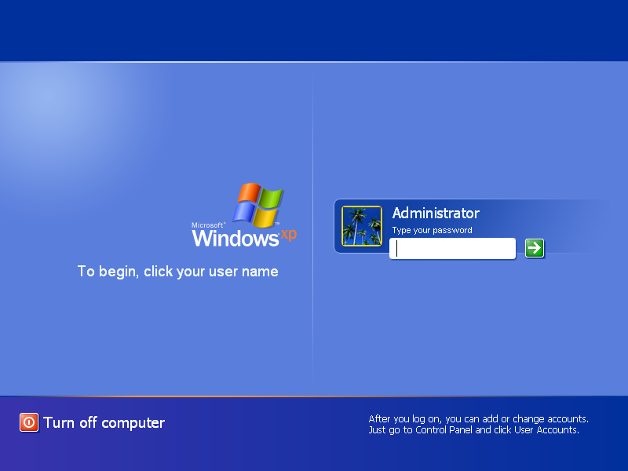

Slide 3
Authentication
Authentication is the process of verifying an actor’s identity
Critical for security of systems
  Permissions, capabilities, and access control are all contingent upon knowing the identity of the actor
Typically parameterized as a username and a secret
  The secret attempts to limit unauthorized access

Slide 4
Types of Secrets
Actors provide their secret to log-in to a system
Three classes of secrets:
  Something you know
    Example: a password
  Something you have
    Examples: a smart card or smart phone
  Something you are
    Examples: fingerprint, voice scan, iris scan

Slide 5
Today’s Topics
  Password Storage
    How should you securely store password to prevent cracking?
    Are there ways to help detect password breaches?
  Password Cracking
    Basic attacks: brute forcing and dictionary
    Hash chains
    Rainbow tables
  Local and Distributed Authentication Systems
    Unix/Linux PAM system
    NIS
    Needham-Schroeder
    Kerberos

Slide 6
Password Storage
Hashing and Salting
Key Stretching and Work Factor
Honeywords

Slide 7


Attacker Goals and Threat Model
Assume we have a system storing usernames and passwords
The attacker has access to the password database/file
I wanna login to those user accounts!
Database
Cracked Passwords
User | Password
cbw | p4ssW0rd
sandi | puppies
amislove | 3spr3ss0
User | Password
cbw | p4ssW0rd
sandi | puppies
amislove | 3spr3ss0

Slide 8
Checking Passwords
System must validate passwords provided by users
Thus, passwords must be stored somewhere
Basic storage: plain text
password.txt
cbw p4ssw0rd
sandi i heart doggies
amislove 93Gd9#jv*0x3N
bob security

Slide 9
Problem: Password File Theft
Attackers often compromise systems
They may be able to steal the password file
  Linux: /etc/shadow
  Windows: c:\windows\system32\config\sam
If the passwords are plain text, what happens?
  The attacker can now log-in as any user, including root/administrator
Passwords should never be stored in plain text

Slide 10
Hashed Passwords
Key idea: store encrypted versions of passwords
  Use one-way cryptographic hash functions
  Examples: MD5, SHA1, SHA256, SHA512, bcrypt, PBKDF2, scrypt
Cryptographic hash function transform input data into scrambled output data
  Deterministic: hash(A) = hash(A)
  High entropy:
    MD5(‘security’) = e91e6348157868de9dd8b25c81aebfb9
    MD5(‘security1’) = 8632c375e9eba096df51844a5a43ae93
    MD5(‘Security’) = 2fae32629d4ef4fc6341f1751b405e45
  Collision resistant
    Locating A’ such that hash(A) = hash(A’) takes a long time (hopefully)
    Example: 2²¹ tries for md5

Slide 11

Hashed Password Example
MD5(‘p4ssw0rd’) = 2a9d119df47ff993b662a8ef36f9ea20
User: cbw
MD5(‘2a9d119df47ff993b662a8ef36f9ea20’) = b35596ed3f0d5134739292faa04f7ca3
hashed_password.txt
cbw 2a9d119df47ff993b662a8ef36f9ea20
sandi 23eb06699da16a3ee5003e5f4636e79f
amislove 98bd0ebb3c3ec3fbe21269a8d840127c
bob e91e6348157868de9dd8b25c81aebfb9

Slide 12
Attacking Password Hashes
Recall: cryptographic hashes are collision resistant
  Locating A’ such that hash(A) = hash(A’) takes a long time (hopefully)
Are hashed password secure from cracking?
  No!
Problem: users choose poor passwords
  Most common passwords: 123456, password
  Username: cbw, Password: cbw
Weak passwords enable dictionary attacks

Slide 13
Most Common Passwords
Rank | 2013 | 2014
1 | 123456 | 123456
2 | password | password
3 | 12345678 | 12345
4 | qwerty | 12345678
5 | abc123 | qwerty
6 | 123456789 | 123456789
7 | 111111 | 1234
8 | 1234567 | baseball
9 | iloveyou | dragon
10 | adobe123 | football
Notes:
From 2013, but it doesn't change too much

Slide 14


Dictionary Attacks
hash()
List of possible password hashes
hashed_
password.txt
English
Dictionary
hash()
Common
Passwords
Common for 60-70% of hashed passwords to be cracked in <24 hours

Slide 15
Hardening Password Hashes
Key problem: cryptographic hashes are deterministic
  hash(‘p4ssw0rd’) = hash(‘p4ssw0rd’)
  This enables attackers to build lists of hashes
Solution: make each password hash unique
  Add a salt to each password before hashing
  hash(salt + password) = password hash
  Each user has a unique, random salt
  Salts can be stores in plain text

Slide 16
Example Salted Hashes
hashed_password.txt
cbw 2a9d119df47ff993b662a8ef36f9ea20
sandi 23eb06699da16a3ee5003e5f4636e79f
amislove 98bd0ebb3c3ec3fbe21269a8d840127c
bob e91e6348157868de9dd8b25c81aebfb9
hashed_and_salted_password.txt
cbw a8 af19c842f0c781ad726de7aba439b033
sandi 0X 67710c2c2797441efb8501f063d42fb6
amislove hz 9d03e1f28d39ab373c59c7bb338d0095
bob K@ 479a6d9e59707af4bb2c618fed89c245

Slide 17
Attacking Salted Passwords
No matches
List of possible password hashes
hashed_
and_salted_
password.txt
hash()
cbw a8
sandi 0X
List of possible password hashes w/ salt a8
List of possible password hashes w/ salt 0X
hash(‘a8’ + word)
cbw XXXX
hash(‘0X’ + word)
sandi YYYY

Slide 18
Breaking Hashed Passwords
Stored passwords should always be salted
  Forces the attacker to brute-force each password individually
Problem: it is now possible to compute hashes very quickly
  GPU computing: hundreds of small CPU cores
  nVidia GeForce GTX Titan Z: 5,760 cores
  GPUs can be rented from the cloud very cheaply
    2x GPUs for $0.65 per hour (2014 prices)

Slide 19
Examples of Hashing Speed
A modern x86 server can hash all possible 6 character long passwords in 3.5 hours
  Upper and lowercase letters, numbers, symbols
  (26+26+10+32)⁶ = 690 billion combinations
A modern GPU can do the same thing in 16 minutes
Most users use (slightly permuted) dictionary words, no symbols
  Predictability makes cracking much faster
  Lowercase + numbers → (26+10)⁶ = 2B combinations

Slide 20
Hardening Salted Passwords
Problem: typical hashing algorithms are too fast
  Enables GPUs to brute-force passwords
Old solution: hash the password multiple times
  Known as key stretching
  Example: crypt used 25 rounds of DES
New solution: use hash functions that are designed to be slow
  Examples: bcrypt, PBKDF2, scrypt
  These algorithms include a work factor that increases the time complexity of the calculation
  scrypt also requires a large amount of memory to compute, further complicating brute-force attacks

Slide 21
bcrypt Example
Python example; install the bcrypt package
[cbw@ativ9 ~] python
>>> import bcrypt
>>> password = “my super secret password”
>>> fast_hashed = bcrypt.hashpw(password, bcrypt.gensalt(0))
>>> slow_hashed = bcrypt.hashpw(password, bcrypt.gensalt(12))
>>> pw_from_user = raw_input(“Enter your password:”)
>>> if bcrypt.hashpw(pw_from_user, slow_hashed) == slow_hashed:
… print “It matches! You may enter the system”
… else:
… print “No match. You may not proceed”
Work factor

Slide 22
Dealing With Breaches
Suppose you build an extremely secure password storage system
  All passwords are salted and hashed by a high-work factor function
It is still possible for a dedicated attacker to steal and crack passwords
  Given enough time and money, anything is possible
  E.g. The NSA
Question: is there a principled way to detect password breaches?

Slide 23
Honeywords
Key idea: store multiple salted/hashed passwords for each user
  As usual, users create a single password and use it to login
  User is unaware that additional honeywords are stored with their account
Implement a honeyserver that stores the index of the correct password for each user
  Honeyserver is logically and physically separate from the password database
  Silently checks that users are logging in with true passwords, not honeywords
What happens after a data breach?
  Attacker dumps the user/password database…
  But the attacker doesn’t know which passwords are honeywords
  Attacker cracks all passwords and uses them to login to accounts
  If the attacker logs-in with a honeyword, the honeyserver raises an alert!

Slide 24

Honeywords Example
Cracked Passwords
User | PW 1 | PW 2 | PW 3
cbw | 123456 | p4ssW0rd | Turtles!
sandi | puppies | iloveyou | blizzard
amislove | coff33 | 3spr3ss0 | qwerty
cbw
SHA512(“fI” | “p4ssW0rd”) → bHDJ8l
Database
Honeyserver
!
User | Salt 1 | H(PW 1) | Salt 2 | H(PW 2) | Salt 3 | H(PW 3)
cbw | aB | y4DvF7 | fI | bHDJ8l | 52 | Puu2s7
sandi | 0x | plDS4F | K2 | R/p3Y8 | 8W | S8x4Gk
amislove | 9j | 0F3g5H | /s | 03d5jW | cV | 1sRbJ5
User | Index
cbw | 2
sandi | 3
amislove | 1

Slide 25
Password Storage Summary
Never store passwords in plain text
Always salt and hash passwords before storing them
Use hash functions with a high work factor
Implement honeywords to detect breaches
These rules apply to any system that needs to authenticate users
  Operating systems, websites, etc.

Slide 26
Password Reuse
People have difficulty remembering >4 passwords
  Thus, people tend to reuse passwords across services
  What happens if any one of these services is compromised?
Service-specific passwords are a beneficial form of compartmentalization
  Limits the damage when one service is inevitably breaches
Some service providers now check for password reuse
  Forbid users from selecting passwords that have appeared in leaks

Slide 27
Password Recovery/Reset
Problem: hashed passwords cannot be recovered (hopefully)
“Hi… I forgot my password. Can you email me a copy? Kthxbye”
This is why systems typically implement password reset
  Use out-of-band info to authenticate the user
  Overwrite hash(old_pw) with hash(new_pw)
Be careful: its possible to crack password reset

Slide 28
Password Cracking
Password Theory
Hash Chains
Rainbow Tables

Slide 29
Attacker Goals and Threat Model
Assume we have a system storing usernames and passwords
The attacker has access to the password database/file
I wanna login to those user accounts!
Database
Cracked Passwords
User | H(PW)
cbw | iuafNas
sandi | 23asZR
amislove | 9xgGw/
User | Password
cbw | p4ssW0rd
sandi | puppies
amislove | 3spr3ss0

Slide 30
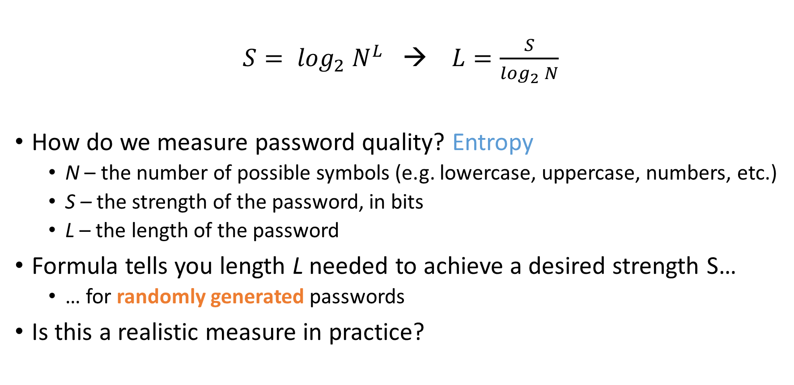
Password Quality
$S= \log_{2} N^{L}$ → $L=\frac{S}{\log_{2} N}$
How do we measure password quality? Entropy
  N – the number of possible symbols (e.g. lowercase, uppercase, numbers, etc.)
  S – the strength of the password, in bits
  L – the length of the password
Formula tells you length L needed to achieve a desired strength S…
  … for randomly generated passwords
Is this a realistic measure in practice?

Slide 31
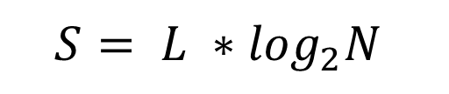
The Strength of Random Passwords
$$S= {L ∗log}_{2}N$$
Very
Strong
Very
Weak

Slide 32
Basic Password Cracking
Problem: humans are terrible at generating/remembering random strings
Passwords are often weak enough to be brute-forced
  Naïve way: systematically try all possible passwords
  Slightly smarter way: take into account non-uniform distribution of characters
Dictionary attacks are also highly effective
  Select a baseline wordlist/dictionary full of likely passwords
    Today, the best wordlists come from lists of breached passwords
  Rule-guided word mangling to look for slight variations
    E.g. password → Password → p4ssword → passw0rd → p4ssw0rd → password1 → etc.
Many password cracking tools exist (e.g. John the Ripper, hashcat)

Slide 33
“Deep Crack”: The EFF DES Cracker
DES uses a 56-bit key
$250K in 1998, capable of brute-forcing DES keys in 56 hours
  Uses 1856 custom ASIC chips
Similar attacks have been demonstrated against MD5, SHA1
Modern equivalent?
  Bitcoin mining ASICs

Slide 34
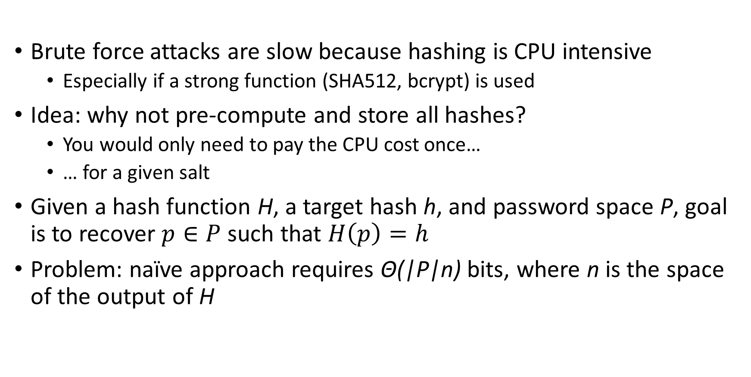
Speeding Up Brute-Force Cracking
Brute force attacks are slow because hashing is CPU intensive
  Especially if a strong function (SHA512, bcrypt) is used
Idea: why not pre-compute and store all hashes?
  You would only need to pay the CPU cost once…
  … for a given salt
Given a hash function H, a target hash h, and password space P, goal is to recover $p∈P$ such that $H\left(p\right)=h$
Problem: naïve approach requires Θ(|P|n) bits, where n is the space of the output of H

Slide 35
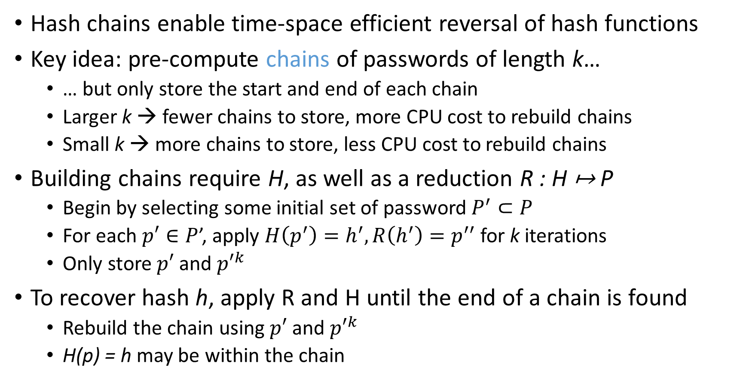
Hash Chains
Hash chains enable time-space efficient reversal of hash functions
Key idea: pre-compute chains of passwords of length k…
  … but only store the start and end of each chain
  Larger k → fewer chains to store, more CPU cost to rebuild chains
  Small k → more chains to store, less CPU cost to rebuild chains
Building chains require H, as well as a reduction R : H ↦ P
  Begin by selecting some initial set of password $P^{′}⊂P$
  For each $p′∈P$’, apply $H\left(p^{′}\right)=h^{′}, R\left(h^{′}\right)=p^{′′}$ for k iterations
  Only store $p′$ and ${p′}^{k}$
To recover hash h, apply R and H until the end of a chain is found
  Rebuild the chain using $p′$ and ${p′}^{k}$
  H(p) = h may be within the chain

Slide 36
Uncompressed Hash Chain Example
p' | H(p’) = h’ | R(h’) = p” | H(p”) = h” | R(h”) = p’’’ | H(p’’’) = h’’’ | R(h’’’) = p*
abcde | \\WPNP_ | vlsfqp | _QOZLR | eusrqv | CMRQ5X | cjldar
passw | VZDGEF | gfnxsk | ZLGEKV | yookol | EBOTHT | zvxscs
12345 | SM-QK\9 | sawtzg | RHKP_D | gvmdwm | BYE4LB | wjizbn
secrt | OKFTaY | btweoz | WA15HK | ttgovl | Q_4\6ZB | eivlqc
K = 3
p | H(p) = h | R(h) = p’ | H(p’) = h’ | R(h’) = p” | H(p”) = h” | R(h”) = p’’’ | H(p’’’) = h’’’
sawtzg | RHKP_D | gvmdwm | BYE4LB | wjizbn | RUZIHK | lsdnif | OGUTJU
Desired password
Hash to recover

Slide 37
Hash Chain Example
Size of the table is dramatically reduced…
… but some computation is necessary once a match is found
p' | p*
abcde | cjldar
passw | zvxscs
12345 | wjizbn
secrt | eivlqc
K = 3
p' | H(p’) = h’ | R(h’) = p” | H(p”) = h” | R(h”) = p’’’ | H(p’’’) = h’’’ | R(h’’’) = p*
12345 | SM-QK\9 | sawtzg | RHKP_D |  |  | wjizbn
p | H(p) = h | R(h) = p’ | H(p’) = h’ | R(h’) = p” | H(p”) = h” | R(h”) = p’’’ | H(p’’’) = h’’’
sawtzg | RHKP_D | gvmdwm | BYE4LB | wjizbn
Desired password
Hash to recover

Slide 38
Problems with Hash Chains
Hash chains are prone to collisions
  Collisions occur when H(p’) = H(p”) or R(h’) = R(h”) (the latter is more likely)
  Causes the chains to merge or overlap
Problems caused by collisions
  Wasted space in the file, since the chains cover the same password space
  False positives: a chain may not include the password even if the end matches
Proper choice of R is critical
  Goal is to cover space likely passwords, not entire password space
  R cannot be collision resistant (like H) since it has to map into likely plaintexts
  Difficult to select R under this criterion

Slide 39
Rainbow Tables
Rainbow tables improve on hash chains by reducing the likelihood of collisions
Key idea: instead of using a single reduction R, use a family of reductions {R₁, R₂, … , R_{k}}
  Usage of H is the same as for hash chains
  A collisions can only occur between two chains if it happens at the same position (e.g. R_{i} in both chains)

Slide 40
Final Thoughts on Rainbow Tables
Caveats
  Tables must be built for each hash function and character set
  Salting and key stretching defeat rainbow tables
Rainbow tables are effective in some cases, e.g. MD5 and NTLM
  Precomputed tables can be bought or downloaded for free

Slide 41
Authentication Protocols
Unix, PAM, and crypt
Network Information Service (NIS, aka Yellow Pages)
Needham-Schroeder and Kerberos

Slide 42
Status Check
At this point, we have discussed:
  How to securely store passwords
  Techniques used by attackers to crack passwords
Next topic: building authentication systems
  Given a user and password, how does the system authenticate the user?
  How can we perform efficient, secure authentication in a distributed system?

Slide 43
Authentication in Unix/Linux
Users authenticate with the system by interacting with login
  Prompts for username and password
  Credentials checked against locally stored credentials
By default, password policies specified in a centralized, modular way
  On Linux, using Pluggable Authentication Modules (PAM)
  Authorizes users, as well as environment, shell, prints MOTD, etc.

Slide 44
Example PAM Configuration
# cat /etc/pam.d/system-auth
#%PAM-1.0
auth required pam_unix.so try_first_pass nullok
auth optional pam_permit.so
auth required pam_env.so
account required pam_unix.so
account optional pam_permit.so
account required pam_time.so
password required pam_unix.so try_first_pass nullok sha512 shadow
password optional pam_permit.so
session required pam_limits.so
session required pam_unix.so
session optional pam_permit.so
Use SHA512 as the hash function
Use /etc/shadow for storage
Notes:
Some password authentication parameters set here (use of shadow file, sha512 as default hash function)

Slide 45
Unix Passwords
Traditional method: crypt
  25 iterations of DES on a zeroed vector
  First eight bytes of password used as key (additional bytes are ignored)
  12-bit salt
Modern version of crypt are more extensible
  Support for additional hash functions like MD5, SHA256, and SHA512
  Key lengthening: defaults to 5000 iterations, up to 10⁸ – 1
  Full password used
  Up to 16 bytes of salt

Slide 46
Password Files
Password hashes used to be in /etc/passwd
  World readable, contained usernames, password hashes, config information
  Many programs read config info from the file…
  But very few (only one?) need the password hashes
Turns out, world-readable hashes are Bad Idea
Hashes now located in /etc/shadow
  Also includes account metadata like expiration
  Only visible to root

Slide 47
Password Storage on Linux
/etc/passwd
username:x:UID:GID:full_name:home_directory:shell
cbw:x:1001:1000:Christo Wilson:/home/cbw/:/bin/bash
amislove:1002:2000:Alan Mislove:/home/amislove/:/bin/sh
$<algo>$<salt>$<hash>
Algo: 1 = MD5, 5 = SHA256, 6 = SHA512
/etc/shadow
username:password:last:may:must:warn:expire:disable:reserved
cbw:$1$0nSd5ewF$0df/3G7iSV49nsbAa/5gSg:9479:0:10000::::
amislove:$1$l3RxU5F1$:8172:0:10000::::

Slide 48
Distributed Authentication
Early on, people recognized the need for authentication in distributed environments
  Example: university lab with many workstations
  Example: file server that accepts remote connections
Synchronizing and managing password files on each machine is not scalable
  Ideally, you want a centralized repository that stores policy and credentials

Slide 49
The Yellow Pages
Network Information Service (NIS), a.k.a. the Yellow Pages
  Developed by Sun to distribute network configurations
  Central directory for users, hostnames, email aliases, etc.
  Exposed through yp* family of command line tools
For instance, depending on /etc/nsswitch.conf, hostname lookups can be resolved by using
  /etc/hosts
  DNS
  NIS
Superseded by NIS+, LDAP,

Slide 50
NIS Password Hashes
Crypt based password hashes
Can easily be cracked
Many networks still rely on insecure NIS
[cbw@workstation ~] ypcat passwd
afbjune:qSAH.evuYFHaM:14532:65104::/home/afbjune:/bin/bash
philowe:T.yUMej3XSNAM:13503:65104::/home/philowe:/bin/bash
bratus:2omkwsYXWiLDo:6312:65117::/home/bratus:/bin/tcsh
adkap:ZfHdSwSz9WhKU:9034:65118::/home/adkap:/bin/zsh
amitpoon:i3LjTqgU9gYSc:8198:65117::/home/amitpoon:/bin/tcsh
kcole:sgYtUsOtyk38k:14192:65104::/home/kcole:/bin/bash
david87:vA06wxjJEUgBE:13055:65101::/home/david87:/bin/bash
loch:6HgIQrVkcBeiw:13729:65104::/home/loch:/bin/bash
ppkk315:s6CTSAkqqr/nU:14061:65101::/home/ppkk315:/bin/bash
haynesma:JYWaQUARSqDQE:14287:65105::/home/haynesma:/bin/bash
ckubicek:jYpwYhqqvr3tA:10937:65117::/home/ckubicek:/bin/tcsh
mwalz:wPIa5Bv/tFVb2:9103:65118::/home/mwalz:/bin/tcsh
sushma:G6XNe18GpeQj.:13682:65104::/home/sushma:/bin/bash
guerin1:n0Da2TmO9MDBI:14512:65105::/home/guerin1:/bin/bash
Notes:
crypt-based password hashes inline
Can easily be run through a cracking program
Pulled from CCIS last year (and also earlier cracking example)

Slide 51
Distributed Authentication Revisited
Goal: a user would like to use some resource on the network
  File server, printer, database, mail server, etc.
Problem: access to resources requires authentication
  Auth Server contains all credential information
  You do not want to replicate the credentials on all services
Auth Server
cbw
Database

Slide 52
Attacker Goals and Threat Model
Goal: steal credentials and gain access to protected resources
Local attacker – may spy on traffic
Active attacker – may send messages
In some cases, may be able to steal information from users
Auth Server
cbw
Database
I wanna access the Database too ;)

Slide 53
(Bad) Distributed Auth Example
Looks good!
Idea: client forwards user/password to service, service queries Auth Server
Problems:
  Passwords being sent in the clear
    Attacker can observe them!
    Clearly we need encryption
  Database learns about passwords
    Additional point of compromise
    Ideally, only the user and the Auth Server should know their password
Auth Server
cbw
Database
cbw:p4ssw0rd
Please verify cbw:p4ssw0rd
cbw:p4ssw0rd

Slide 54
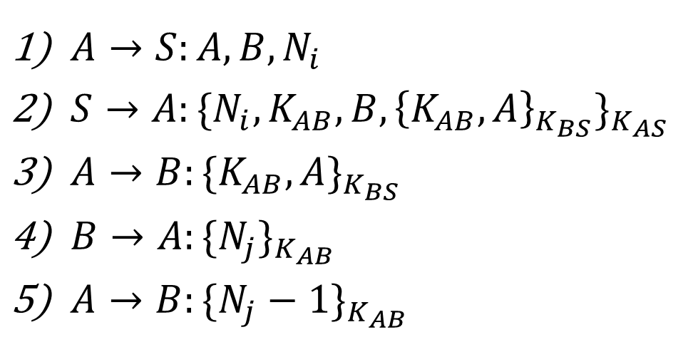
Needham-Schroeder Protocol
Let Alice A and Bob B be two parties that trust server S
K_{AS} and K_{BS} are shared secrets between [A, S] and [B, S]
K_{AB} is a negotiated session key between [A, B]
N_{i} and N_{j} are random nonces generated by A and B
$A→S:A,B,N_{i}$
$S→A:{\{N_{i}, K_{AB}, B, {\left\{K_{AB}, A\right\}}_{K_{BS}}\}}_{K_{AS}}$
$A→B:{\{K_{AB}, A\}}_{K_{BS}}$
$B→A:{\{N_{j}\}}_{K_{AB}}$
$A→B:{\{N_{j}−1\}}_{K_{AB}}$
K_{AS} is not sent in the clear, authenticates S and A
K_{BS} is not sent in the clear, authenticates B
Challenge nonce forces A to acknowledge they have K_{AB}
Notes:
Client sends its ID, ID of service, and nonce
Server sends A's nonce, session key, B's ID, ticket (blob encrypted with shared secret with B), encrypted with (A,S) shared secret
A sends ticket to B
B sends nonce encrypted with session key to A
A sends nonce applied with agreed-upon operation to B

Slide 55

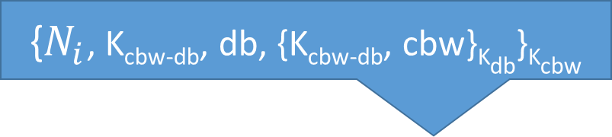
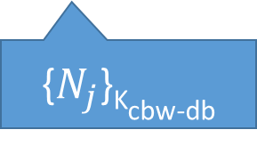

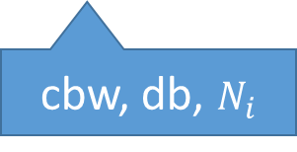
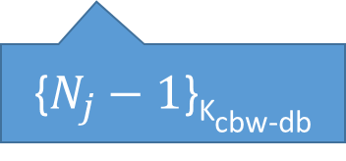
Needham-Schroeder Example
{$N_{i}$, K_{cbw-db}, db, {K_{cbw-db}, cbw}_{Kdb}}_{Kcbw}
$A→S:A,B,N_{i}$
$S→A:{\{N_{i}, K_{AB}, B, {\left\{K_{AB}, A\right\}}_{K_{BS}}\}}_{K_{AS}}$
$A→B:{\{K_{AB}, A\}}_{K_{BS}}$
$B→A:{\{N_{j}\}}_{K_{AB}}$
$A→B:{\{N_{j}−1\}}_{K_{AB}}$
Auth Server
cbw
db
cbw
cbw
Database
cbw-db
db
{$N_{j}−1$}_{Kcbw-db}
cbw, db, $N_{i}$
{K_{cbw-db}, cbw}_{Kdb}
cbw-db
{$N_{j}$}_{Kcbw-db}

Slide 56
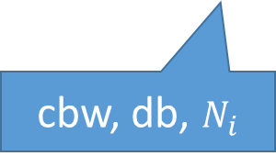


Attacking Needham-Schroeder
{$N_{i}$, K_{cbw-db}, db, {K_{cbw-db}, cbw}_{Kdb}}_{Kcbw}
Spoof the client request
  Fail! Client key is needed to decrypt
Spoof the Auth Server response
  Fail! Need to know the client key
Spoof the client-server interaction
  Fail! Need to know the server key
Replay the client-server interaction
  Fail! Need to know the session key
cbw
Auth Server
cbw
cbw
db
cbw, db, $N_{i}$
Database
db
evil
cbw-db
{$N_{i}$, K_{evil}, db, {K_{evil}, cbw}_{Kdb}}_{Kcbw}
{K_{cbw-db}, cbw}_{Kdb}
{K_{evil}, cbw}_{Kdb}
{$N_{j}$}_{Kcbw-db}
cbw, db, $N_{i}$

Slide 57
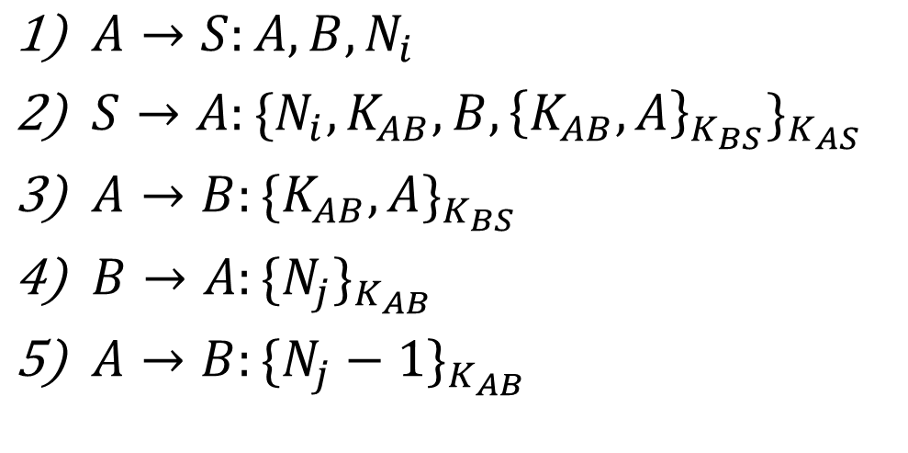
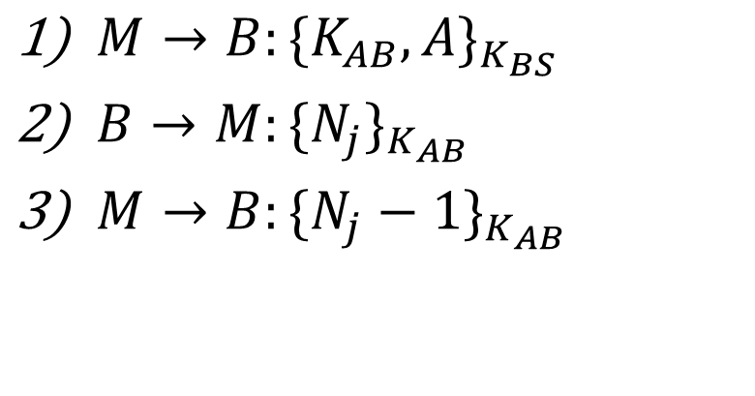
Replay Attack
Correct Protocol
Replay Attack
$A→S:A,B,N_{i}$
$S→A:{\{N_{i}, K_{AB}, B, {\left\{K_{AB}, A\right\}}_{K_{BS}}\}}_{K_{AS}}$
$A→B:{\{K_{AB}, A\}}_{K_{BS}}$
$B→A:{\{N_{j}\}}_{K_{AB}}$
$A→B:{\{N_{j}−1\}}_{K_{AB}}$
$M→B:{\{K_{AB}, A\}}_{K_{BS}}$
$B→M:{\{N_{j}\}}_{K_{AB}}$
$M→B:{\{N_{j}−1\}}_{K_{AB}}$
Attacker must hack A to steal K_{AB}
  So the attacker can also steal K_{AS}
  However, what happens after A changes K_{AS}
  Attacker can still conduct the replay attack! Only is K_{AB} necessary!
Notes:
Client sends its ID, ID of service, and nonce
Server sends A's nonce, session key, B's ID, ticket (blob encrypted with shared secret with B), encrypted with (A,S) shared secret
A sends ticket to B
B sends nonce encrypted with session key to A
A sends nonce applied with agreed-upon operation to B

Slide 58
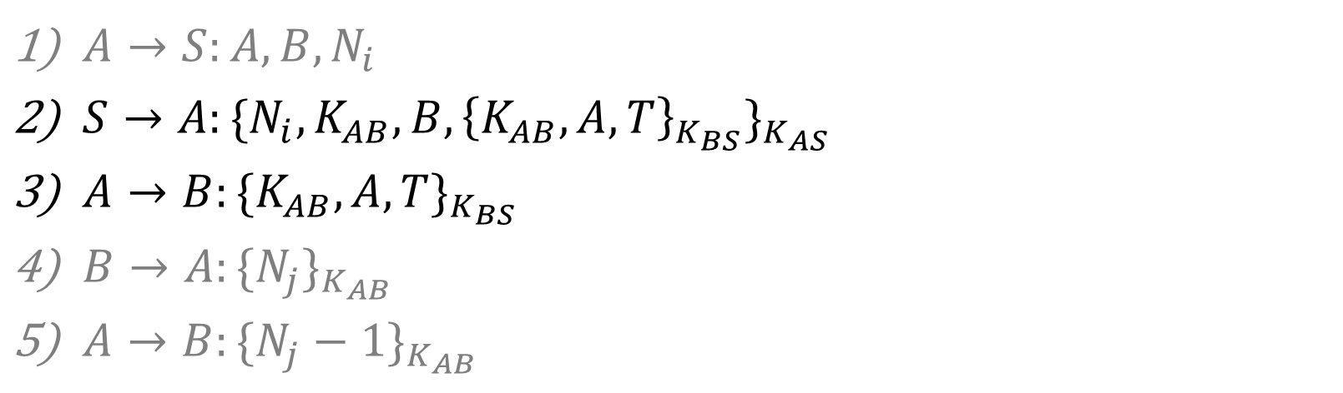
Fixed Needham-Schroeder Protocol
Let Alice A and Bob B be two parties that trust server S
K_{AS} and K_{BS} are shared secrets between [A, S] and [B, S]
K_{AB} is a negotiated session key between [A, B]
N_{i} and N_{j} are random nonces generated by A and B
T is a timestamp chosen by S
$A→S:A,B,N_{i}$
$S→A:{\{N_{i}, K_{AB}, B, {\left\{K_{AB}, A, T\right\}}_{K_{BS}}\}}_{K_{AS}}$
$A→B:{\{K_{AB}, A, T\}}_{K_{BS}}$
$B→A:{\{N_{j}\}}_{K_{AB}}$
$A→B:{\{N_{j}−1\}}_{K_{AB}}$
B only accepts requests with fresh timestamps
Notes:
Client sends its ID, ID of service, and nonce
Server sends A's nonce, session key, B's ID, ticket (blob encrypted with shared secret with B), encrypted with (A,S) shared secret
A sends ticket to B
B sends nonce encrypted with session key to A
A sends nonce applied with agreed-upon operation to B

Slide 59
Kerberos
Created as part of MIT Project Athena
  Based on Needham-Schroeder
Provides mutual authentication over untrusted networks
  Tickets as assertions of authenticity, authorization
  Forms basis of Active Directory authentication
Principals
  Client
  Server
  Key distribution center (KDC)
    Authentication server (AS)
    Ticket granting server (TGS)

Slide 60

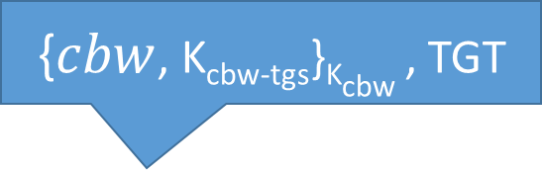
Kerberos Example
{$cbw$, K_{cbw-tgs}}_{Kcbw} , TGT
Auth Server
cbw
tgt
{K_{cbw-db}}_{Kcbw-tgs} , {K_{cbw-db}}_{Kdb}
Ticket Granting
Server
cbw
tgt
TGT
cbw
db
cbw-tgs
TGT, db, {cbw, T}_{Kcbw-tgs}
cbw-db
cbw
Database
{K_{cbw-db}}_{Kdb}, {cbw, T}_{Kcbw-db}
db
{T - 1}_{Kcbw-db}
cbw-db

Slide 61
Attacking Kerberos
Don’t put all your eggs in one basket
  The Kerberos Key Distribution Server (KDS) is a central point of failure
  DoS the KDS and the network ceases to function
  Compromise the KDS leads to network-wide compromise
Time synchronization
  Inaccurate clocks lead to protocol failures (due to timestamps)
  Solution?
  Use NTP ;)

Slide 62
Sources
Many slides courtesy of Wil Robertson: https://wkr.io
Honeywords, Ari Juels and Ron Rivest: http://www.arijuels.com/wp-content/uploads/2013/09/JR13.pdf

